Slide 1
HAWKES LEARNING
Organizational Psychology: The Social Dimension of Work
Introduction to Psychology
Notes:
In organizational psychology, the focus is on the social dimension of work.

Slide 2



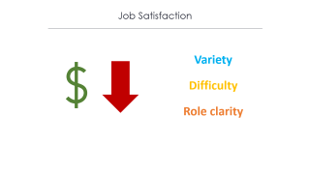

Job Satisfaction
Notes:
One of the primary areas of interest in organizational psychology is job satisfaction, the degree to which someone enjoys his or her job. Job satisfaction can encompass both what we think about our work and what we feel about our work. Organizations often assess these ratings to determine how their employees are feeling.

Slide 3

Job Satisfaction
Variety
Difficulty
Role clarity
Notes:
Research has shown that job satisfaction is related to variety, difficulty level, and role clarity of the job. Pay level is less important than these other factors when it comes to job satisfaction. It probably isn’t surprising that job satisfaction is related to job performance.

Slide 4


Job Stress
Notes:
Another important aspect in organizational psychology is the impact of job stress. Job stress can come in a variety of different forms, one of which is job insecurity. This can result from downsizing in which corporations cut the number of employees as a cost-saving measure. In other cases, companies may merge, and some employees will be redundant and, therefore, let go.

Slide 5

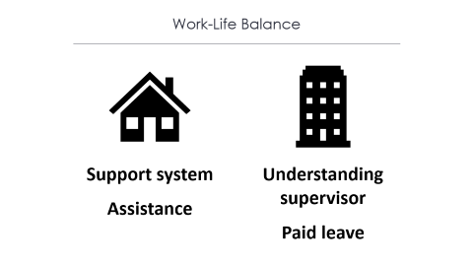
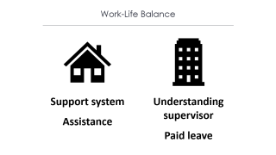
Work-Life Balance
Notes:
Many people juggle the demands of work with the demands of their home lives in an attempt to achieve work-life balance. We have a limited amount of time each day, and these two responsibilities often battle for attention. Women often have greater family demands, which causes increased work-family conflict.

Slide 6
Work-Life Balance
Support system
Understanding supervisor
Assistance
Paid leave
Notes:
Work-family conflict can be decreased by having a support system and having assistance at home. In addition, having understanding supervisors or leave with pay can help. Flextime or telecommuting might be more difficult, as working from home often makes the work-home conflict more evident.

Slide 7
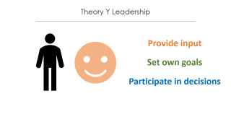
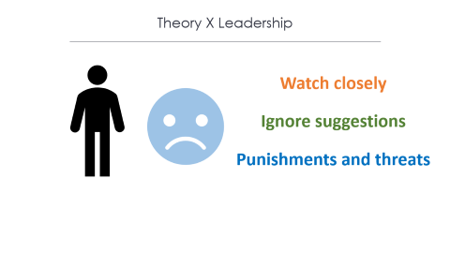
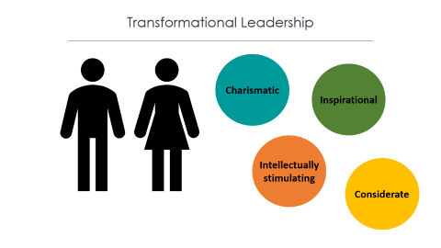

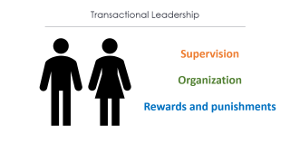



Leadership Styles
Notes:
Organizational psychology also focuses on leadership behavior.

Slide 8


Theory X Leadership
Watch closely
Ignore suggestions
Punishments and threats
Notes:
The Theory X approach to leadership suggests that managers assume that most people dislike work and are not self-directed. These managers will watch employees carefully and ignore employee suggestions. Punishments and threats are used to change behavior.

Slide 9

Theory Y Leadership
Provide input
Set own goals
Participate in decisions
Notes:
In contrast, the Theory Y approach assumes that most people seek inner satisfaction and fulfillment from their work. These leaders allow employees to provide input, set their own goals, and participate in decisions.

Slide 10
Leadership Styles
Notes:
Transactional and transformational leadership have also been studied.

Slide 11

Transactional Leadership
Supervision
Organization
Rewards and punishments
Notes:
A transactional leader is one whose focus is on supervision and organization, using rewards and punishments to change employee behavior.

Slide 12
Transformational Leadership
Charismatic
Inspirational
Intellectually stimulating
Considerate
Notes:
In contrast, a transformational leader has four attributes: charismatic, inspirational, intellectually stimulating, and considerate.

Slide 13





Work Teams
Notes:
Many organizations today are restructuring to have work teams that bring together diverse skills, experience, and expertise. Some teams work better than others. Teams can be inefficient due to poor communication or decision-making skills. They can also be impacted by conflict or conformity.

Slide 14
Work Teams
Problem resolution
Creative
Tactical
Virtual
Notes:
There are different types of teams. A problem resolution team is charged with tackling a particular issue. A creative team is used to develop innovative possibilities or solutions. A tactical team is used to execute a well-defined plan or objective. Finally, a team can be virtual, brought together across geographic areas by means of technology.

Slide 15
Organizational Culture
Observable artifacts
Espoused values
Notes:
Organizational culture, the values, visions, and norms of the company, is also important. Culture is made up of observable artifacts, which refer to the symbols, language, narratives, and practices. Espoused values are concepts that management enforces.

Slide 16


Harassment
Notes:
Organizational culture can include a culture of harassment. In preventative efforts, corporations have sexual harassment policies that specify procedures to protect employees. Sexual harassment, in general, has been defined as any unwanted sexual attention and is not just limited to offers of sexual favors, threats, or the creation of a hostile environment.

Slide 17

Violence
Notes:
Violence in the workplace is also a concern. Murder is actually the second leading cause of death in the workplace and is the primary cause of death for women in the workplace. Many corporations have policies in place to protect against workplace violence.

Slide 18




HAWKES LEARNING

