Slide 1
HAWKES LEARNING
What Is Stress?
Introduction to Psychology
Notes:
In this section, we will consider the question of what, exactly, is stress?

Slide 2



What Is Stress?
Situation
Notes:
Stress has been somewhat difficult to define. Some say it is a demanding or threatening situation. Others have defined it in terms of the physiological responses that occur in these situations. Taken together, stress is typically characterized as the process by which a person perceives and responds to events that the person appraises as threatening or overwhelming.

Slide 3





Appraisals
Primary Appraisal
Secondary Appraisal
Threat
Cannot handle
Can handle
Challenge
Notes:
There are two different types of appraisals—primary and secondary.

Slide 4
Primary Appraisal
Threat
Challenge
Notes:
A primary appraisal involves judgement about the degree of potential harm or threat to wellbeing that a stressor may entail. A threat assessment might result if there is harm or loss anticipated. In contrast, a challenge appraisal may result if the person believes the task will benefit him or her.

Slide 5
Secondary Appraisal
Cannot handle
Can handle
Notes:
A secondary appraisal is the judgement of options available to cope with the stressor. The degree to which a person feels he or she can handle a situation can attenuate the stress that is felt.

Slide 6


Good Stress
Notes:
Stress doesn’t always have a negative connotation as it often motivates us to do things in our best interests. Eustress, this good stress, is associated with positive feelings, optimal health, and performance.

Slide 7
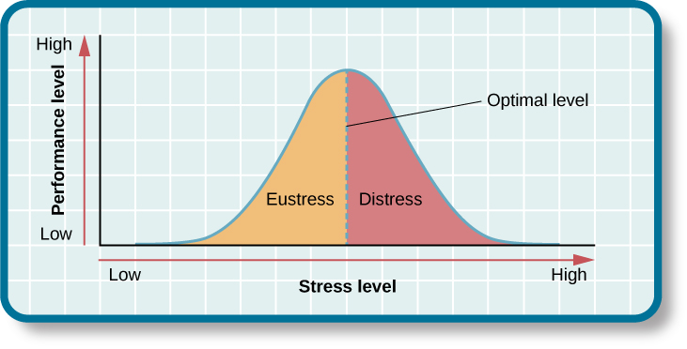
Stress
Notes:
As stress increases, performance and general well being also increases. However, once stress passes that optimal level, performance begins to suffer. Therefore, there is an ideal amount of stress that allows us to perform at our best.

Slide 8





Physiological Responses
Notes:
Stress causes a variety of responses. Physiologically, we might have accelerated heart rate, headaches, or GI issues. Cognitively, we might have difficulty concentrating or making decisions. Finally, we may alter our behavior to cope, such as drinking alcohol or smoking.

Slide 9
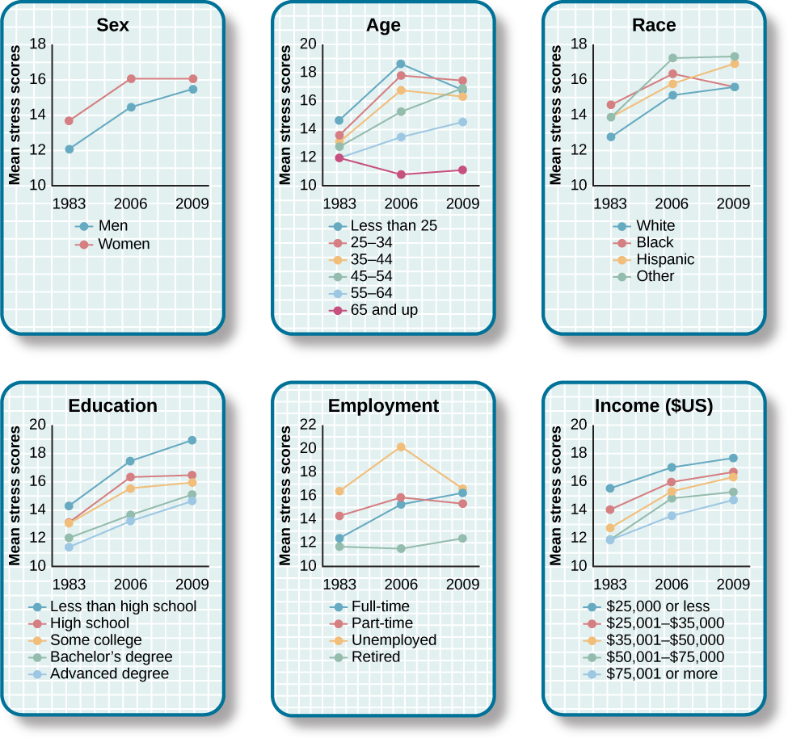
Stress Impacts
Notes:
Individuals are impacted differentially by stress. Surveys over the past several decades have shown that women experience more stress than men. Similarly impacted are the unemployed and those with less education. Interestingly, there was a sharp increase in reported stress between 2006 to 2009 for men, Whites, people aged 45 to 64, college graduates, and those with full time jobs.

Slide 10

Walter Cannon
Fight or Flight
Notes:
Historically, Walter Cannon was one of the first to identify the physiological response to stress. He specifically proposed the existence of the fight or flight response—the body’s response when in a threatening situation. When threatened, say by an angry dog, the body prepares to fight or run, making sure there is enough energy available to survive.

Slide 11


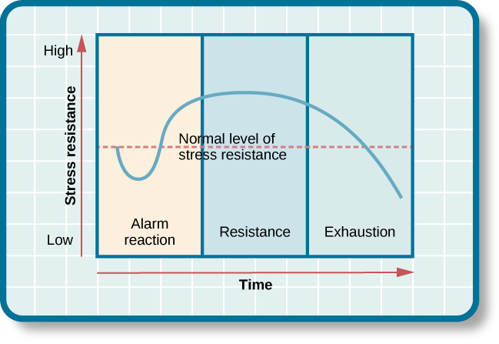
Hans Selye
Notes:
Additional research was conducted by Hans Selye who exposed rats to extreme cold and documented their ability to survive or not. He found that the animals experienced a variety of physiological responses that he identified as the general adaptation syndrome in which animals first have an alarm reaction to the situation, then resist as long as they can, before they finally experience exhaustion.

Slide 12

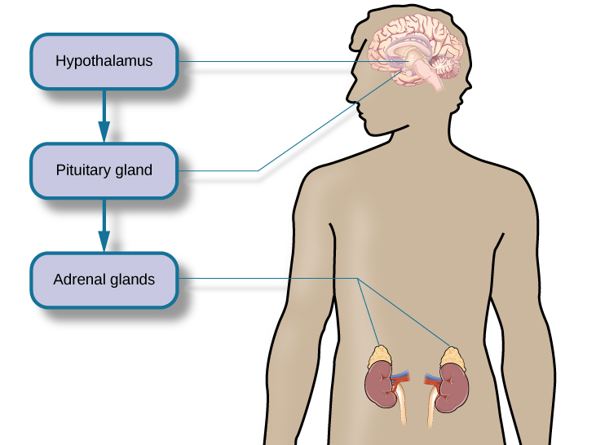
Physiological Basis
Sympathetic nervous system
Hypothalamic pituitary axis
Physiological Basis
Energy
Hormones
Immune system
Decrease pain sensitivity
Notes:
The physiological basis of stress involves the sympathetic nervous system and the hypothalamic pituitary adrenal axis. The sympathetic nervous system triggers arousal to a stressor, which then triggers the HPA axis to release hormones to aid in the situation. Specifically, the system results in the release of cortisol from the adrenal glands.

Slide 13
Physiological Basis
Energy
Immune system
Decrease pain sensitivity
Notes:
This process can provide extra energy, improve immune system functioning, and decrease pain sensitivity. Extended release of cortisol, however, can weaken our immune systems. In short, our response to stress is designed to be an acute, rather than chronic, response.

Slide 14




HAWKES LEARNING

