Slide 1
HAWKES LEARNING
Stress and Illness
Introduction to Psychology
Notes:
In this section, we will consider the relationship between stress and illness. Given that our stress responses are supposed to be for acute situations, our tendency to experience more prolonged stress ultimately impacts our health.

Slide 2
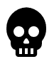



Psychophysiological Disorders
Notes:
Physical disorders or diseases whose symptoms are brought about or worsened by stress are called psychophysiological disorders. These disorders can include cardiovascular, gastrointestinal, respiratory, musculoskeletal, and skin disorders.

Slide 3
HAWKES LEARNING
Stress and Illness
Introduction to Psychology
Notes:
Studies have shown that there are disease-prone personality characteristics. In fact, depression is a risk factor for all major disease-related causes of death. Neuroticism—or how anxious and moody a person is—has been linked with chronic health problems and mortality.

Slide 4


Immune System
Healthy
Immune System
Immune System
Joints
Thyroid gland
Notes:
To better understand the relationship between stress and illness, we must better understand the immune system. The immune system exists to help protect the body from toxins and microorganisms that can harm or damage the body. When working as it should, the immune system keeps us healthy.

Slide 5
Immune System
Joints
Thyroid gland
Notes:
Sometimes, our immune system does not function properly, and instead of attaching foreign invaders, it attacks ourselves. In this case, the person has an autoimmune disease. Rheumatoid arthritis is one example—here, the immune system attacks the joints. In Grave’s disease, the thyroid is affected.

Slide 6
Immune System
Notes:
In other cases, the immune system may break down and be unable to protect us. In immunosuppression, the decreased effectiveness of the immune system can make us susceptible to a host of illnesses.

Slide 7





Psychoimmunology
Drug
Immunosuppression
HPA Axis
Research
Cardiovascular Problems
Stress Hormones
Hypertension
Lymphocytes
High stress
Low stress
Heart attack
Stroke
Caught cold!
Kidney failure
Notes:
Psychoneuroimmunology is the field that studies how psychological factors can influence the immune system. One of the first studies that demonstrated a relationship between stress and the immune system was a demonstration that the immune system could be classically conditioned. Specifically, pairing flavored water with an immunosuppressive drug resulted in later immunosuppression to the flavored water alone!

Slide 8
HPA Axis
Stress Hormones
Lymphocytes
Notes:
When we experience a stressful event, the HPA axis produces stress hormones, which can negatively impact the immune system by inhibiting the production of lymphocytes, which are the white blood cells that are important to the immune response.

Slide 9
Research
High stress
Low stress
Caught cold!
Notes:
In one telling study, a host of healthy volunteers were given drops containing the cold virus. Individuals who had reported higher stress levels for more than one month were considerably more likely to catch the cold. Other studies have demonstrated that stress slows down healing.

Slide 10
Cardiovascular Problems
Hypertension
Heart attack
Stroke
Kidney failure
Notes:
Stress can impact the development of cardiovascular disorders, such as heart disease, which includes symptoms of chest pain. A major risk for heart disease is hypertension or high blood pressure. Hypertension can ultimately lead to heart attack, stroke, kidney failure, and more. Exposure to job strain, natural disasters, marital conflict, and more can all contribute.

Slide 11





Personality
Type A
Type B
Notes:
Interestingly, personality may have a mediating influence in stress and heart disease relationship. Researchers have identified two types of personalities—Type A and Type B.

Slide 12
Type A
Notes:
Type A personalities are intense, driven, and rushed. They are deadline oriented and often get frustrated and angry. These individuals are more likely to suffer from heart attacks.

Slide 13
Type B
Notes:
In contrast, laid back and relaxed types were Type B personalities. It turns out that Type A personalities are 7 times more likely to experience heart disease than Type Bs! For Type A personalities, their anger appears to be the biggest risk factor.

Slide 14
Emotional States
Anger
Disgust
Contempt
Fear
Guilt
Nervousness
Notes:
Other emotional states have been linked to heart disease, such as negative affectivity or the tendency to experience distressed emotional states comprised of anger, contempt, disgust, guilt, fear, and nervousness.

Slide 15





Depression
Notes:
There also appears to be a relationship between depression and heart disease. In fact, the more severe the depression, the greater the risk of heart disease. One issue may be that depression often leads to unhealthy coping mechanisms, such as unhealthy eating habits, smoking, drinking, or a sedentary lifestyle. All of these factors may complicate the issue, leading more directly to heart disease.

Slide 16
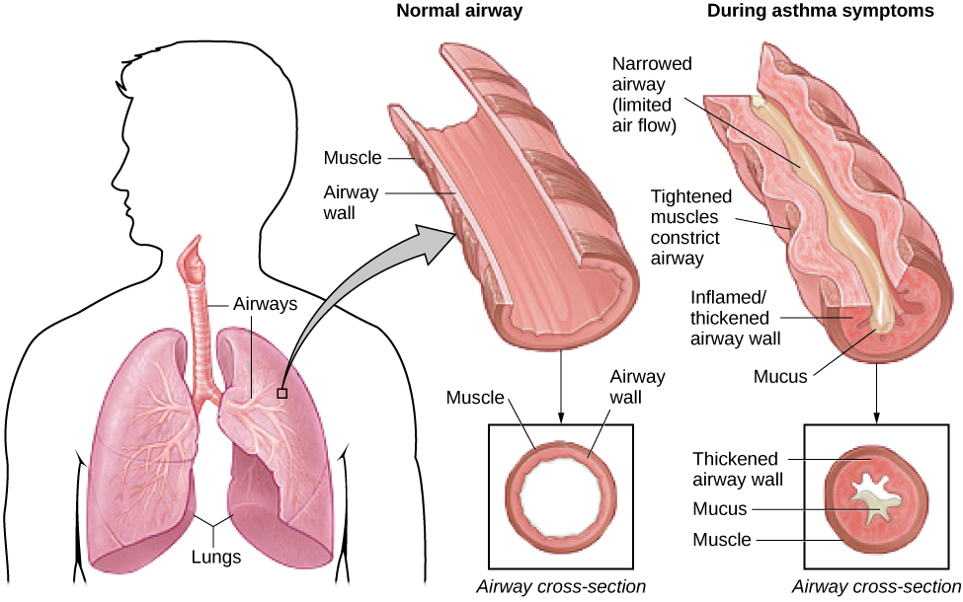
Asthma
Notes:
Asthma is a chronic disease in which the airways of the respiratory system become obstructed, leading to difficulty breathing. For some people with asthma, psychological factors may serve as triggers for an asthma attack. In fact, negative emotions and asthma attacks have been linked in several studies.

Slide 17

Tension Headaches
Sleep deprivation
Skipping meals
Eye strain
Overexertion
STRESS
Notes:
Our final topic is tension headaches, which are triggered by tightening of facial and neck muscles. A number of factors contribute to these sorts of headaches including sleep deprivation, skipping meals, eye strain, overexertion, and—you guessed it—stress.

Slide 18




HAWKES LEARNING
Notes:
Taken together, it becomes clear that stress can negatively impact our health.

