Slide 1
HAWKES LEARNING
Regulation of Stress
Introduction to Psychology
Notes:
Given the tremendous impact of stress in our lives, it is important that we learn to regulation its influences.

Slide 2






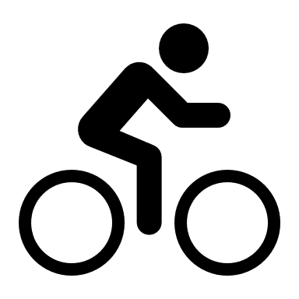


Coping Strategies
Problem-Focused Coping
Emotion-Focused Coping
Problem
Emotions
Notes:
Coping refers to mental and behavioral efforts that we used to handle stressful problems. There are a variety of coping styles.

Slide 3

Problem-Focused Coping
Problem
Notes:
In problem-focused coping, the individual attempts to manage or alter the problem. For example, poor performance in a grade might result in seeking out a tutor or talking to the professor in a problem-centered coping strategy. This strategy is more likely to occur if the situation is perceived as within our control.

Slide 4
Emotion-Focused Coping
Emotions
Notes:
In emotion-focused coping, the person attempts to change the emotions associated with the stressor. Here, someone might “take their mind off” the stress of the bad grade. This strategy is more likely to occur if we perceive the situation as outside of our control.

Slide 5

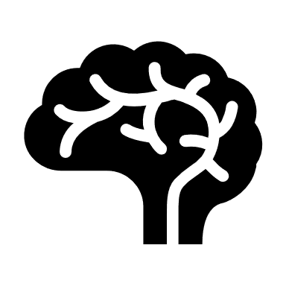
Perceived Control
Perception of Control
Notes:
Perceived control is our belief that we can shape outcomes. Research has shown that the perception of control results in better physical and mental health and greater psychological well-being. These individuals believe their health is in their control, so they often engage in healthy behaviors.

Slide 6



Social Support
Advice
Guidance
Acceptance
Emotional Comfort
Notes:
Social support is also an important mediator of stress. Social support can consist of advice, guidance, acceptance, and emotional comfort. Research suggests that individuals who are better socially connected have a 50% greater likelihood of survival compared to those without. In fact, a person with higher social support is statistically less likely to catch a cold.

Slide 7

Social Support
Immune system functioning
Blood pressure
Healthy behaviors
Notes:
Social support increases immune system functioning. It has also been shown to reduce blood pressure for those performing stressful tasks. Social support may also lead to better health behaviors, such as health diet and exercise.

Slide 8
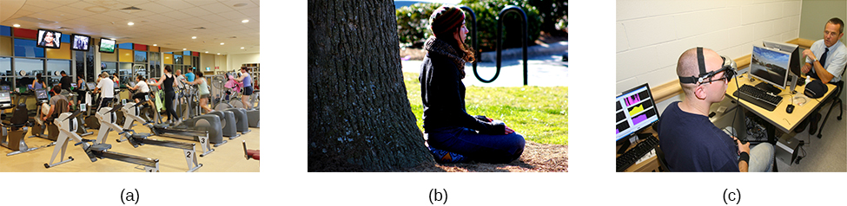
Other Methods
Exercise
Relaxation Response Technique
Biofeedback
Stress
Memory impacts
Anxiety/Depression
Notes:
There are other ways that we can manage our stress levels.

Slide 9
Exercise
Stress
Memory impacts
Anxiety/Depression
Notes:
For example, exercise is one well known way to reduce stress. Individuals in better physical health are more resistant to stress and the adverse effects of stress. Exercise itself can minimize the negative effects of stress on the hippocampus and memory. Exercise has been shown to reduce anxiety and depression.

Slide 10
Relaxation Response Technique
Notes:
Another technique—the relaxation response technique—involves sitting upright in a comfortable position in a quiet environment, repeating a word or phrase, and passively allowing the mind to focus on pleasant thoughts. This method helps to reduce sympathetic arousal and can be used to treat high blood pressure.

Slide 11
Biofeedback
Notes:
Biofeedback is another method in which individuals use equipment to measure neuromuscular and autonomic activity, and feedback is provided to the person. The goal is for the person to learn to control his or her physiological responses. It has been applied successfully with those suffering from tension headaches, high blood pressure, and phobias.

Slide 12




HAWKES LEARNING

