Slide 1
HAWKES LEARNING
The Pursuit of Happiness
Introduction to Psychology
Notes:
Psychology is also interested in the pursuit of happiness.

Slide 2
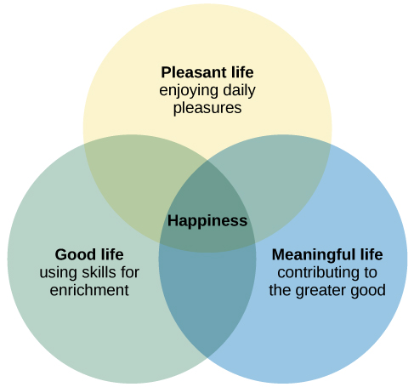
What Is Happiness?
Notes:
What is happiness? In general, it is an ambiguous term with many different definitions depending on the person. It may be easier to think of happiness in terms of the elements of which it is comprised. A pleasant life means that day-to-day pleasures that add fun, joy, and excitement occur. A good life is achieved through identifying our skills and abilities and using those to enrich our lives. Finally, a meaningful life involves a deep sense of fulfillment that comes from using our talents for the greater good.

Slide 3





Happiness Levels
Notes:
How happy are people? The average person tends to be relatively happy. In recent years, the happiness levels of minorities, recent college graduates, and individuals who are disabled have declined. Challenging economic conditions may certainly play a role here.

Slide 4




Factors that Affect Happiness
Age
Notes:
What are factors that affect happiness? Research suggests that there are quite a few factors that can contribute to happiness, such as age and older individuals being happier. Married people also tend to be happier than those who are not married.

Slide 5





Factors that Affect Happiness
$75,000
Notes:
Can money buy happiness? Research suggests that wealth correlates with happiness but only to a point. Specifically, well-being rises with income until about $75,000 and then levels out. The truly wealthy may be unable to enjoy the simple pleasures of life, making them, ultimately, less happy than the less well off.

Slide 6




Happy People
JOB
Notes:
Happy people are more likely to graduate from college, obtain satisfying jobs, and succeed in those jobs. Intelligence does not appear to be related to happiness. Contrary to popular belief, parenthood often results in lower reported happiness. Additionally, attractive people aren’t necessarily happier than those who are not.

Slide 7


Life Events
Notes:
Life events can bring happiness or misery, but the intensity of the feeling is usually short-lived. Newlywed bliss wears off, the elation of winning the lottery wears off. On the flip side, grief eventually subsides, and loss is bettered handled. Some events are more impactful, such as unemployment or disability.

Slide 8
Positive Psychology
Forgiveness
Altruism
Science of
Creativity
Empathy
Compassion
Positive Emotions
Notes:
Positive psychology focuses on understanding how to build human strength and well-being. It is the science of happiness. Some of the topics studied in this area include altruism, empathy, creativity, forgiveness, compassion, positive emotions, and more.

Slide 9




Effects of Happiness
Notes:
Having a positive affect, such as happiness, joy, enthusiasm, and excitement, has been associated with greater social connectedness, emotional and practical support, adaptive coping efforts, lower depression, and longevity and favorable physiological functioning. It can also be protective against heart disease. Optimism, the tendency to look on the bright side, is also a significant predictor of positive health outcomes.

Slide 10





Flow
Notes:
A final topic for this lesson is the idea of flow, which is a particular experience that is so engaging and engrossing that it becomes worth doing for its own sake. Having something in your life that triggers this feeling helps to foster a deep sense of well-being.

Slide 11




HAWKES LEARNING

