Slide 1
HAWKES LEARNING
What Are Psychological Disorders?
Introduction to Psychology
Notes:
What, exactly, are psychological disorders?

Slide 2
Psychological Disorders
Abnormal thoughts
Abnormal feelings
Abnormal behaviors
Notes:
A psychological disorder is a condition characterized by abnormal thoughts, feelings, or behaviors. Psychopathology is the field that studies these disorders in terms of their symptoms, causes (or etiology), and treatments.

Slide 3


Psychological Disorders
NORMAL
ABNORMAL
Notes:
It is important to be able to draw a distinction between normal and abnormal behaviors. Being depressed over a loss in your family would be normal. Being depressed 2 years after the loss, however, would be atypical. However, a phenomenon being atypical is not enough for a diagnosis.

Slide 4



Cultural Expectations
Notes:
Another factor to consider is whether or not the behavior is in line with cultural expectations. For example, it is customary in the United States to engage in friendly exchange with strangers. For someone who does not engage in this behavior, it could be a sign of a disorder. However, someone from another culture may not have this expectation.

Slide 5





Harm
Isolation
Activities
Notes:
Another factor is the degree to which the dysfunction is harmful. In many cases, this might be the best definition. In the previous example of a two-year long depression over a death in the family, this experience would likely be harmful because depression is often accompanied by a tendency to isolate and stop engaging in pleasurable activities. The impacts of these behaviors would certainly be harmful.

Slide 6
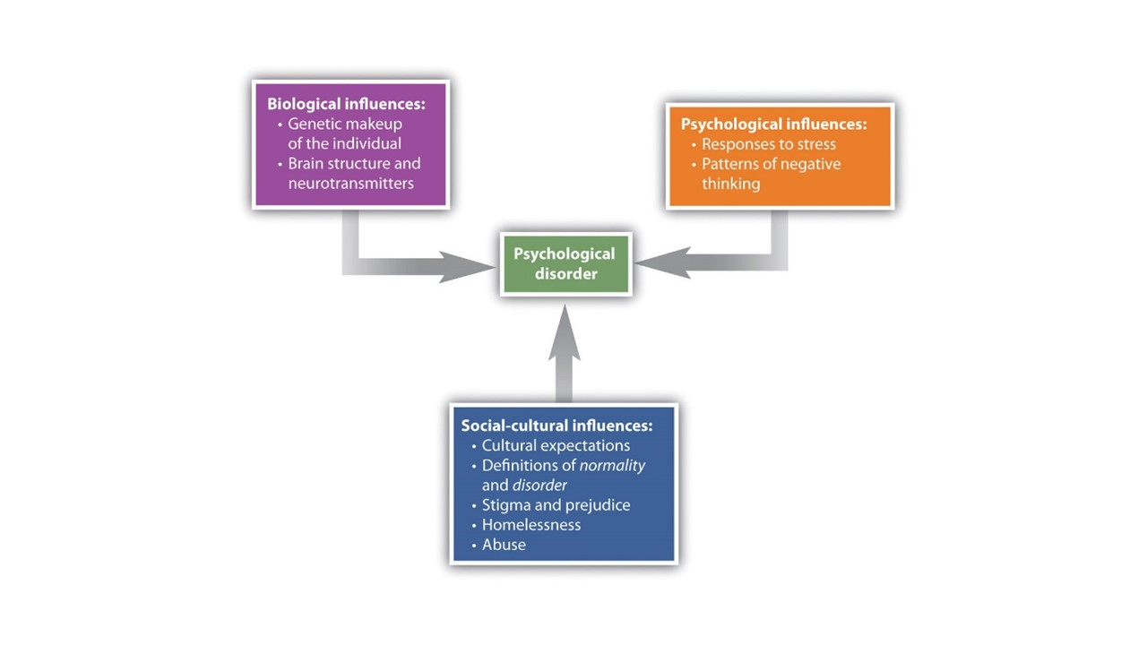
Diagnosis
Notes:
In order to help clinician’s determine diagnoses, the American Psychological Association has developed formal definitions of each disorder. In general, a psychological disorder consists of significant disturbances in thoughts, feelings, and behaviors that reflect biological, psychological, or developmental dysfunction that lead to stress or disability in one’s life. And, finally, these disturbances are not culturally expected.

Slide 7




HAWKES LEARNING
Notes:
In summary, we all feel depressed or anxious from time to time, but it does not qualify for a disorder unless it is harmful to us or others, impacting our own lives or the lives around us.

