Slide 1
HAWKES LEARNING
Disorders in Childhood
Introduction to Psychology
Notes:
In some cases, disorders are diagnosed in childhood. These conditions are neurodevelopmental disorders in the DSM-5.

Slide 2

Attention Deficit-Hyperactivity Disorder
Inattention
Hyperactivity
Notes:
One disorder of childhood that many are likely familiar with is Attention Deficit-Hyperactivity Disorder. A child with this disorder shows a pattern of inattention or hyperactive and impulsive behavior that interferes with normal functioning.

Slide 3
Symptoms
Inattention
vs.
Hyperactivity
Notes:
Inattention can include difficulty with attention, failure to follow instructions, disorganization, lack of attention to detail, becoming easily distracted, and forgetfulness. Hyperactivity can include excessive movement, blurting out responses, difficulty waiting, interrupting others, and being hasty.

Slide 4

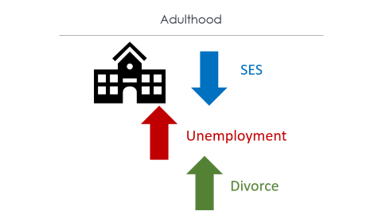

Prevalence
Notes:
ADHD occurs in approximately 5% of the population with boys more likely affected. These children usually have issues with lower grades and standardized scores, rejection from peers, and disciplinary issues at school.

Slide 5
Adulthood
SES
Unemployment
Divorce
Notes:
Research suggests that ADHD may not resolve by adulthood. In addition, ADHD has a lot of long-term impacts, such as worse educational attainment, lower SES, higher likelihood of unemployment, and higher likelihood to be divorced.

Slide 6
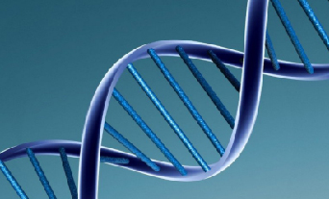
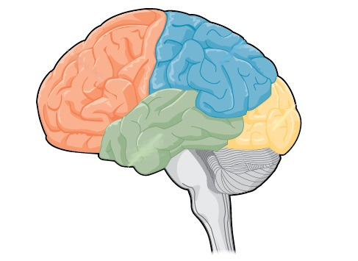
Causes
Dopamine
Notes:
Genetics appears to play a major role in development of ADHD. Dopamine, specifically reduced levels or activity, appear to be related to the symptomology of ADHD. In fact, the common medications for ADHD elevate dopamine activity. Children with ADHD also have smaller frontal lobes, which may explain the hyperactive and uncontrolled behavior these individuals display.

Slide 7


Autism Spectrum Disorder
Social interactions
Repetitive patterns
Communication
Notes:
Another developmental disorder is autism spectrum disorder. Individuals with autism have difficulties with social interactions and communication and engage in repetitive patterns of behavior or interests. For instance, a person might rip paper into strips repeatedly.

Slide 8

Prevalence
DSM
Awareness
Notes:
The prevalence of autism is about 1 in 88 children with boys being diagnosed more often. There was an increase in diagnosis in the 1980s, largely stemming from changes to the DSM criteria and a better awareness of the symptoms of autism.

Slide 9
Causes
Pollutants
Genetic mutations
Notes:
Causes of autism have been controversial over the years, initially pointing to bad parenting. What we now know is that genetics are certainly a factor. Exposure to pollutants and other possible genetic mutations are likely contributing environmental factors.

Slide 10
Causes
NOT VACCINES
Notes:
What does not cause autism, however, is vaccinations. Although erroneously published back in the 1980s, the research that demonstrated this link has been repeatedly refuted. Although false, the belief persists due to cognitive bias errors, such as confirmation bias.

Slide 11




HAWKES LEARNING

