Slide 1
HAWKES LEARNING
Perspectives on Psychological Disorders
Introduction to Psychology
Notes:
There are different perspectives on psychological disorders.

Slide 2


Perspectives
Study
Treat
Notes:
Perspectives can influence how individuals study a disorder and how they treat it. Therefore, it is important to understand the perspectives to best realize how they may influence the view of different disorders.

Slide 3
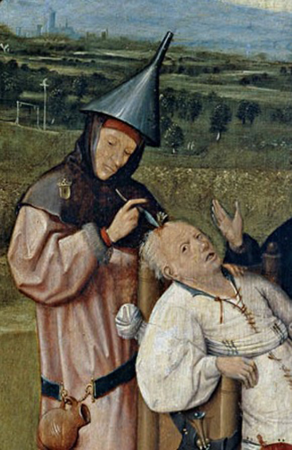
Early Beginnings
Notes:
In the beginning, psychological disorders were often attributed to supernatural forces. In fact, abnormal behavior was often blamed on demonic forces. Some societies, even today, still hold some of these beliefs.

Slide 4
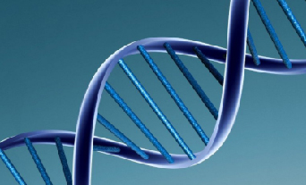
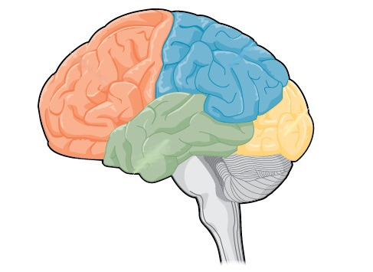
Biological Perspective
Chemical imbalances
Notes:
The biological perspective views psychological disorders as linked to biological phenomena, such as genetics, chemical imbalances, and brain abnormalities. Most psychological disorders have a genetic component. As a result, many researchers are attempting to locate the specific genes that lead to the development of these disorders.

Slide 5


Diathesis-Stress Model
Notes:
A final perspective is the diathesis-stress model that emphasizes the importance of learning, stress, and faulty and self-defeating thoughts and stresses the relationship between this psychological component and the biological component. In this case, someone may have a biological predisposition to a disorder, and the environmental or psychological impact can push the person to develop it.

Slide 6




HAWKES LEARNING

