Slide 1
HAWKES LEARNING
Anxiety Disorders
Introduction to Psychology
Notes:
Everyone experiences anxiety sometimes, but that is different from anxiety disorders.

Slide 2


Fear and Anxiety
Fear
Anxiety
Notes:
Fear is different from anxiety. Fear is in response to an immediate threat, a real occurrence, such as a dog about to attack. Anxiety, however, is apprehension about a potential threat, such as being late to an appointment, that may not actually occur. In general, anxiety is important. It motivates us to take actions and avoid possible problems. However, it can become maladaptive.

Slide 3



Anxiety Disorders
25 to 30%
>
Notes:
It is when anxiety is excessive, persistent, and out of proportion to the actual threat that it becomes a problem. Anxiety disorders are characterized by excessive and persistent fear or anxiety. Approximately 25 to 30 percent of the U.S. population meets the criteria for an anxiety disorder in their lifetime. They are also more likely to occur in women than men.

Slide 4
HAWKES LEARNING
Anxiety Disorders
Introduction to Psychology
Notes:
There are different types of anxiety disorders.

Slide 5





Specific Phobia
Notes:
A specific phobia is when a person experiences excessive, distressing, and persistent fear or anxiety about a specific object or situation. People realize their fear is irrational, but they are unable to stop. How impactful the phobia is on a person’s life depends on the type of phobia. A phobia of being buried alive may not impact a person’s day-to-day life much, whereas a person with a cat phobia might be more impacted.

Slide 6


Specific Phobias
12.5%
Notes:
Phobias are relatively common with approximately 12.5% of the population meeting the criteria in their lifetimes. Agoraphobia is a separate disorder in the DSM-5. In this one, people fear situations in which escape might be difficult if one experiences a panic attack. As a result, many of these individuals stay home as much as possible.

Slide 7



Specific Phobias
Notes:
Many theories suggest that phobias develop through learning. Classical conditioning can result in a phobia. For example, a child who has been bitten by a dog (US) can come to fear dogs in general (CS) due to the previously experienced pain.

Slide 8



Specific Phobias
Notes:
Vicarious learning is another means of learning a phobia. Here, if others around us demonstrate a phobia, we may internalize that phobia as well. If someone reacts as if a bug is the scariest creature in the world, a child may adopt that same fear. Verbal transmission can also pass along phobias. If people constantly tell you how horrible and disgusting subways are, you may develop a fear about them.

Slide 9






Social Anxiety Disorders
Notes:
Social anxiety disorder is characterized by extreme and persistent fear of social situations in which a person could be evaluated negatively by others. The core of this issue is the person’s fear that he or she will act in an embarrassing way in front of others. These individuals usually engage in safety behaviors such as avoiding eye contact or minimizing interactions that may make the situation worse.

Slide 10


Social Anxiety Disorders
Notes:
Some individuals with social anxiety disorder self-medicate with alcohol. In fact, several studies have demonstrated comorbidity between substance use disorder and social anxiety disorder.

Slide 11

Social Anxiety Disorders
Notes:
Risk factors for developing social anxiety disorder include being teased as a child. Behavioral inhibition, which is a tendency to show fear and restraint when presented with unfamiliar people or situations, may also contribute.

Slide 12
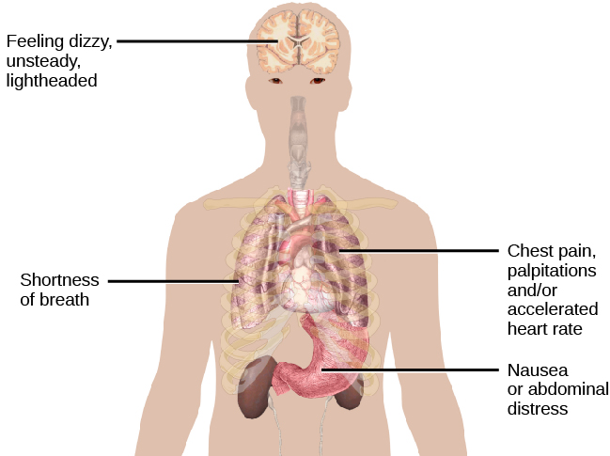
Panic Disorder
Notes:
In panic disorder, people experience recurrent and unexpected panic attacks and concern over having additional ones. A panic attack is defined as a period of extreme fear or discomfort that develops abruptly and reaches a peak within 10 minutes. Symptoms include accelerated heart rate, sweating, trembling, fears of losing control, and fears of dying.

Slide 13
Panic Attacks
Locus coeruleus
Norepineprhine
Fight or Flight
Notes:
The cause of panic disorder isn’t clear. There appears to be a genetic component, but the exact gene or genes is not known. One brain area, the locus coeruleus, may play a role. This area releases norepinephrine, which can trigger the body’s fight-or-flight response. Perhaps this area of the brain is overactive.

Slide 14
Panic Attacks
Fear and anxiety
Physical symptoms
Panic attack
Notes:
Cognitive factors may play a role in panic disorder. These individuals may interpret bodily reactions catastrophically. These interpretations increase fear and anxiety, triggering additional physical symptoms, ultimately resulting in the experience of a panic attack.

Slide 15


Generalized Anxiety Disorder
Negative emotions
Notes:
A final anxiety disorder is generalized anxiety disorder in which individuals worry consistently. These people often worry about everyday things even though their concerns are unjustified. There does appear to be a genetic component in generalized anxiety. Cognitively, generalized anxiety may represent a mental strategy to avoid negative emotions.

Slide 16




HAWKES LEARNING

