Slide 1
HAWKES LEARNING
Obsessive-Compulsive and Related Disorders
Introduction to Psychology
Notes:
In this section, we will discuss obsessive-compulsive and related disorders.

Slide 2



Obsessive-Compulsive Disorder
Thoughts
Behaviors
Notes:
People with obsessive-compulsive disorder, or OCD, experience thoughts and urges that are intrusive and unwanted and the need to engage in repetitive behaviors or mental acts. Obsessions are the thoughts that plague the individual, such as dirt and germs being everywhere. The compulsions are the actions, such as constantly washing or cleaning.

Slide 3

Body Dysmorphic Disorder
Mirror
Hide
Surgery
Notes:
Body dysmorphic disorder is a related disorder in which individuals are preoccupied with a perceived flaw in his or her physical appearance that is either nonexistent or barely noticeable to others. The preoccupation drives the person to engage in repetitive behaviors, such as checking the mirror, hiding that body part, or engaging in cosmetic surgery.

Slide 4

Hoarding
Notes:
Hoarding disorder is when people cannot bear to part with personal belongings, regardless of whether or not they truly lack value. As a result, these individuals accumulate excessive amounts of clutter. These individuals either believe the item will have some use later or they are sentimental about the item.

Slide 5



Genetics
Notes:
OCD has a moderate genetic component. It is more likely to occur when a person has a relative with OCD. Concordance rates between twins also indicates a high degree of genetic contribution, with identical twins having a 57% concordance rate.

Slide 6
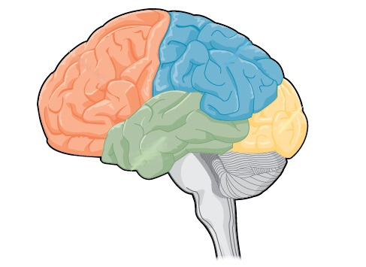
Orbitofrontal Cortex
Notes:
One brain region that might contribute to OCD is the orbitofrontal cortex, an area of the frontal lobe involved in learning and decision-making. Here, the orbitofrontal cortex becomes overactive. This brain region is part of the so-called OCD circuit, which results in the obsessions and compulsions.

Slide 7




HAWKES LEARNING

