Slide 1
HAWKES LEARNING
Mood Disorders
Introduction to Psychology
Notes:
In this section, we will discuss mood disorders that are characterized by severe disturbances in mood and emotions.

Slide 2

Mood Disorders
Extreme
Interfere with life
Notes:
It is important to keep in mind that all of us experience variations in our moods and emotions, which are usually caused by events in our lives. In the case of a disorder, however, these variations are extreme and interfere with daily life.

Slide 3


DSM-5 for Depression
Weight
Sleeping
Fatigue
Worthlessness
Suicidal ideation
Notes:
The DSM-5 includes both depressive disorders and bipolar and related disorders. In major depressive disorder, individuals experience intense and persistent sadness that occurs most of the day, nearly every day, accompanied by a loss of interest in activities the person finds enjoyable. Some other symptoms include significant change in weight, difficulty sleeping, fatigue, feelings of worthlessness, and suicidal ideation.

Slide 4




Prevalence
Notes:
Major depressive disorder is kind of like the “common cold” of mental health—6.6% of people have depression each year, which is a relatively high prevalence for a disorder. Having one episode of depression increases the likelihood of having another in the future. Women are more likely to report depression. Possible risk factors include being unemployed, earning less than $20,000 a year, or living in urban areas.

Slide 5


Depression Sub-Types
Peripartum
Persistent
Notes:
There are different subtypes of depression. A seasonal pattern indicates the person experiences depression only during certain times of the year. Peripartum onset refers to depression that applies to pregnant women or women who have recently given birth. Persistent depressive disorder refers to individuals who are chronically depressed.

Slide 6


Bipolar Disorder
Rapid speaking
Euphoria
Risk-taking
Notes:
In bipolar disorder, a person experiences moods that vary from depression to mania. To be diagnosed, the person must have at least one manic episode, characterized by elevated or irritable mood and abnormally increased activity levels. Other symptoms include rapid speaking, euphoria, switching from one topic to the next in rapid succession, risk-taking, or taking on several tasks at the same time due to an inflated sense of accomplishment.

Slide 7


Prevalence
>
1/3
Notes:
Bipolar disorder has about a 1% prevalence rate with men diagnosed more than women. Many do not receive treatment and a good proportion (about one in three) attempt suicide.

Slide 8
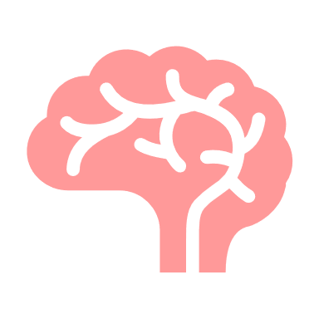
Causes
Genetic component
Chemical imbalances
Notes:
When it comes to causes, mood disorders have a strong genetic component. People with mood disorders also often have chemical imbalances, specifically norepinephrine and serotonin. There are also differences in brain areas for these disorders.

Slide 9
Brain Differences
Amygdala
Prefrontal Cortex
Notes:
The amygdala has increased activity, especially in response to negative stimuli. The prefrontal cortex also has less activation, which would normally dampen the response of the amygdala. These findings indicate that depressed individuals are more likely to respond negatively and have greater difficulty controlling those negative emotions.

Slide 10
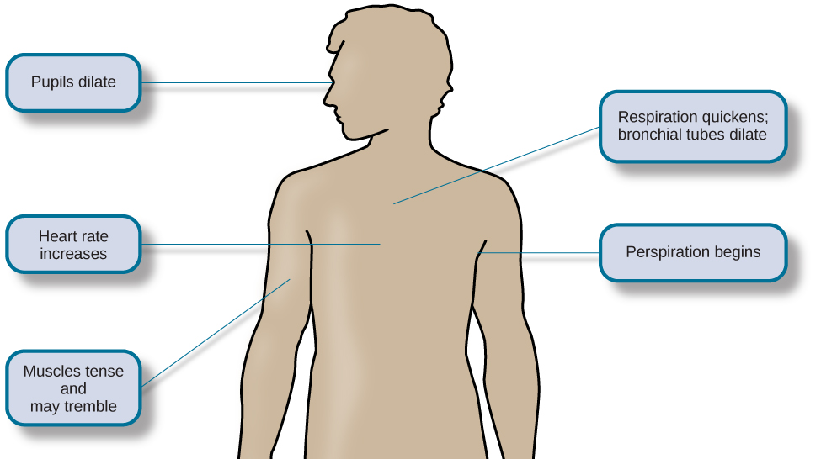
Cortisol
Amygdala
Prefrontal cortex
Notes:
Cortisol also seems to be a culprit. Normally, cortisol release helps to trigger the fight-or-flight response. In depression, cortisol levels are increased, and this increase activates the amygdala and deactivates the prefrontal cortex.

Slide 11




Cognitive View of Depression
Future
Notes:
The cognitive view of depression indicates that depression is triggered by negative thoughts, interpretations, and expectations. Individuals with depression likely have depressed schemas and see events in a negative way. These schemas prompt dysfunctional and pessimistic thoughts about the self, the world, and the future.

Slide 12
Cognitive View of Depression
Hopelessness
Stable
Global
Notes:
Individuals may experience hopelessness, which results from a tendency to perceive negative life events as having stable (will never change) and global (will impact my whole life) causes. That is certainly different from an approach that the same situation is both fixable and limited in impact. Also, thoughts about one’s own depression or rumination can lengthen an episode.

Slide 13



Suicide
Past attempts
Unable to escape
Bullying victim
Family history
Isolation
Notes:
One risk of depression is suicide. Suicide is more common among men but that may be due to the weapon of choice—firearms. Risk factors for suicide include having issues with substance use, past suicide attempts, access to lethal means, withdrawal from social relationships, a sense of entrapment or feeling unable to escape, being a victim of bullying, and suicide in a family member.

Slide 14




HAWKES LEARNING

