Slide 1
HAWKES LEARNING
Schizophrenia
Introduction to Psychology
Notes:
Schizophrenia is a devastating disorder that is characterized by major disturbances in thought, perception, emotion, and behavior.

Slide 2


Prevalence
Thoughts
Perceptions
Behaviors
1%
Notes:
The prevalence rate of schizophrenia is approximately 1% of the population. It is considered a psychotic disorder in which a person’s thoughts, perceptions, and behaviors are impaired to the point he or she cannot function in life.

Slide 3











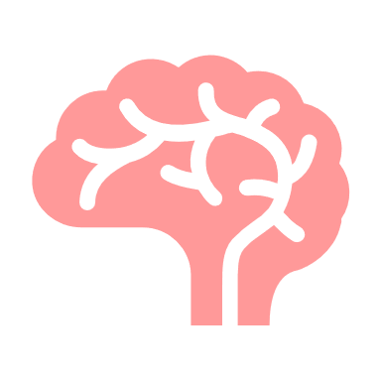






Symptoms
Hallucinations
Delusions
Disorganized Thinking
Tactile
Disjointed
Visual
Incoherent
Olfactory
Auditory
Disorganized Motor Behavior
Negative Symptoms
ha! ha! ha!
Behaviors
Emotions
Drives
Notes:
There are a variety of different symptoms in schizophrenia.

Slide 4
Hallucinations
Tactile
Visual
Olfactory
Auditory
Notes:
Hallucinations are perceptual experiences that are not real, such as hearing a voice that is not there. A hallucination can occur for any sense, but auditory hallucinations are the most common in schizophrenia.

Slide 5
Delusions
Notes:
Delusions are beliefs that are contrary to reality. There are a variety of different delusions. For example, in paranoid delusions, a person may believe that other people are plotting to harm the person. In grandiose delusions, individuals may feel they have a special power or knowledge that is extremely important. In somatic delusions, individuals are worried that something unusual will happen to their bodies, such as having a body part eaten by bugs.

Slide 6
Disorganized Thinking
Disjointed
Incoherent
Notes:
Disorganized thinking refers to disjointed and incoherent thought processes. Here, individuals may ramble or jump from topic to topic with no logical progression.

Slide 7
Disorganized Motor Behavior
ha! ha! ha!
Notes:
Disorganized or abnormal motor behavior refers to unusual behaviors and movements. Giggling, engaging in repeated movements, or odd facial expressions might be examples. Sometimes, people will demonstrate catatonic behaviors—decreased reactivity to the environment.

Slide 8
Negative Symptoms
Behaviors
Emotions
Drives
Notes:
Negative symptoms reflect decreases or absences of normal behaviors, emotions, or drives. An example might be a lack of emotional response in facial expressions, speech, or movements.

Slide 9
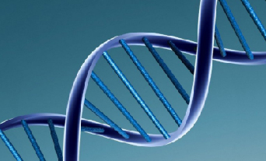


Causes
Notes:
The cause of schizophrenia appears to be at least partially genetic. The risk of developing schizophrenia is much greater if one of your parents has schizophrenia. In general, research suggests that there is a genetic component to schizophrenia that then arises from a combination of genetic and environmental factors. A disturbed family environment can increase the likelihood of someone with a predisposition to schizophrenia to actually develop the disorder.

Slide 10

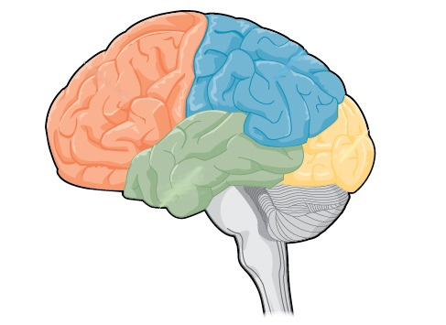


Physiological Factors
Neurotransmitters
Brain Differences
Dopamine
Receptors
Developmental Impacts
Drug Use
Flu epidemic
Marijuana
Notes:
There are a number of physiological factors that have been identified in schizophrenia.

Slide 11
Neurotransmitters
Dopamine
Receptors
Notes:
One factor is the increase in the neurotransmitter, dopamine, in cases of schizophrenia. The dopamine hypothesis posits that an overabundance of DA or an increase in activity at DA receptors is largely responsible for the symptoms of schizophrenia.

Slide 12
Brain Differences
Notes:
Another interesting difference in individuals with schizophrenia is that they have increased ventricles in the brain, suggesting they have lost cortical tissue. This decrease seems to impact the frontal lobe, which is important for a great deal of cognitive functioning and is clearly disturbed in schizophrenia.

Slide 13
Developmental Impacts
Flu epidemic
Notes:
Research also suggests that events during pregnancy can contribute to the development of schizophrenia. Specifically, a mother who contracts the flu during a certain period of her pregnancy may be more likely to later have a child who develops schizophrenia. This exposure may alter some factor that later predisposes the child to develop the disorder.

Slide 14
Drug Use
Marijuana
Notes:
Marijuana use has also been linked to the development of schizophrenia as an environmental risk factor. Early marijuana use may disrupt normal brain development during important maturation periods.

Slide 15




HAWKES LEARNING

