Slide 1
HAWKES LEARNING
Mental Health Treatment: Past and Present
Introduction to Psychology
Notes:
Mental health treatment has varied across the past and the present.

Slide 2







Rates of Mental Illness
19%
13%
Notes:
First, it is important to note that approximately 19% of U.S. adults and 13% of children have a form of mental illness. Of these, about 13.4% of adults and 50% of children receive treatment, which means that many people are untreated for their mental illnesses.

Slide 3
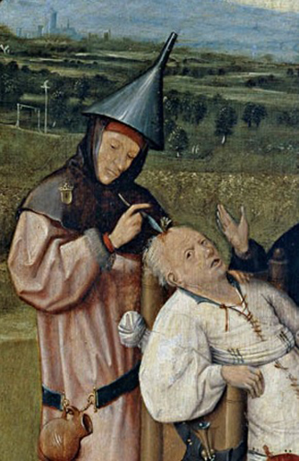
Historical Beginnings
Demonic possession
Witchcraft
Angry god
Notes:
For much of history, people with mental illnesses were treated rather poorly. It was largely thought that mental illness was caused by demonic possession, witchcraft, or an angry god. Much of the time, rituals, such as exorcisms, were performed to remove the demons. In some cases, a hole was drilled into the person’s skull to allow the demon’s release.

Slide 4

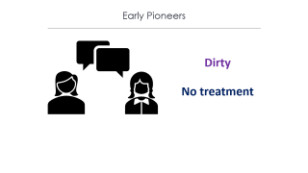
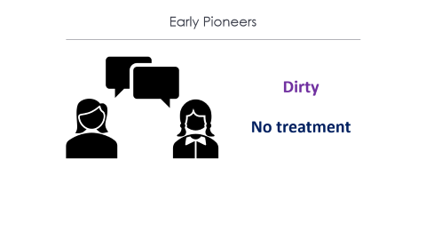
Asylums
Notes:
Eventually, people with mental illness were placed into asylums, which were the first institutions created for the specific purpose of housing people with disorders. These individuals were treated poorly, often beaten or chained.

Slide 5

Early Pioneers
Dirty
No treatment
Notes:
Philippe Pinel argued that these individuals should be treated more humanely, that they should be unchained and spoken to. Many people benefited and were able to leave the hospital. Later, Dorothea Dix led reform efforts in which she began lobbying for change. Despite this push, however, asylums were still dirty, didn’t offer much treatment, and kept people for decades.

Slide 6
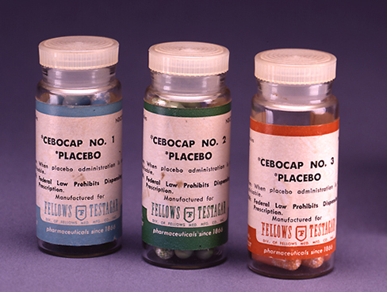
Psychopharmacology
Antipsychotics
Notes:
The real change that impacted mental health was the advent of antipsychotic medications in the late 1950s and early 1960s. These medications helped to control hallucinations and delusions. As a result, individuals started to be released from asylums, and many asylums started to close.

Slide 7


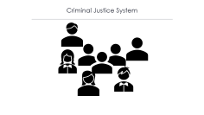
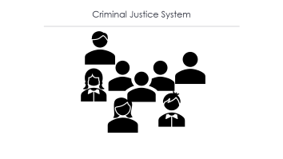
Modern Day
Notes:
Today, there are community mental health centers across the nation. Unfortunately, when asylums closed, individuals were supposed to get picked up by local centers, but the system wasn’t set up properly. They were underfunded, and the staff was largely untrained. As a result, many people did not receive care and became homeless.

Slide 8

Criminal Justice System
Notes:
Another group of individuals with mental illness can be found in the correctional system. Estimates indicate that approximately 1.2 million individuals with mental illness are incarcerated.

Slide 9


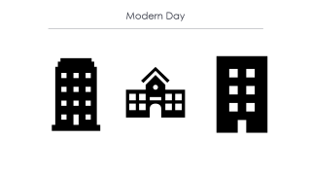
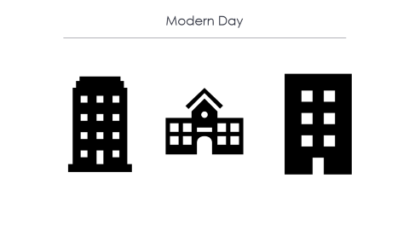
Modern Day
Notes:
Instead of asylums, today we have psychiatric hospitals run by state governments and local community hospitals focused on short-term care. Long-term care is often limited due to insurance and financial costs.

Slide 10

Modern Day
Notes:
Today, psychological treatment can occur in a variety of places. Community mental health centers, private or community practices, schools, and prisons all offer psychological services. In addition, there are a variety of people that provide such services, such as a psychologist or psychiatrist, social worker, or trained religious personnel.

Slide 11




HAWKES LEARNING
Notes:
Despite the changes in the mental health care system, approximately two thirds of people with mental illness still receive no treatment.

