Slide 1
HAWKES LEARNING
Types of Treatment
Introduction to Psychology
Notes:
There are a variety of different types of treatment. The two we will consider here are psychotherapy and biomedical therapy.

Slide 2





Psychotherapy
Notes:
Psychotherapy employs various methods to help someone overcome personal problems or attain personal growth. There are a variety of different types of psychotherapeutic techniques.

Slide 3
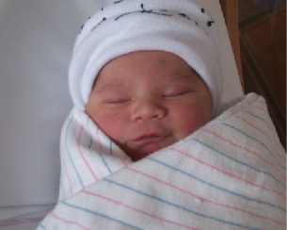
Psychoanalysis
Repressed impulses
Trauma
Notes:
Psychoanalysis was the first form of psychotherapy, developed by Sigmund Freud. He believed that much of our psychological problems resulted from repressed impulses and trauma from childhood. If these feelings could be uncovered, individuals would feel better.

Slide 4

Psychoanalysis
Free association
Dream analysis
Notes:
In order to determine these long-hidden feelings, therapists would employ free association in which they asked patients to relax and say whatever came to mind. The therapist would listen for hints of repressed trauma or other impactful events. In dream analysis, a therapist would look for hidden meaning in a patient’s dreams.

Slide 5









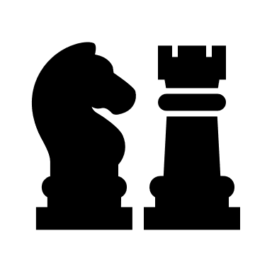
Play Therapy
Notes:
Another type of psychotherapy is play therapy. In this technique, play is used to help clients resolve difficulties and achieve growth. Children play out their hopes, fantasies, and traumas using dolls or other toys.

Slide 6

Behavior Therapy
Classical Conditioning
Operant Conditioning
Notes:
Behavior therapy employs learning principles to help clients change undesirable behavior. Both classical and operant conditioning are used in this technique. For instance, classical conditioning can be used to help a child stop bedwetting at night by associating the urge to urinate with an alarm.

Slide 7


Aversive Conditioning
Notes:
Aversive conditioning involved using an unpleasant stimulus to help stop an undesirable behavior. For example, a child who bites his nails might have a nasty-tasting substance painted on them such that he would taste that substance each time he bit, ultimately reducing the behavior.

Slide 8



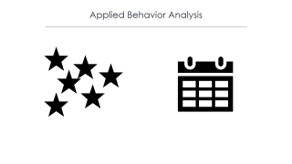
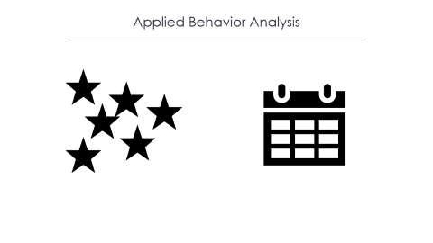
Exposure Therapy
Systematic desensitization
Notes:
In exposure therapy, the goal is to reduce a fearful or anxious response to a stimulus. In systematic desensitization, clients will be faced with the stimulus (real or imaged) and learn to manage their fear or anxiety. If someone is scared of bugs, they may have to face an image of a bug, a stuffed bug, until finally facing a real bug. Clients may also face their fears using virtual reality.

Slide 9


Applied Behavior Analysis
Notes:
Another type of behavior therapy involves applied behavior analysis in which children with autism are rewarded and motivated for desired behaviors. Sometimes, individuals use a token economy in which individuals are reinforced with tokens that can be exchanged for items or privileges.

Slide 10

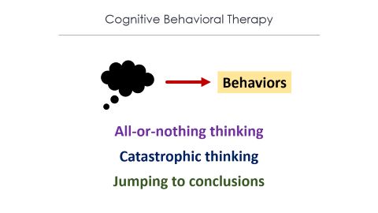

Cognitive Therapy
Notes:
Cognitive therapy focuses on how a person’s thoughts lead to feelings of distress. For instance, a person’s self-defeating beliefs would exacerbate depression. Through questioning, a therapist can help a client recognize dysfunctional ideas and help the person find better avenues of coping.

Slide 11
Cognitive Behavioral Therapy
Behaviors
All-or-nothing thinking
Catastrophic thinking
Jumping to conclusions
Notes:
Cognitive behavioral therapy focuses on present issues compared to a person’s past. CBT helps a client examine how his or her thoughts affect behavior. This approach is designed to change the way people think and act. All-or-nothing thinking, catastrophizing, and jumping to conclusions are all negative cognitive distortions that can worsen symptomology.

Slide 12
Humanistic Therapy
Self Awareness
Acceptance
Identifying conflicts
Understanding feelings
Notes:
Humanistic therapy involves focusing on helping people achieve their potential. The idea is to become more self-aware and accepting of the self. Part of humanistic therapy is client-centered therapy in which the client is aided in identifying conflicts and understanding feelings. The therapist does not advise or interpret for the client but instead allows the client to work to a solution on his or her own.

Slide 13

Effectiveness?
Notes:
With all of these different types of psychotherapy, which is more effective? There appears to be three components that are important in therapy. First, the treatment should be evidence-based. Second, the expertise of the therapist is paramount. Finally, the client’s characteristics, values, and culture are also important factors.

Slide 14
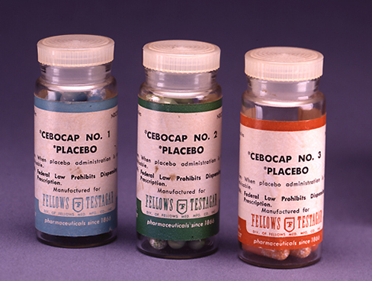
Biomedical Therapy
Antidepressants
Mood stabilizers
Medications
Antipsychotics
Electroconvulsive Therapy
Notes:
Biomedical therapy is another option. This type of therapy includes medications, such as antidepressants, mood stabilizers, or antipsychotics. These medications help to correct chemical imbalances that may contribute to the symptoms of different disorders. Another biomedical therapy is electroconvulsive therapy in which seizures are induced to alleviate symptoms of severe depression.

Slide 15




HAWKES LEARNING
Notes:
Taken together, it is clear that there are a variety of methods that can be used to help individuals who suffer from mental illness.

