Slide 1
HAWKES LEARNING
Treatment Modalities
Introduction to Psychology
Notes:
There are a variety of treatment modalities, which we will consider here.

Slide 2



Treatment
Notes:
When a person seeks treatment, he or she undergoes an intake, which is an assessment to determine clinical needs. In this session, the client’s needs are identified and issues, such as confidentiality and treatment goals, are discussed.

Slide 3

Individual Therapy
Notes:
In individual therapy, the client and clinician meet one-on-one for multiple sessions in order to explore feelings, work through life challenges, identify aspects of self to change, and set goals to meet those expectations. The amount of time spent in this type of therapy can vary widely with the person and the severity of the needs.

Slide 4

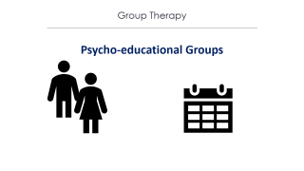
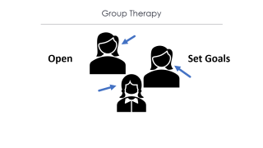
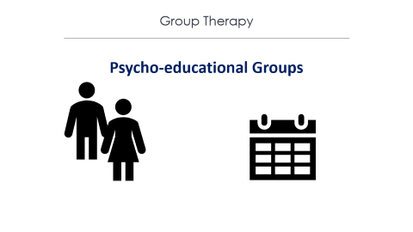
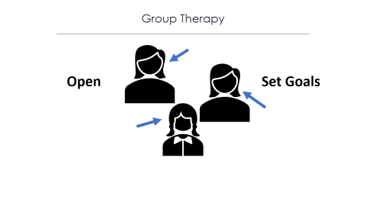
Group Therapy
Not open to talking
Confidentiality
Notes:
In group therapy, a clinician meets together with several clients with similar problems. One benefit of group therapy is that it can reduce the degree of shame and isolation felt by the clients. There are, of course, some limitations in that people may not wish to talk in front of others. There may also be concerns about confidentiality.

Slide 5



Group Therapy
Psycho-educational Groups
Notes:
Some groups have a strong educational component, which are called psycho-educational groups. For example, a group for children whose parents have cancer may spend time educating the children about cancer and what to expect in the months or years to come.

Slide 6
Group Therapy
Open
Set Goals
Notes:
Group dynamics can vary from having a relatively open structure to having set goals. A single person is often not the focus of an entire meeting, but instead, individuals take turns sharing their progress, conflicts, or goals.

Slide 7

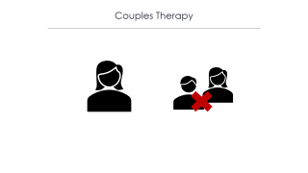

Couples Therapy
Notes:
Couples therapy involves two people in an intimate relationship who are having difficulties.

Slide 8
Couples Therapy
Notes:
The primary therapy used in couples is cognitive-behavioral therapy. The therapist helps the couple see their individual contributions to relationship conflicts and helps them determine ways to resolve those issues. Sometimes, the end result of such therapy is a determination that the couple should actually not be together.

Slide 9

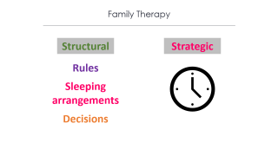

Family Therapy
Coping
Resolution
Growth
Notes:
Family therapy is exactly as it sounds—it focuses on an entire family or even more than one family. The family is viewed as a system in which each individual has a role to play, which contributes to the larger issues. Goals include helping each family member cope and encouraging resolution and growth for both individual family members and the family as a whole.

Slide 10

Family Therapy
Structural
Strategic
Rules
Sleeping arrangements
Decisions
Notes:
In structural family therapy, the therapist examines and discusses who makes the rules, who sleeps where, and how decisions are made—a focus on the structure of the family itself. In strategic family therapy, the goal is to address a specific problem within the family that can be handled in a short amount of time.

Slide 11




HAWKES LEARNING
Notes:
Overall, there are a variety of different modalities that may be used in therapy.

