Slide 1
HAWKES LEARNING
Substance-Related and Addictive Disorders: A Special Case
Introduction to Psychology
Notes:
In this section, we will consider substance-related and addictive disorders.

Slide 2

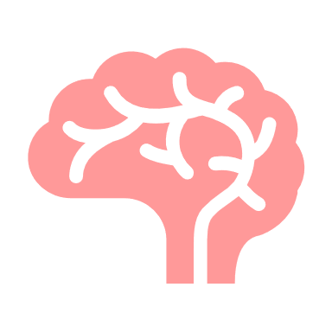
Addiction
Voluntary choice
Notes:
Addiction is often viewed as a chronic disease. The choice to use a substance initially is voluntary but continued use can begin to change the brain, causing individuals to have a more difficult time ceasing substance use. As a result, many people relapse or return to abusing drugs or alcohol.

Slide 3
Goals of Treatment
Compulsive Drug-Seeking Behaviors
NO!
Behavioral therapy
Medication
Notes:
The goal of substance-related treatment is to help the person with an addiction stop compulsive drug-seeking behaviors. Treatment usually includes behavioral therapy and medication.

Slide 4
Effectiveness
Legal
Communication
Vocation
Stress
Addiction
Parenting
Relationships
Notes:
Factors that impact effectiveness of treatment include the duration of the treatment with a three-month minimum being recommended. Treatment also needs to be holistic, focusing on drug addiction, communication, stress management, relationship issues, parenting, as well as vocational and legal concerns.

Slide 5





Group Therapy
Support
Affiliation
Notes:
Group therapy is beneficial for those with substance use issues. People with addiction are more likely to maintain sobriety in a group format. This result may be due to support and affiliation. In addition, others better understand the issues that an individual with addiction faces.

Slide 6
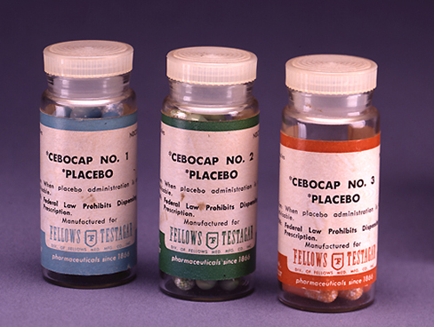
Medication
Detox
Prevent seizure
Medications
Prevent reuse
Withdrawal
Notes:
Medication can also be used, such as medications to help detox the individual, prevent seizures from detox, prevent reuse of the drug, and to manage withdrawal symptoms.

Slide 7

Psychological Issues
Mentally ill and chemically addicted
Notes:
A person who is addicted to drug or alcohol often has additional psychological issues that are considered comorbid which means they co-occur. If a person has both substance use and another mental illness, such as depression, this person falls into the category of mentally ill and chemically addicted. In cases of comorbidity, the best treatment is thought to address both disorders simultaneously.

Slide 8




HAWKES LEARNING

