Slide 1
HAWKES LEARNING
Human Genetics
Introduction to Psychology
Notes:
Psychological researchers study genetics in order to understand the underlying biological basis of some behaviors. These investigations help us to answer questions, such as why certain individuals are more likely to contract a disease or whether there are biological causes of psychological illnesses, like depression.

Slide 2

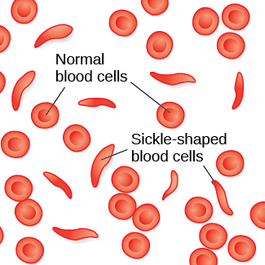
Sickle Cell Anemia
High fever
Severe pain
Swelling
Tissue damage
HAWKES LEARNING
Notes:
To understand the impact of genetics, we can consider the case of sickle cell anemia, a genetic condition in which red blood cells, which are normally round, take on a crescent shape. As a result, these crescent cells clog blood vessels and block blood flow, leading to high fever, severe pain, swelling, and tissue damage. Many people with sickle cell anemia die early. How, then, does sickle cell anemia persist?

Slide 3


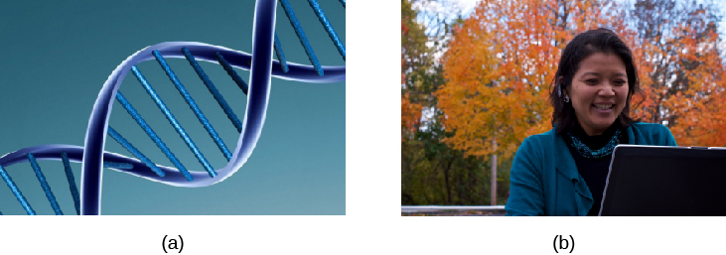
Sickle Cell Anemia
Malaria
HAWKES LEARNING
Notes:
Sickle-cell anemia remains relatively common among people of African descent. It turns out that the gene for sickle cell anemia is protective against malaria, common in Africa. Individuals who are carriers of sickle-cell anemia, but who do not have the full blown symptoms, will survive malaria. They can then go on to have their own children, possibly passing that gene on to the offspring.

Slide 4
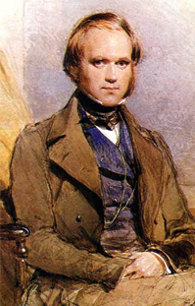

Charles Darwin
Natural Selection
HAWKES LEARNING
Notes:
Charles Darwin described the theory of evolution by natural selection, which states that organisms that are better suited to their environments will survive and reproduce. In the case of sickle cell anemia, a carrier in Africa is better suited to the environment.

Slide 5
Genetic Variation
Egg
Sperm
23
23
HAWKES LEARNING
Notes:
Genetic variation is what contributes to a species’ adaptation to the environment. In humans, genetic variation begins with an egg and a 100 million sperm. The egg and sperm each contain 23 chromosomes.

Slide 6


Chromosomes and DNA
DNA
Chromosome
HAWKES LEARNING
Notes:
A chromosome is a long string of genetic material known as deoxyribonucleic acid (DNA), which is helix-shaped molecules made up of base pairs. In each chromosome, sequences of DNA make up genes that control or partially control a number of visible characteristics, or traits, such as eye color or hair color.

Slide 7
Genetic Variation
23
23
Phenotype
Genotype
HAWKES LEARNING
Notes:
When a sperm and egg fuse, 23 chromosomes pair up and create a zygote with 23 pairs of chromosomes. The resulting characteristics of the person, or the phenotype, is determined by the underlying genes or genotype. A person’s genotype may or may not match the phenotype. For example, someone may have a blue-eye gene but have brown eyes.

Slide 8
Dominant Genes
Dominant
Recessive
D
d
Have dominant trait
NO dominant trait
D
d
D
D
d
d
HAWKES LEARNING
Notes:
Most traits are controlled by multiple genes, but there are some that are controlled by a single gene. In these cases, there is usually one gene that is considered dominant. If it is present, the person will have the trait. A person’s phenotype will only NOT have the trait if the person received both recessive copies of the trait.

Slide 9


Dominant Genes
DD
dd
d
D
d
D
HAWKES LEARNING
Notes:
A cleft chin, for example, is present in individuals with one dominant copy. If a mom has two dominant genes, she will pass that gene on to all of her offspring. If the father has a smooth chin and passes along a recessive smooth chin gene, the dominant gene from mom will always influence the phenotype, resulting in children with cleft chins.

Slide 10
Recessive Genes
Dd
dd
d
d
HAWKES LEARNING
Notes:
The only way that a child could have a smooth chin would be if mom did not have two dominant copies of the cleft chin gene, and instead, she had one dominant and one recessive. Then, if she passed on the recessive gene, it would combine with dad’s recessive gene, and the child would have a smooth chin.

Slide 11


Genes and Environment
HAWKES LEARNING
Notes:
Genes do not exist in a vacuum. Instead, we also exist in an environment that can impact how and when our genes express themselves. There is a unique interaction between genes and the environment, and researchers have tried a variety of ways to describe that interaction.

Slide 12


Range of Reaction
HAWKES LEARNING
Notes:
One explanation is the range of reaction, which asserts that our genes set the boundaries within which we can operate, and our environment interacts with the genes to determine where in that range we will fall. For example, perhaps a person’s genetics indicates high intellectual potential. However, that person is born in a deprived environment with little opportunity. This person will likely not reach his or her full intellectual potential based on that interaction.

Slide 13

Genetic Environmental Correlation
HAWKES LEARNING
Notes:
Another explanation is a genetic environmental correlation. Here, our genes are thought to influence our environment, and our environment influences our genes. A child of an NBA player would probably be exposed to basketball from an early age. That exposure might allow the child to reach his or her full genetic athletic potential.

Slide 14

Epigenetics
HAWKES LEARNING
Notes:
The field of epigenetics looks beyond the genotype and studies how the same genotype can be expressed in different ways. For instance, identical twins, which share 100% genetic similarity, may be affected differently by disease. Although these individuals share an identical genotype, their phenotype differs as a result of how that genetic information is expressed over time.

Slide 15




HAWKES LEARNING
Notes:
Genes can affect more than how we look. In fact, they have been linked to personality, sexual orientation, and even spirituality. Genes provide the biological blueprints for our cells, tissues, organs, and body, and they also significantly impact our experiences and behaviors.

