Slide 1
HAWKES LEARNING
Cells of the Nervous System
Introduction to Psychology
Notes:
The nervous system is composed of two basic cell types: glial cells and neurons.

Slide 2

Glial Cells
Neurons
˂
Glial Cells
10:1 ratio
Structure
Transport
Insulation
Immune responses
HAWKES LEARNING
Notes:
Although there are 100 billion neurons, glial cells outnumber neurons ten to one. These cells provide multiple supportive roles to neurons including providing structure, providing insulation, transporting nutrients and waste products, and mediating immune responses.

Slide 3

Neurons
HAWKES LEARNING
Notes:
On the other hand, neurons are the central building blocks of the nervous system. Their outer surface is made up of a semipermeable membrane across which small molecules, and molecules without an electrical charge are allowed to pass through. Larger molecules, however, cannot pass.

Slide 4
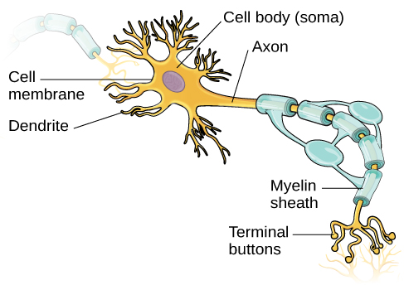
Neurons
Nucleus
HAWKES LEARNING
Notes:
The nucleus of the neuron is located in the soma, which has branching projections, called dendrites, that are responsible for receiving information from other neurons. These signals are transmitted down the axon, a major projection from the soma, that ends in multiple terminal buttons that contain vesicles of neurotransmitters, or chemical messengers.

Slide 5
Neurons
HAWKES LEARNING
Notes:
Some axons are covered in myelin sheath, which is a fatty tissue formed by glial cells. Myelin coats the axon and act as insulation, increasing the speed at which the message travels.

Slide 6


Neurons
NT
NT
NT
HAWKES LEARNING
Notes:
Once a neuronal signal reaches the end of an axon, neurotransmitters are released from the terminal button and cross the synapse, which is the small space between two neurons. They bind to receptors on the next cell in a lock-and-key relationship.

Slide 7



Neuronal Signals
Extracellular fluid
Intracellular fluid
HAWKES LEARNING
Notes:
To understand how a neuronal signal is generated, we must first understand a bit more about what is happening inside of the cell. A neuron exists in a fluid environment–it is surrounded by extracellular fluid and contains intracellular fluid. There are ions present in both of these areas that contribute to the fact that the inside of the cell is more negatively charged than the outside.

Slide 8
Resting Membrane Potential
Na⁺
K⁺
Na⁺
K⁺
Na⁺
Na⁺
HAWKES LEARNING
Notes:
When a cell is not active, it is considered to be at rest, ready for action. In this resting state, sodium, a positive ion, is in higher concentrations outside of the cell. Potassium, another positive ion, is more concentrated inside of the cell. The higher concentrations of sodium outside are what contribute to the negative value of the resting membrane potential.

Slide 9
Change from Rest
Na⁺
K⁺
Na⁺
Positive charge
K⁺
Na⁺
Na⁺
Action Potentials
HAWKES LEARNING
Notes:
When the resting neuron receives a signal at the dendrites, small gates on the membrane open, allowing those sodium ions to enter into the cell. This influx of sodium causes the inner charge to change to a positive. If enough sodium enters to trigger the threshold of excitation, an action potential will form.

Slide 10
Action Potential
Na⁺
K⁺
K
HAWKES LEARNING
Notes:
In an action potential, additional gates open, allowing more sodium to enter, causing a spike in the polarity of the cell. Potassium ions leave to counteract this change in charge, and eventually the polarity resets, actually becoming slightly more negative than at rest for a short period of time. The cell then returns to rest.

Slide 11
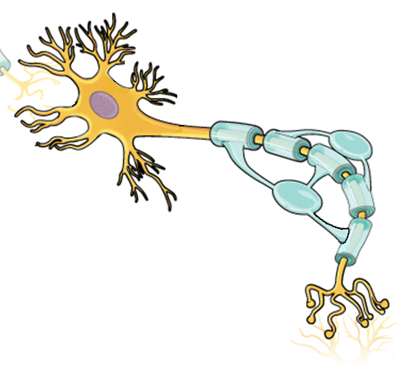

Action Potentials
HAWKES LEARNING
Notes:
These changes in polarity, taken together, comprise the action potential, the electrical signal that moves from the cell body down the axon. The electrical signal moves down the axon like a wave. The action potential is considered an all-or-none phenomenon in that it either happens, or it does not. In fact, the action potential is recreated at its full strength at every point along the axon. It does not fade away or get smaller as it travels.

Slide 12
Action Potentials
NT
NT
NT
HAWKES LEARNING
Notes:
When the action potential arrives at the terminal button, the vesicles release their neurotransmitters into the synapse. The neurotransmitters travel across the synapse and bind to receptors. When this occurs, the whole process begins again.

Slide 13
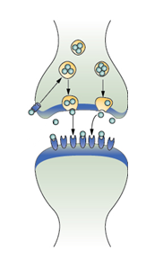
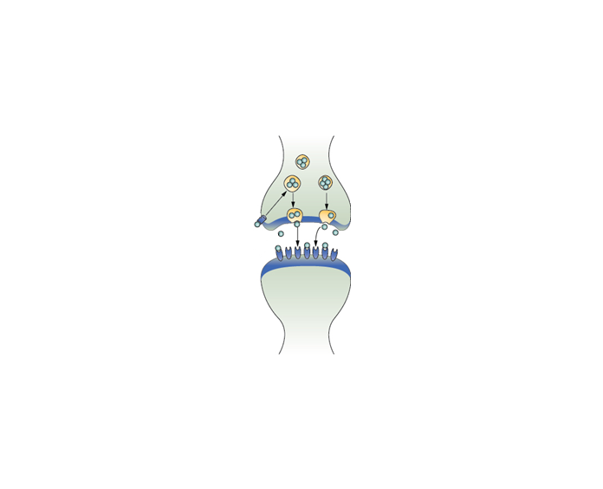
Neurotransmitters
Drift away
Broken down
Reuptake
HAWKES LEARNING
Notes:
After release, excess neurotransmitters drift away, are broken down, or are reabsorbed in a process called reuptake. Essentially, neurotransmitters are brought into the cell and repackaged for later use.

Slide 14
Drugs and Neurotransmitters
Drugs
Neurotransmitters
Parkinson’s disease
Dopamine
Agonist
increase
HAWKES LEARNING
Notes:
Much of what we know about neurotransmitters comes from research on the effects of drugs. Medications that help regulate different neurotransmitters can help alleviate symptoms related to neurotransmitter imbalances. For example, for someone with Parkinson’s disease, they have a lack of dopamine. An agonist drug would increase the levels of available dopamine.

Slide 15
Drugs and Neurotransmitters
Drugs
Neurotransmitters
Schizophrenia
Dopamine
Antagonist
decrease
HAWKES LEARNING
Notes:
In contrast, someone with schizophrenia has too much dopamine. Here, a doctor would prescribe an antagonist that would reduce the levels of available dopamine.

Slide 16

Reuptake Inhibitors
Reuptake
HAWKES LEARNING
Notes:
Drugs can also be reuptake inhibitors, which prevent unused neurotransmitters from being transported back to the neuron. For example, many people with depression take selective serotonin reuptake inhibitors, which prevent serotonin from being taken back into the cell too quickly. This allows serotonin to act for longer, relieving depression symptoms.

Slide 17




HAWKES LEARNING

