Slide 1
HAWKES LEARNING
Parts of the Nervous System
Introduction to Psychology
Notes:
The nervous system can be divided into two major subdivisions.

Slide 2
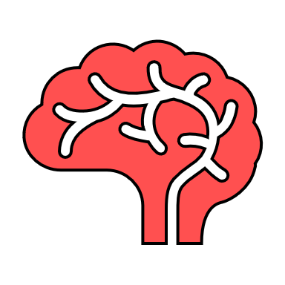
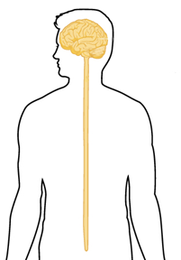
Central Nervous System
HAWKES LEARNING
Notes:
The first division is the central nervous system, which is comprised of the brain and spinal cord. This presentation, however, will largely focus on the other division and leave the central nervous system for another lesson.

Slide 3
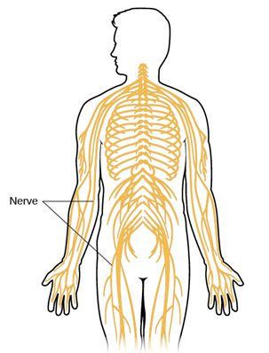

Peripheral Nervous System
Nerves
HAWKES LEARNING
Notes:
The second division is the peripheral nervous system, which is made up of thick bundles of axons called nerves that carry messages back and forth between the brain, spinal cord, and the muscles, organs, and senses in the periphery of the body.

Slide 4
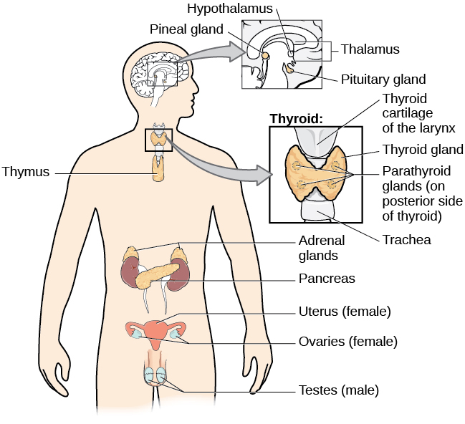
Peripheral Nervous System
Somatic Nervous System
Autonomic Nervous System
Sensory Neurons
Motor Neurons
Not voluntary
Afferent pathway
Efferent pathway
HAWKES LEARNING
Notes:
The peripheral nervous system can be further divided into two major subdivisions–the somatic nervous system and the autonomic nervous system.

Slide 5
Somatic Nervous System
Sensory Neurons
Motor Neurons
Afferent pathway
Efferent pathway
HAWKES LEARNING
Notes:
The somatic nervous system consists of sensory and motor neurons. Motor neurons carry instructions from the brain to the muscles in an efferent (moving away) path. Sensory neurons carry sensory information to the central nervous system along an afferent (moving towards) path.

Slide 6
Autonomic Nervous System
Not voluntary
HAWKES LEARNING
Notes:
In contrast, the autonomic nervous system controls our internal organs and glands and is generally considered to be outside the realm of voluntary control. It can be divided into two additional subdivisions.

Slide 7




Sympathetic Nervous System
Stress
HAWKES LEARNING
Notes:
The first is the sympathetic nervous system, which is involved in preparing the body for stress-related events. For example, when someone is scared, the person’s pupils will dilate, heart rate and blood pressure will increase, and adrenaline will surge. These responses make up the fight-or-flight reaction. We are ready to fight or run, depending on the situation.

Slide 8

Parasympathetic Nervous System
Homeostasis
HAWKES LEARNING
Notes:
In contrast, the parasympathetic nervous system is associated with returning the body back to homeostasis (a state of equilibrium) after stress-related events. Once the threat has been resolved, the parasympathetic nervous system takes over and returns bodily functions to a relaxed state.

Slide 9




HAWKES LEARNING

