Slide 1
HAWKES LEARNING
The Brain and the Spinal Cord
Introduction to Psychology
Notes:
In this lesson, we will discuss the central nervous system.

Slide 2
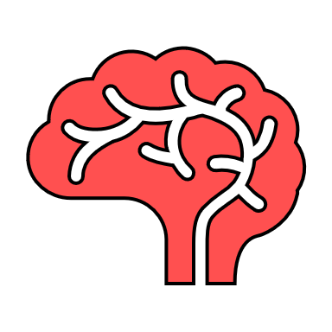
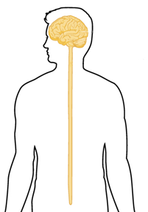
Central Nervous System
HAWKES LEARNING
Notes:
Specifically, we will focus on the overall organization of the brain and the functions of each area. We will begin with the spinal cord.

Slide 3

Spinal Cord
Relay station
Reflexes
HAWKES LEARNING
Notes:
The spinal cord acts like a relay station, connecting the brain to the outside world. It routes messages to and from the brain and also has its own system of automatic processes, called reflexes.

Slide 4
Spinal Cord
Brain Stem
Sensory neuron
IN
Motor neuron
OUT
30 segments
HAWKES LEARNING
Notes:
The top of the spinal cord merges with the brain stem, which is where basic processes of life are controlled. The spinal cord is segmented into 30 different areas, each connected to a different part of the peripheral nervous system. Sensory nerves bring messages in; motor nerves bring messages out.

Slide 5
HAWKES LEARNING
The Brain and the Spinal Cord
Introduction to Psychology
Notes:
The brain itself is divided into several different subgroups, such as the forebrain, the midbrain, and the hindbrain. We will start with the forebrain.

Slide 6
Cerebral Cortex
Gyri
Sulci
HAWKES LEARNING
Notes:
The surface of the brain, known as the cerebral cortex, is characterized by bumps (gyri) and grooves (sulci). These allow reference points to separate the brain into different regions. For example, the longitudinal fissure is a deep groove that separates the brain into two halves or hemispheres. The cerebral cortex is responsible for higher order processing, like thought and language.

Slide 7
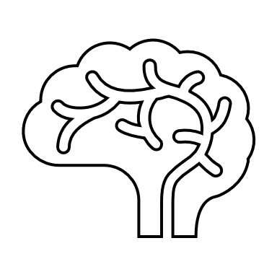

Hemispheres
Communicate
Controls right side of the body
Controls right side of the body
Lateralization
HAWKES LEARNING
Notes:
It is important to note that the hemispheres are lateralized, which means that each half does something different than the other half. For instance, the left side of the brain controls the right half of the body and vice versa.

Slide 8

Corpus Callosum
No language!
Left Brain
Right Brain
HAWKES LEARNING
Notes:
The two halves are connected by the corpus callosum, a thick bundle of fibers that allows the two halves of the brain to talk to each other. In cases when the corpus callosum has been cut to prevent seizures, the two halves of the brain no longer communicate.
For this person, if an object is shown in the left visual field, the right brain sees it. That means the person cannot verbally identify the object because the left brain has language.

Slide 9
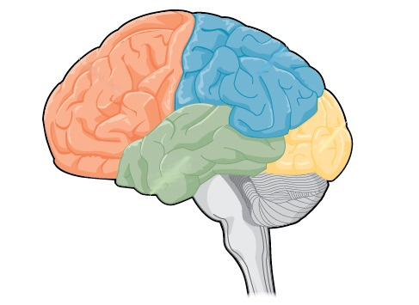
Lobes
HAWKES LEARNING
Notes:
The cerebral cortex can be further divided into different lobes or areas of specialization.

Slide 10
Lobes
HAWKES LEARNING
Notes:
The frontal lobe is involved in planning and coordinating movement, higher order processing, and speech production.

Slide 11
Lobes
HAWKES LEARNING
Notes:
The parietal lobe contains the somatosensory cortex, which processes our feelings of touch, temperature, and pain as well as other senses.

Slide 12
Lobes
HAWKES LEARNING
Notes:
The temporal lobes are located above the ears and are associated with hearing, memory, emotions, and language comprehension.

Slide 13
Lobes
HAWKES LEARNING
Notes:
The final lobe, the occipital, contains the primary visual cortex, which is responsible for organizing visual information.

Slide 14




Forebrain
Thalamus
Limbic system
Hippocampus
Amygdala
Hypothalamus
HAWKES LEARNING
Notes:
The forebrain contains several other subcortical structures. The thalamus is a sensory relay center. The limbic system contains the hippocampus, responsible for memory; the amygdala, responsible for emotion, and the hypothalamus, responsible for regulating body temperature, appetite, and blood pressure.

Slide 15
Midbrain
Reticular formation
AROUSAL
SLEEP
HAWKES LEARNING
Notes:
The midbrain also contains several structures. For example, the reticular formation regulates sleep, arousal, and alertness.

Slide 16





Midbrain
Ventral tegmental area
Substantia nigra
HAWKES LEARNING
Notes:
Also in the midbrain, the substantia nigra and ventral tegmental area are together responsible for dopamine release, mood, reward, and addiction.

Slide 17
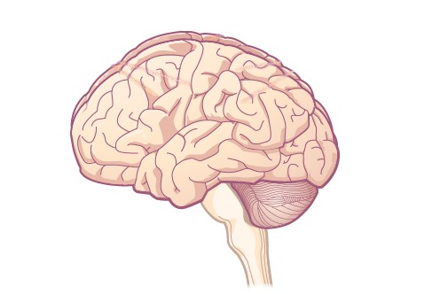
Hindbrain
HAWKES LEARNING
Notes:
The hindbrain is the lowest part of the brain, nearest the spinal cord. It contains the medulla, which controls breathing, blood pressure, and heart rate; the pons, which connects the brain to the spinal cord; and the cerebellum, which is involved in balance, gait, and coordination.

Slide 18
Brain Imaging
Radiation
Magnetic Fields
Electrical Activity
HAWKES LEARNING
Notes:
One way that we can learn about the brain is to use newer imaging techniques, which allow researchers to see cortical structures or even activity in the brain as it occurs. These techniques use a variety of different means to obtain this information, such as radiation, magnetic fields, or monitoring electrical activity.

Slide 19
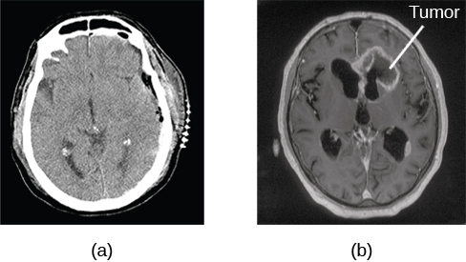
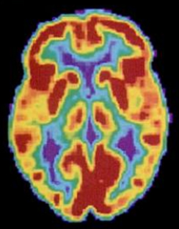
Radiation
Computerized tomography
Positron emission tomography
HAWKES LEARNING
Notes:
The techniques that use radiation include the computerized tomography (CT) and positron emission tomography (PET) scans. The CT scan depicts an x-ray of the brain, whereas a PET scan can show which areas are more active at a given time.

Slide 20
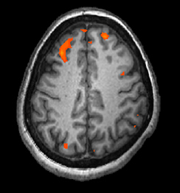
Magnetic Fields
Magnetic resonance imaging
Functional magnetic resonance imaging
HAWKES LEARNING
Notes:
The techniques that use magnetic fields include magnetic resonance imaging (MRI) and functional magnetic resonance imaging (fMRI). Similar to our radioactive scans, the MRI shows x-ray images, whereas the fMRI shows activity.

Slide 21
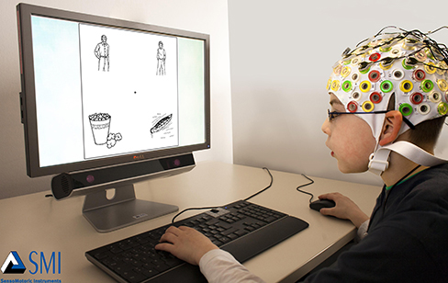
Electrical Activity
HAWKES LEARNING
Notes:
Finally, the electroencephalogram monitors the brain’s electrical activity using an array of electrodes placed on the head. Brain waves are then recorded, allowing researchers to see the frequency and amplitude of different wave forms.

Slide 22




HAWKES LEARNING

