Slide 1
HAWKES LEARNING
The Endocrine System
Introduction to Psychology
Notes:
The endocrine system consists of a series of glands that produce chemicals known as hormones.

Slide 2



Hormones
Slower acting
Longer lasting
HAWKES LEARNING
Notes:
You have likely heard of hormones as related to developmental changes, like puberty. Hormones are like neurotransmitters–they are chemical messengers that bind to receptors like a lock-and-key relationship. Unlike neurotransmitters, though, their action can be far reaching within the body because they are released into the bloodstream. For these reasons, hormones are slower acting but longer lasting.

Slide 3
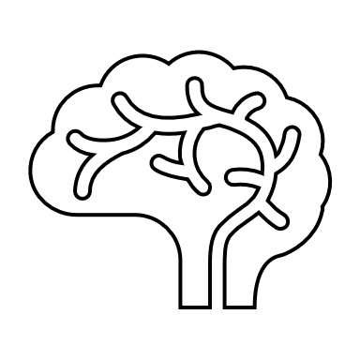
Hormones
Hypothalamus
Pituitary Gland
Hormonal action
HAWKES LEARNING
Notes:
Hormones regulate a great number of bodily functions and are triggered by action from the hypothalamus and the pituitary gland.

Slide 4


Pituitary Gland
Master gland
HAWKES LEARNING
Notes:
The pituitary gland is known as the “master gland” because it controls all endocrine glands. It secretes several hormones including growth hormone, endorphins, and hormones that regulate fluid levels.

Slide 5





Thyroid Gland
Metabolism
HAWKES LEARNING
Notes:
The thyroid gland helps to regulate growth, metabolism, and appetite. Too much or too little of a hormone called thyroxine can lead to severe issues such as Grave’s disease and hypothyroidism.

Slide 6

Adrenal Glands
Epinephrine
Norepinephrine
HAWKES LEARNING
Notes:
The adrenal glands help with the stress response by releasing epinephrine (adrenalin) and norepinephrine (noradrenalin).

Slide 7




Pancreas
Insulin
Glucagon
HAWKES LEARNING
Notes:
The pancreas helps to regulate blood sugar via insulin and glucagon. Individuals who do not make enough insulin have diabetes.

Slide 8




Gonads
Ovaries
Testes
Estrogens
Testosterone
Progesterone
HAWKES LEARNING
Notes:
Finally, the gonads secrete sexual hormones that are important for sexual development and reproduction. Ovaries produce estrogens and progesterone, whereas testes secrete testosterone.

Slide 9




HAWKES LEARNING

