Slide 1
HAWKES LEARNING
What is Consciousness?
Notes:
You may have wondered what is consciousness?

Slide 2






Consciousness
Internal
External
HAWKES LEARNING
Notes:
Consciousness describes our awareness of internal and external stimuli. Internal might be pain, feelings of thirst, or thoughts. External could be lights, sounds, and temperature.

Slide 3



Consciousness
Fully aware
Deep sleep
HAWKES LEARNING
Notes:
Consciousness can be thought of as a continuum from full awareness to deep sleep with different levels of awareness in between. When you space out or daydream, these would be considered different levels of awareness.

Slide 4



Biological Rhythms
Z
Z
Z
28 days
24 hours
Circadian
HAWKES LEARNING
Notes:
Like many other psychological phenomenon, much of consciousness is rooted in our biology. Biological rhythms are internal patterns of biological activity. For example, a woman’s menstrual cycle fluctuates over a period of 28 days. Body temperature fluctuates over a 24 hour period, making it a circadian, or about a day, rhythm. Our sleep wake cycle is another circadian rhythm.

Slide 5
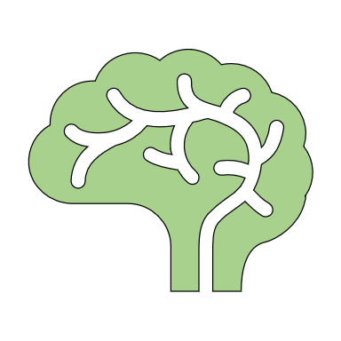

Internal Clock
Hypothalamus
Thalamus
?
Pineal gland
Suprachiasmatic nucleus (SCN)
Pituitary gland
Pons
HAWKES LEARNING
Notes:
The presence of our sleep-wake circadian rhythm leads researchers to wonder if people have an internal clock that indicates when we should sleep and be awake. It turns out we do have a clock, and it is located within the hypothalamus in an area known as the suprachiasmatic nucleus or SCN for short. The axons of light-sensitive neurons provide information to this area regarding how much light is present in the outside world.

Slide 6


Synchrony
Z
Z
Z
HAWKES LEARNING
Notes:
For most people, our circadian rhythms match with the outside world – we are awake during the day and asleep at night. The pineal gland releases melatonin which helps to regulate our biological rhythms by indicating the presence of night.

Slide 7

Asynchrony
Fatigue
Sluggish
Irritable
Insomnia
HAWKES LEARNING
Notes:
Sometimes, however, a person’s circadian rhythm can get out of synchrony with the outside world. When someone travels across time zones he or she may experience jet lag—feelings of fatigue, sluggishness, irritability, and insomnia. People who work rotating shifts may also have difficulties.

Slide 8
Sleep Debt
Decreased
- Alertness
- Mental
Efficiency
HAWKES LEARNING
Notes:
When a person does not get sleep on a consistent basis, the person can build up a sleep debt. The consequences of a sleep debt include decreased levels of alertness and mental efficiency.

Slide 9



Recommendations
7 to 9 hours
18+ hours
HAWKES LEARNING
Notes:
The National sleep foundation suggests 7 to 9 hours of sleep for adults. In comparison, newborn babies may sleep for 18 hours!

Slide 10




HAWKES LEARNING

