Slide 1
HAWKES LEARNING
Sleep and Why We Sleep
Notes:
We spend approximately a third of our lives sleeping. Given how much we could accomplish during that time, sleep must be important! Why do we sleep so much? Is it essential?

Slide 2

What is Sleep?
HAWKES LEARNING
Notes:
Sleep is reduced sensory awareness and low levels of physical activity. The importance of sleep is demonstrated when we do not get enough. When next given a chance to sleep, we fall asleep quicker, an experience known as sleep rebound.

Slide 3


Brain Areas
Thalamus
Relay station
Hypothalamus
Pons
HAWKES LEARNING
Notes:
Sleep-wake cycles seem to be controlled by multiple brain areas such as the thalamus, the hypothalamus which contains the suprachiasmatic nucleus which is the body’s biological clock, and the pons which helps to regulate rapid eye movement.

Slide 4
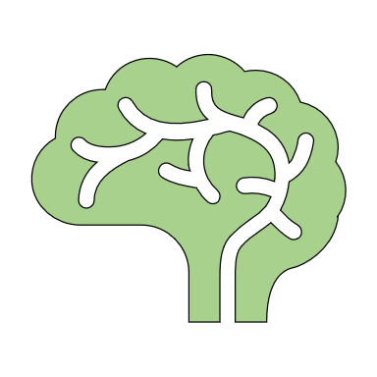
Hormones
Hypothalamus
Thalamus
Pineal gland
Suprachiasmatic nucleus (SCN)
Pituitary gland
Pons
HAWKES LEARNING
Notes:
Sleep is also associated with the secretion of a variety of different hormones, including melatonin from the pineal gland and follicle stimulating hormone, luteinizing hormone, and growth hormone all from the pituitary.

Slide 5
Why Sleep?
?
Z
Z
Z
HAWKES LEARNING
Notes:
Why do we sleep? There are several hypotheses that attempt to explain why.

Slide 6



Adaptive Function
Energy
HAWKES LEARNING
Notes:
The first is the adaptive function of sleep hypothesis which suggests that sleep is essential to restore resources that are expended during the day. There is, however little research to support this explanation. Short period of inactivity and rest may be enough to restore these resources.

Slide 7



Predation
Sleep less!
HAWKES LEARNING
Notes:
Another hypothesis holds that our sleep patterns evolved as adaptive responses to predatory risks which increase at night. Thus, we sleep and keep ourselves safe. However, some research shows that prey animals tend to sleep LESS than predators!

Slide 8



Benefits
Motor function
HAWKES LEARNING
Notes:
Although we do not know exactly we sleep, we do know there are benefits, including maintaining a healthy weight, lowering stress levels, improving mood, increasing motor coordination, and increasing cognitive functioning.

Slide 9


Cognitive Impact
Attention!
HAWKES LEARNING
Notes:
A final theory about sleep involves sleep’s importance to cognitive function and memory formation. Sleep deprivation results in disruptions in cognition and memory, leading to difficulties with attention, making decisions, and recalling long-term memories. As the sleep deprivation continues, the cognitive impacts worsen.

Slide 10

Benefits to Cognition
Slow Wave Sleep
HAWKES LEARNING
Notes:
Research has also shown that slow wave sleep after learning can improve later performance of that task. Therefore, sleep appears to be important for cognitive functioning.

Slide 11




HAWKES LEARNING

