Slide 1
HAWKES LEARNING
Stages of Sleep
Notes:
Sleep is composed of several different stages that can be differentiated from one another by patterns of brain wave activity. In general, sleep can be divided into two different phases: REM sleep and non-REM sleep. We will discuss the non-REM stages of sleep first.

Slide 2

Stages of Non-REM
4 stages
HAWKES LEARNING
Notes:
There are four stages of non-REM sleep.

Slide 3

Stage 1
Z
Z
Z
HAWKES LEARNING
Notes:
The first stage is Stage 1 which is a transitional phase between wakefulness and sleep. Here we drift off to sleep or rest our eyes. During this stage it is relatively easy to wake someone up and they will report not having been asleep. In terms of brain wave activity, stage 1 contains both alpha and theta waves.

Slide 4
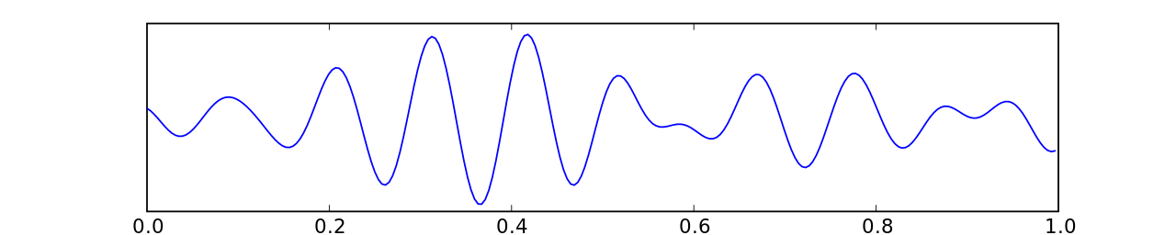
Alpha Waves
This Photo by Unknown Author is licensed under CC BY-SA
Low frequency
High amplitude
HAWKES LEARNING
Notes:
Alpha waves are low frequency, high amplitude waves that resemble someone who is relaxed but awake.

Slide 5

Theta Waves
This Photo by Unknown Author is licensed under CC BY-SA
Even lower frequency
Even higher amplitude
HAWKES LEARNING
Notes:
Theta waves are even lower frequency higher amplitude brain waves.

Slide 6
Stage 2
DEEP RELAXATION
HAWKES LEARNING
Notes:
Stage 2 sleep involves a state of deep relaxation. Theta waves continue but are now interrupted by sleep spindles and K complexes.

Slide 7
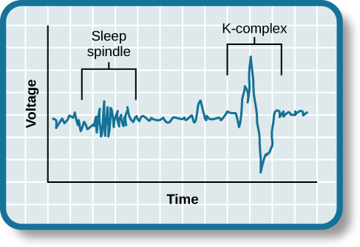
Sleep Spindles
This Photo by Unknown Author is licensed under CC BY
HAWKES LEARNING
Notes:
A sleep spindle is a rapid burst of higher frequency brain waves that may be important for learning and memory.

Slide 8
K Complexes
This Photo by Unknown Author is licensed under CC BY
HAWKES LEARNING
Notes:
K-complexes include high amplitude brain activity that occurs in response to environmental stimuli. These may function to allow the individual to remain asleep.

Slide 9
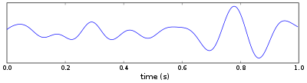


Stage 3 and 4
This Photo by Unknown Author is licensed under CC BY-SA
Deep or slow wave sleep
HAWKES LEARNING
Notes:
Stage 3 and Stage 4 are characterized as deep, or slow wave, sleep because they have low frequency, high amplitude delta waves. It is much more difficult to wake someone up during this stage, and the person’s heart rate and respiration slows.

Slide 10
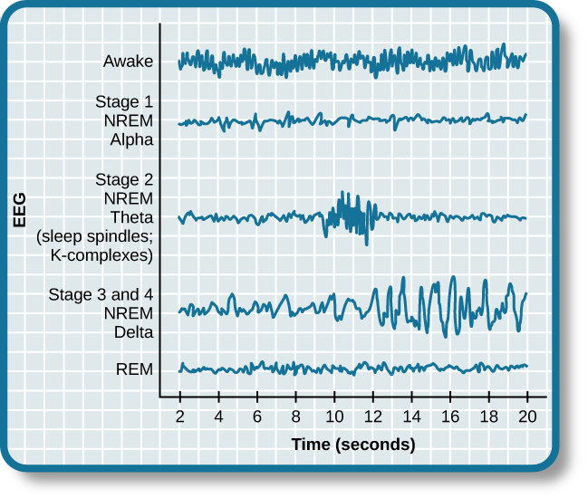
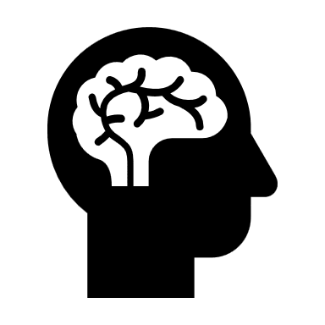
REM Sleep
Activity
This Photo by Unknown Author is licensed under CC BY
HAWKES LEARNING
Notes:
In contrast to non-REM sleep, REM, or rapid eye movement sleep, involves brain waves that are similar to when a person is awake. This is also the time during sleep when dreams occur. Oddly, individuals are paralyzed during this period which seems paradoxical – high brain activity and low physical activity.

Slide 11

REM Importance
REM sleep
REM
HAWKES LEARNING
Notes:
REM sleep appears to be important to our functioning. In fact, if someone is deprived of REM sleep, they will spend more time in REM when finally allowed to sleep again. This phenomenon is known as REM rebound.

Slide 12







Dreams
Notes:
What are dreams and why do we have them? Various researchers have tried to explain why.

Slide 13


Sigmund Freud
Manifest Content
Latent Content
HAWKES LEARNING
Notes:
For instance, Sigmund Freud was convinced that dreams represented an opportunity to gain access to the unconscious. Specifically, Freud made distinctions between the manifest content, or the actual storyline, versus the latent content, or the hidden meaning, of dreams.

Slide 14


Carl Jung
Mother archetype
HERO!
HAWKES LEARNING
Notes:
In contrast, Carl Jung felt dreams allowed us to tap into the collective unconscious which was a repository of universal archetypes shared by everyone.

Slide 15





Rosalind Cartwright
HAWKES LEARNING
Notes:
Rosalind Cartwright believed that dreams simply reflect life events that are important to the dreamer. For example, if you received a promotion at work, you might dream about it.

Slide 16


John Hobson
Lucid Dreaming
HAWKES LEARNING
Notes:
Finally, John Hobson suggested that dreaming involves constructing a virtual reality in our heads that we might use to help us during wakefulness. He felt that lucid dreaming, or dreams where people become aware they are dreaming and are able to control some of the outcomes, are the key to better understanding dreams.

Slide 17




HAWKES LEARNING

