Slide 1
HAWKES LEARNING
Sleep Problems and Disorders
Notes:
For many of us, sleep isn’t easy. There are several kinds of sleep disturbances, and they can affect not only the person experiencing them, but others too.

Slide 2

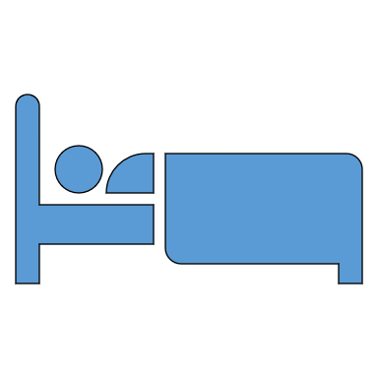
Insomnia
Z
Z
Z
Z
Z
HAWKES LEARNING
Notes:
One issue with sleep is experiencing insomnia, which is a consistent difficulty in falling or staying asleep. Everyone has the occasional bout of insomnia, but it becomes problematic when it happens consistently.

Slide 3





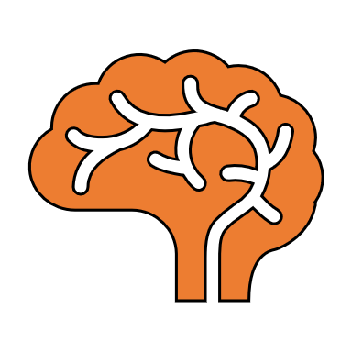
Causes of Insomnia
AGE
Routines
HAWKES LEARNING
Notes:
What causes insomnia? There are a host of possibilities including age, drug use, exercise, mental status, and bedtime routines.

Slide 4





Treatments for Insomnia
Medication
HAWKES LEARNING
Notes:
How can one overcome insomnia? Some people increase their physical activity during the other. Others use over the counter medications to help them sleep. Others will engage in cognitive behavior therapy in which a therapist helps them to change sleep related behaviors in hopes of reducing bouts of insomnia.

Slide 5


Parasomnias
HAWKES LEARNING
Notes:
Parasomnias refers to a group of sleep disorders in which unwanted, disruptive motor activities or experiences occur.

Slide 6




Sleepwalking
Z
Z
Z
Z
HAWKES LEARNING
Notes:
One example of a parasomnia is sleep walking. Here, the sleeper engages in relatively complex behavior ranging from wandering to driving a car to cooking a meal. The sleepers usually have their eyes open but are unresponsive.

Slide 7
REM Sleep Behavior Disorder
Kick
Punch
No sleep paralysis
Scratch
Yell
HAWKES LEARNING
Notes:
REM sleep behavior disorder occurs when the typical paralysis during sleep does not occur. These individuals have high levels of physical activity during REM, sometimes kicking, punching, scratching, yelling, or behaving as frightened or attacked.

Slide 8



Restless Leg Syndrome
HAWKES LEARNING
Notes:
Restless leg syndrome involves uncomfortable sensations in the legs during periods of inactivity or when trying to fall asleep. These sensations are improved if the person moves the legs, which can disrupt the ability to sleep.

Slide 9

Night Terrors
Panic
HAWKES LEARNING
Notes:
Night terrors result in a sense of panic and are often accompanied by screams during non-REM sleep. The sleeper usually is unaware that night terrors occurred, as the person falls back asleep quickly.

Slide 10
Sleep Apnea
No breathing
Obstructive
Central
CPAP device
HAWKES LEARNING
Notes:
Another issue with sleep is sleep apnea which is when the sleeper stops breathing at night. This cessation of breathing can be obstructive, meaning that the airway becomes blocked, or central, meaning that the brain signals are disrupted, resulting in disrupted breathing.
The most common treatment is to fit the patient with a continuous positive airway pressure (CPAP) device that forces air into the airways to keep them open.

Slide 11

Sudden Infant Death Syndrome
Prematurity
Hyperthermia
HAWKES LEARNING
Notes:
Sudden infant death syndrome (SIDS) occurs when an infant younger than 12 months of age stops breathing and dies during sleep. Risk factors include being a boy, premature birth, smoking in the home, and hyperthermia. Parents are advised to keep the crib free of blankets and other items that may contribute to SIDS.

Slide 12



Narcolepsy
Sleep at inopportune times
Cataplexy
Hypocretin
STRESS
HAWKES LEARNING
Notes:
Finally, narcolepsy involves falling asleep at inopportune times, without control. It can be associated with cataplexy which mirrors paralysis. These episodes are usually triggered by stressful events and are a result of a lack of a substance called hypocretin.

Slide 13




HAWKES LEARNING

