Slide 1
HAWKES LEARNING
Substance Use and Abuse
Notes:
Some people use drugs and other substances that result in altered states of consciousness.

Slide 2

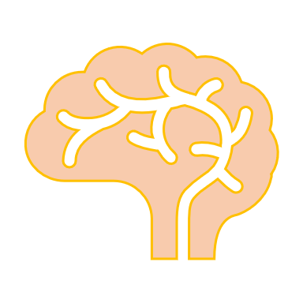


Substance Use Disorder
Addictive Disorders
DSM
HAWKES LEARNING
Notes:
A book called the Diagnostic and Statistical Manual of Mental Disorders (5th edition) is used to diagnose individuals who suffer from a variety of psychological disorders. Drug use disorders are considered addictive disorders with specific criteria.

Slide 3



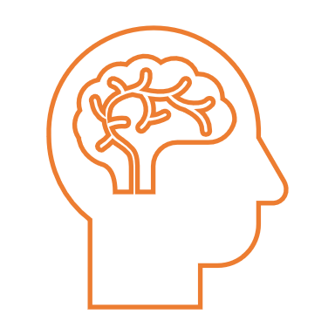
Criteria
Uses more than intended
Continues use despite negative consequences
Compulsive patterns of use
Physical and psychological dependence
HAWKES LEARNING
Notes:
Specifically, the criteria include that the person uses more of the substance than intended, continues to use despite negative consequences, shows compulsive patterns of use, and experiences physical and psychological dependence.

Slide 4
Dependence
HAWKES LEARNING
Notes:
Dependence means that the person has a need of the drug. Physical dependence causes changes in bodily functions whereas psychological dependence is emotional need for the drug.

Slide 5
Tolerance
time
Adaptation
HAWKES LEARNING
Notes:
Tolerance and withdrawal are also important to understand. Tolerance means that the person will need more of the drug to get the same effects as the body becomes adapted to the presence of the drug.

Slide 6


Withdrawal
HAWKES LEARNING
Notes:
That same adaptation results in withdrawal feelings when someone does not use. The body is prepared for the drug so it counteracts the impacts it assumes are coming. If coffee makes you alert, your body will counteract by making you feel sluggish in preparation for your coffee intake.

Slide 7
Drugs and Drug Categories
AGONISTS
ANTAGONISTS
NT
NT
HAWKES LEARNING
Notes:
There are different categories of drugs but they all interact with our neurotransmitter systems. Drugs are either considered agonists or antagonists. Agonists increase the likelihood of neurotransmitter activity whereas antagonists decrease the likelihood of neurotransmitter activity. Let’s look at the different classes of drugs.

Slide 8

Depressants
Ethanol
Barbiturates
Benzodiazepines
HAWKES LEARNING
Notes:
Depressants suppress central nervous system activity and include ethanol (or alcohol), barbiturates, and benzodiazepines. These substances work as agonists to gamma aminobutyric acid (GABA), which has a calming effect in the brain.

Slide 9





Ethanol / Alcohol
Low Doses
Excessive Doses
Z
Z
Z
?
HAWKES LEARNING
Notes:
Alcohol, specifically, can have different effects depending on dosage. At low doses, people feel sedated, their reaction time slows, they feel less alert, and they do things they might not otherwise do, like call exes. At excessive doses, individuals may lose consciousness entirely and have difficulty remembering what happened.

Slide 10
Stimulants
Cocaine
Amphetamines
MDMA
Nicotine
Caffeine
Dopamine
Reward and Craving
HAWKES LEARNING
Notes:
Stimulants, including cocaine, amphetamines, MDMA, nicotine, and caffeine, increase overall levels of neural activity. Many acts as agonists for dopamine which is associated with reward and craving. Repeated use of stimulants can lead to overall increases in dopamine, norepinephrine, and serotonin.

Slide 11




Stimulants
Nausea
Euphoric highs
Anxiety
HAWKES LEARNING
Notes:
Individuals who use cocaine, amphetamines, and MDMA experience euphoric highs. Negative consequences include nausea, increased blood pressure and heart rate, anxiety, hallucinations, and paranoia.

Slide 12

Caffeine
Adenosine
Arousal
HAWKES LEARNING
Notes:
Caffeine is a stimulant drug that is widely used to maintain alertness and arousal whose primary mechanism is antagonizing adenosine activity. Some negative consequences of caffeine include insomnia, agitation, nausea, and irregular heartbeat.

Slide 13

Nicotine
Stroke
Cancer
Acetylcholine
HAWKES LEARNING
Notes:
Nicotine is another stimulant; this one is highly addictive and associated with increased risk of heart disease, stroke, and cancers. Nicotine is an agonist for acetylcholine receptors.

Slide 14
Opioids
Heroin
Morphine
Methadone
Codeine
PAIN
HAWKES LEARNING
Notes:
Opioids include heroin, morphine, methadone, and codeine and they have analgesic or pain-reducing effects. In cases where individuals are withdrawing from opioids, these people may be provided with methadone which is a synthetic opioid that is less euphoric. Use of this substances makes quitting opioid use more tolerable.

Slide 15





Hallucinogens
Serotonin
Mescaline
LSD
Glutamate
PCP
Ketamine
HAWKES LEARNING
Notes:
Taking hallucinogens results in profound alternations in sensory and perceptual experiences, such as vivid hallucinations. Some agonize serotonin (mescaline and LSD) and others antagonize glutamate (PCP and ketamine).

Slide 16




HAWKES LEARNING

