Slide 1
HAWKES LEARNING
Other Stages of Consciousness
Notes:
States of consciousness can vary from fully awake to fully asleep and various stages in between. Here we consider hypnosis and meditation.

Slide 2

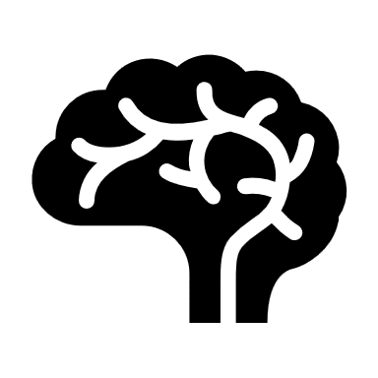
Hypnosis
Hypnotherapy
HAWKES LEARNING
Notes:
Hypnosis is a state of extreme self-focus and attention where minimal attention is given to outside stimuli. Hypnosis has been used in a variety of ways, such as to alter people’s thoughts and perceptions, to help with memory, and to provide therapeutic assistance. Contrary to popular belief, people undergoing hypnosis usually have memories of the experience and have control over their behaviors.

Slide 3


Hypnosis
Focus
Comfort
Imagine
Open
HAWKES LEARNING
Notes:
The four components that appear necessary to induce hypnosis are: focusing on one thing, being comfortable, being open to the therapist and the experience, and using imagination.

Slide 4



Hypnosis
Pain
HAWKES LEARNING
Notes:
Hypnosis has been shown to be at least somewhat effective for pain management, depression and anxiety, smoking cessation and weight loss.

Slide 5
Theories of Hypnosis
Dissociation Theory
Social-Cognitive Theory
PAIN
HAWKES LEARNING
Notes:
How does hypnosis work? There are two different theories that attempt to answer this question.
Dissociation theory states that hypnosis is a disassociated state of consciousness, pulling the person’s attention elsewhere which would be beneficial in cases of pain management.
The other theory is the social-cognitive theory that suggests people are performing the social role of a hypnotized person.

Slide 6

Meditation
This Photo by Unknown Author is licensed under CC BY-NC
HAWKES LEARNING
Notes:
On the other hand, meditation is another form of altered consciousness which involves the act of focusing on a single target, such as the breath or a repeated sound to increase awareness in the moment.

Slide 7





Meditation
Temper
Clarity
HAWKES LEARNING
Notes:
Meditation can be performed alone in which a person clears his or her mind to achieve relaxation and focus. Health benefits of meditation include reductions in temper, depression, and stress, as well as increases in relaxation and clarity.

Slide 8




HAWKES LEARNING

