Slide 1
HAWKES LEARNING
Sensation versus Perception
Introduction to Psychology
Notes:
We have a variety of different senses that allow us to experience the world.

Slide 2
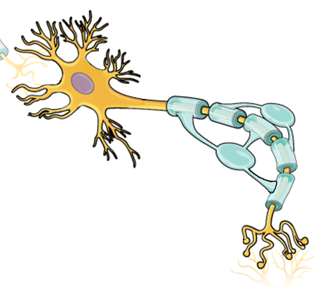







Sensation
Sensation
Absolute Threshold
Transduction
Difference Threshold
HAWKES LEARNING
Notes:
It is important to note that sensation differs from perception.

Slide 3
Sensation
Transduction
HAWKES LEARNING
Notes:
Sensation results when our sensory neurons relay information to the brain in the form of action potentials. For example, our eyes share information about light with the brain through action potentials. This conversion is known as transduction.

Slide 4
Absolute Threshold
HAWKES LEARNING
Notes:
Whether we can detect a stimulus depends on our absolute threshold, or the minimum amount of stimulus energy that must be present for the stimulus to be detected half of the time. Another way to think about this is by asking how dim can a light be or how soft can a sound be and still be detected half of the time.

Slide 5
Difference Threshold
HAWKES LEARNING
Notes:
Sometimes we are interested in how much difference in stimulus intensity is required to see a difference, known as the just noticeable difference or difference threshold. For example, you would probably notice a cell phone screen illuminating in a dark movie theater but not at a park on a sunny day. The background contrast and the stimulus intensity can influence our perception.

Slide 6









Perception
Motivation
Inattentional Blindness
Habituation
Signal Detection
HAWKES LEARNING
Notes:
These descriptions of sensations differ from the experience of perception. Perception is the way sensory information is organized, interpreted, and consciously experienced. For example, you may see an array of colors, edges, contours, and shapes, but your perception is your friend, Jim.

Slide 7
Habituation
HAWKES LEARNING
Notes:
Sensation doesn’t always equal perception. For example, we often experience things in our environments that we begin to consciously ignore. Have you ever been around someone with strong perfume? Eventually, you don’t smell it anymore. In truth, your sense receptors still pick up the smell, but your brain is no longer perceiving it.

Slide 8
Inattentional Blindness
HAWKES LEARNING
Notes:
In addition, we often don’t pay attention to stimuli in the environment to perceive it. We have a tendency to engage in a process called inattentional blindness, where we do not see something in our environment that is completely visible. Have you ever watched a movie and noticed an error? Most people don’t see the majority of these errors! But sometimes scars change sides of a person’s face or lamps that were previously broken in another scene are present again later.

Slide 9
Motivation
HAWKES LEARNING
Notes:
Motivation can also influence our perceptions. Have you ever waited impatiently for an important text, and you swear you felt your phone vibrate, and there was no call? In this case, your desire for a situation resulted in perceiving a stimulus that was not actually there.

Slide 10
Signal Detection
HAWKES LEARNING
Notes:
In a reverse situation, we are sometimes better able to pick up certain stimuli over others, such as hearing a child’s cry over disruptive background noise. This signal detection can explain why people are hypersensitive to certain stimuli over others.

Slide 11



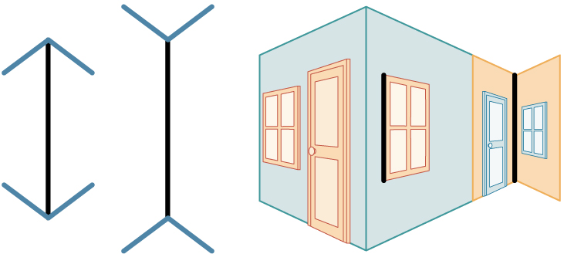
Influences on Perception
Beliefs
Values
Prejudices
Expectations
Experiences
Experiences
HAWKES LEARNING
Notes:
Our perceptions can also be influenced by beliefs, values, prejudices, expectations, and life experiences.

Slide 12
Experiences
HAWKES LEARNING
Notes:
In an interesting study that compared people who live in Western culture versus individuals from South Africa, demonstrated that western individuals are more susceptible to the Müller-Lyer illusion, which applies more to our type of environment–filled with straight-lined buildings, compared to round huts for South Africa.

Slide 13




HAWKES LEARNING

