Slide 1
HAWKES LEARNING
Waves and Wavelengths
Introduction to Psychology
Notes:
Visual and auditory stimuli both occur in the form of waves. In order to understand these senses, it is important to first understand properties of those waves.

Slide 2
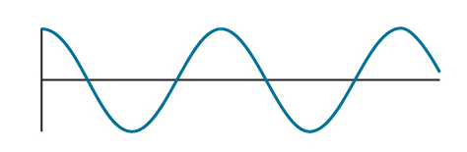
Characteristics of Waves
Amplitude
Wavelength
HAWKES LEARNING
Notes:
Two physical characteristics of waves are amplitude, or the height of the wave, and wavelength, the distance from one peak to the next. Wavelength indicates the frequency of the wave.

Slide 3





Light Waves
HAWKES LEARNING
Notes:
There are a variety of light waves in the spectrum, but humans are only able to see a small fraction. The frequency of the waves determines the color we see. Reds are formed from longer wavelengths, whereas blues are formed from shorter ones.

Slide 4








Light Waves
HAWKES LEARNING
Notes:
The amplitude of the light waves indicates how bright the color is; dimmer colors have lower amplitude waves, and brighter colors having higher amplitude waves.

Slide 5


Sound Waves
Low Pitch
High Pitch
HAWKES LEARNING
Notes:
For sound, the frequency of the wave is associated with the sound’s pitch. High-pitch sounds have high frequency and low-pitch sounds have low frequency.

Slide 6






Sound Waves
HAWKES LEARNING
Notes:
The loudness of a sound is determined by the amplitude of the wave and is measured in decibels. A typical conversation might be around 60 dB whereas a rock concert might be 120 dB. Damage to hearing can occur past 80 dB, and the threshold for pain is approximately 130 dB.

Slide 7
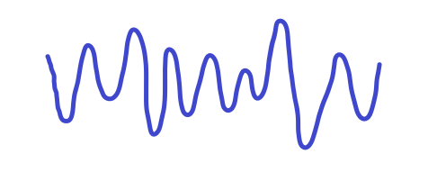
Sound Waves
HAWKES LEARNING
Notes:
Sounds have another quality, timbre, which refers to a sound’s purity. Timbre is how different instruments can all play the same note but sound uniquely different.

Slide 8




HAWKES LEARNING

