Slide 1
HAWKES LEARNING
Vision
Introduction to Psychology
Notes:
We are able to use our vision to help create mental representations of the world around us. In order to understand how vision works, we must first understand the components of the eye.

Slide 2

Structure of the Eye
Pupil
Iris
HAWKES LEARNING
Notes:
In order to see, light waves enter the eye via the pupil, which can dilate, or open, or constrict, or close, depending on the iris’s movements.

Slide 3
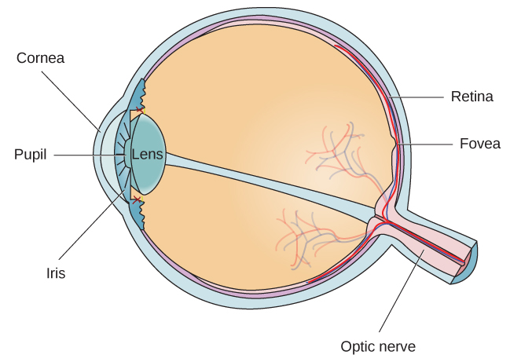

Structure of the Eye
HAWKES LEARNING
Notes:
After entering through the pupil, light crosses the lens, which helps focus the light onto the back of the eye where the fovea is located. The fovea is part of the light-sensitive retina that lines the back of the eye and contains photoreceptors.

Slide 4
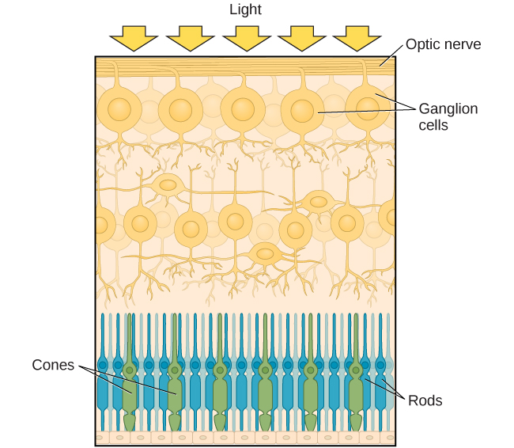



Photoreceptors
Cones
Rods
Fovea
Bright light
Fine detail
Processes color
Periphery
Low light
Movement
Monochromatic
Rods and Cones
HAWKES LEARNING
Notes:
Photoreceptors come in two varieties: cones and rods.

Slide 5
Cones
Fovea
Bright light
Fine detail
Processes color
HAWKES LEARNING
Notes:
Cones, found predominantly in the fovea, respond to brightly lit conditions, help with perception of fine detail, and provide processing of colors.

Slide 6
Rods
Periphery
Low light
Movement
Monochromatic
HAWKES LEARNING
Notes:
In contrast, rods are found predominantly in the periphery of the retina, respond to low light levels, and help with deciphering movement and monochromatic conditions.

Slide 7
Rods and Cones
HAWKES LEARNING
Notes:
These photoreceptors help you to see in a variety of conditions. For instance, when in the brightly lit lobby of a movie theater, your cones allow you to see the bright conditions and the colors therein. However, upon walking into the already darkened theater, you will want your rods to hurry up and become adjusted so that you don’t accidentally sit on a stranger’s lap in the dark.

Slide 8
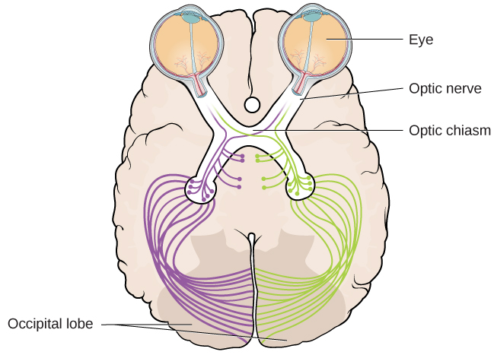
Visual Pathway
HAWKES LEARNING
Notes:
Once the photoreceptors process light, they send information from the eyes to the brain via the optic nerves that exit out of the back of each eye. The optic nerves cross at the optic chiasm, which is where information gets sorted into the left and right visual fields.

Slide 9
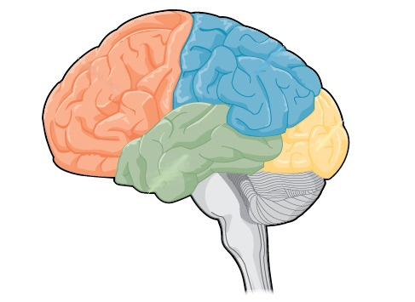

Visual Pathway
Where?
What?
HAWKES LEARNING
Notes:
Once the information arrives at the occipital lobe, the visual information will be processed via a “what” pathway and a “where” pathway, which helps identify both the identity of the object and where it is located. These pathways allow you to identify your phone and locate it when it rings.

Slide 10
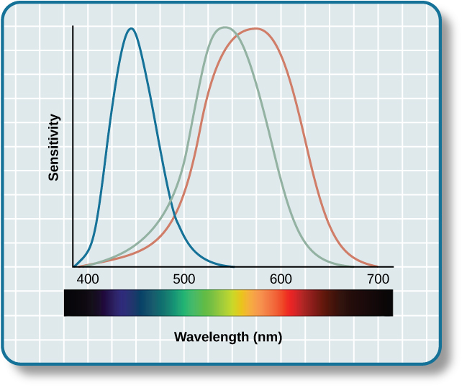



Color Vision
Trichromatic Color Theory
Opponent-Processing Theory
Afterimages
Stimulus On
Stare here!
Then look here!
HAWKES LEARNING
Notes:
In order to see color, we have two processes at work. The first is the trichromatic theory of color vision, and the other is opponent-processing.

Slide 11
Trichromatic Color Theory
HAWKES LEARNING
Notes:
According to the trichromatic, or three colors, theory of color vision, we are able to see a multitude of different colors that are combinations of activity of three different cones. These cones each respond to a specific wavelength of light and, as a result, process red, blue, or green. Combinations of activity of these cones can create experiences of other colors in the spectrum.

Slide 12
Opponent-Processing Theory
Stimulus On
HAWKES LEARNING
Notes:
In opponent-processing theory, color is coded in opponent pairs: black–white, red–green, and yellow–blue. The idea is that some cells are activated by one of the colors and inhibited by the other. For example, a cell might become excited to red but inhibited by green.

Slide 13
Afterimage
Stare here!
Then look here!
HAWKES LEARNING
Notes:
As a result, we do not see greenish reds or yellowish blues. Also, we can experience negative afterimages. If you stare at something red and then shift your eyes to a white surface, you will see a green afterimage!

Slide 14



Depth Perception
Binocular Cues
Monocular Cues
Linear Perspective
HAWKES LEARNING
Notes:
We also have the ability to perceive depth, which is created by binocular and monocular cues.

Slide 15
Binocular Cues
HAWKES LEARNING
Notes:
A binocular cue is a cue that uses information from both eyes. For example, objects that are close to your face create different images on your left versus your right eye, a phenomenon called binocular disparity. The degree of difference allows your brain to process how far something is away from you.

Slide 16
Monocular Cues
Linear Perspective
HAWKES LEARNING
Notes:
A monocular cue is one that uses information from only one eye. For example, linear perspective refers to the suggestion of distance when two parallel lines converge to a point in the distance. These cues allow us to see depth in 2D images.

Slide 17




HAWKES LEARNING

