Slide 1
HAWKES LEARNING
Hearing
Introduction to Psychology
Notes:
Our auditory system allows us to hear the myriad of sounds around us, from sounds of nature to the voice of our best friends. In order to understand how hearing works, we must first understand the anatomy of the auditory system.

Slide 2
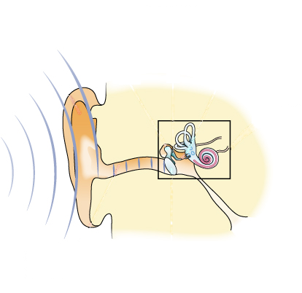
Structure of the Ear
The Outer Ear
The Middle Ear
Tympanic membrane
Pinna
The Inner Ear
Ossicles
Auditory canal
Semi-circular canals
Cochlea
HAWKES LEARNING
Notes:
The ear can be separated into three different sections: the outer, the middle, and the inner ear.

Slide 3
The Outer Ear
Tympanic membrane
Pinna
Auditory canal
HAWKES LEARNING
Notes:
The outer ear includes the pinna, or the visible part of our ear, the auditory canal, and the tympanic membrane or ear drum.

Slide 4
The Middle Ear
Ossicles
HAWKES LEARNING
Notes:
The middle ear contains three tiny bones, the malleus, the incus, and the stapes, which are collectively referred to as the ossicles.

Slide 5
The Inner Ear
Semi-circular canals
Cochlea
HAWKES LEARNING
Notes:
The inner ear contains the semi-circular canals, which are involved in balance and movement, and the cochlea. The cochlea is a fluid-filled snail-shaped structure that contains the sensory receptor cells.

Slide 6

Auditory Pathway
HAWKES LEARNING
Notes:
Sound enters the auditory canal and causes the tympanic membrane to vibrate which, in turn, causes the ossicles to vibrate, amplifying the sound. The stapes presses against the opening to the cochlea, the oval window, and causes the fluid inside the cochlea to move. These movements stimulate hair cells on the basilar membrane which then transduce this information into action potentials.

Slide 7
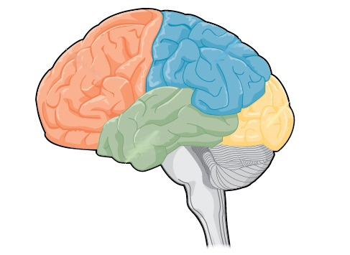
Auditory Pathway
Action Potentials
Thalamus
HAWKES LEARNING
Notes:
Once action potentials have been generated, this information passes to other areas of the brain including the thalamus and the auditory cortex located in the temporal lobes. Processing in these areas helps us to determine what a sound is and where it is located.

Slide 8


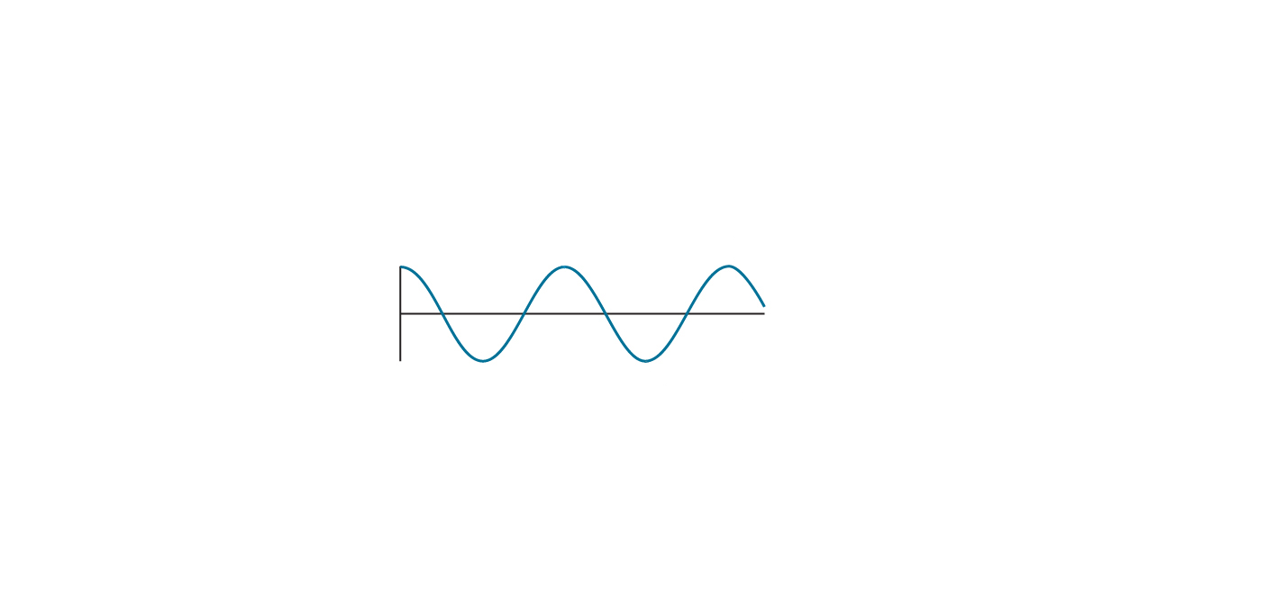
Pitch Perception
Temporal Theory
Place Theory
Cell A
Cell B
Lower frequencies
Higher frequencies
HAWKES LEARNING
Notes:
High frequency sounds are perceived as high pitch, whereas low frequency sounds are perceived as low pitch. There are two theories, temporal theory and place theory, to explain why we hear sounds as either higher or lower in pitch.

Slide 9
Temporal Theory
Cell A
Cell B
HAWKES LEARNING
Notes:
The temporal theory asserts that frequency is coded by the activity level of the sensory neuron. For example, if Cell A responds to higher pitched sounds, cell A would fire more in presence of high frequency waves. In contrast, Cell B that responds to lower pitches would fire more in presence of low frequency waves.

Slide 10
Place Theory
Higher frequencies
Lower frequencies
HAWKES LEARNING
Notes:
The other theory, place theory, suggests that different portions of the basilar membrane are sensitive to sounds of different frequencies. Specifically, the base responds best to high frequencies and the tip to low frequencies.

Slide 11
Pitch Perception
Temporal Theory
Place Theory
Cell A
Cell B
Lower frequencies
Higher frequencies
HAWKES LEARNING
Notes:
As with vision, both theories probably work together to help us hear sounds of different pitches.

Slide 12



Sound Localization
Monaural Cues
Binaural Cues
Interaural Level Difference
Binaural Cues
Interaural Timing Difference
HAWKES LEARNING
Notes:
In order to localize sound, we use monaural and binaural cues.

Slide 13
Monaural Cues
HAWKES LEARNING
Notes:
For instance, monaural cues to each ear are the same if the sound is in front, behind, above, or below us.

Slide 14
Binaural Cues
Interaural Level Difference
HAWKES LEARNING
Notes:
Binaural cues, however, help us locate items that are off center. For example, a sound to the person’s left will be louder at the left ear than the right, a term known as interaural level difference.

Slide 15
Binaural Cues
Interaural Timing Difference
HAWKES LEARNING
Notes:
In addition, the sound will reach the left ear earlier than the right, a term known as interaural timing difference.

Slide 16
Sound Localization
Monaural Cues
Binaural Cues
Interaural Level Difference
Binaural Cues
Interaural Timing Difference
HAWKES LEARNING
Notes:
These cues help the brain determine a sound’s location.

Slide 17

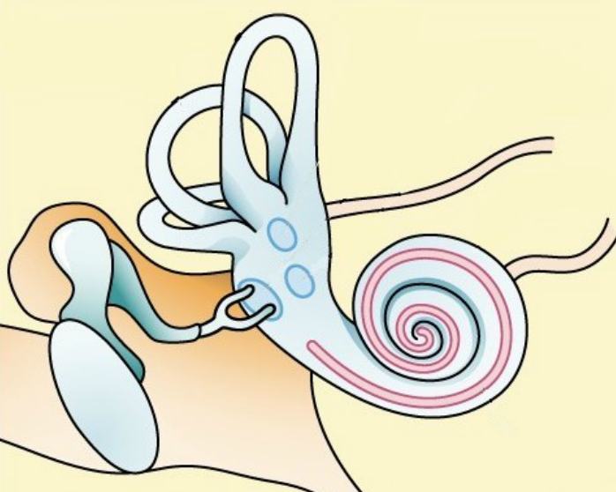
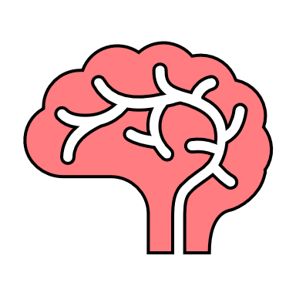
Deafness
Congenital Deafness
Conductive Hearing Loss
Ossicles
HEARING
Sensorineural Hearing Loss
Eardrum
Cochlear Implant
HAWKES LEARNING
Notes:
Some people have issues with their hearing. For example, deafness occurs when someone has either a partial or complete inability to hear.

Slide 18
Congenital Deafness
HEARING
HAWKES LEARNING
Notes:
If a person is born deaf, it is known as congenital deafness.

Slide 19
Conductive Hearing Loss
Ossicles
Eardrum
HAWKES LEARNING
Notes:
In other cases, people can suffer from conductive hearing loss in which damage to the auditory system, such as the eardrum or ossicles, has occurred.

Slide 20
Sensorineural Hearing Loss
Cochlear Implant
HAWKES LEARNING
Notes:
When people have hearing difficulty due to failure to transmit neural signals from the cochlea to the brain, it is known as sensorineural hearing loss.
In cases of severe hearing loss impacting the inner ear, a person may be able to receive a cochlear implant, which is an electronic device that receives incoming information and directly stimulates the auditory nerve to transmit information to the brain.

Slide 21




HAWKES LEARNING

