Slide 1
HAWKES LEARNING
The Other Senses
Introduction to Psychology
Notes:
In this lesson, we will explore our chemical senses and our body senses.

Slide 2




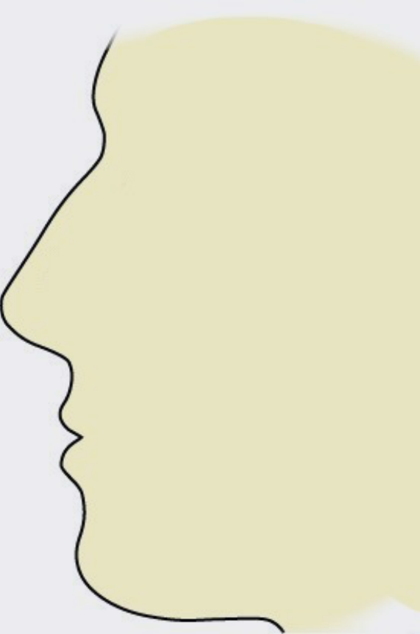
The Chemical Senses
Taste
Smell
Olfactory bulb
Sour candy
Limbic system
Coffee
Monosodium Glutamate
Fatty Content
Primary olfactory cortex
Action Potentials
HAWKES LEARNING
Notes:
The chemical senses include taste (gustation) and smell (olfaction).

Slide 3
Taste
Sour candy
Coffee
Monosodium Glutamate
Fatty Content
HAWKES LEARNING
Notes:
Although this may differ from what you have previously learned, it appears we have six taste receptors including sweet, salty, sour, and bitter. The two newer ones include umami (a taste for monosodium glutamate) and one that tastes the fatty content of food.

Slide 4

Taste Pathway
Medulla
Thalamus
Limbic system
Gustatory cortex
Action Potentials
HAWKES LEARNING
Notes:
The taste pathway starts with taste buds on the tongue that become activated when we eat. Chemical changes result in the generation of action potentials that are sent to the medulla, thalamus, limbic system, and the gustatory cortex between the frontal and temporal lobes.

Slide 5
Smell
Olfactory bulb
Limbic system
Primary olfactory cortex
Action Potentials
HAWKES LEARNING
Notes:
When it comes to smell, the olfactory receptor cells are located in a mucous membrane at the top of the nose. When odor molecules bind to these receptors, chemical changes within the cell result in action potentials that are sent to the olfactory bulb, then to the limbic system, and then to the primary olfactory cortex.

Slide 6


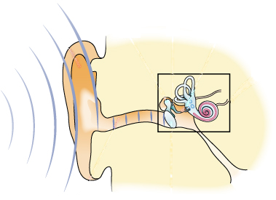
The Body Senses
Tactile Senses
Vestibular Senses
Pressure
Vibrations
Stretch
HAWKES LEARNING
Notes:
Our body senses include those responsible for feelings of touch and others that contribute to balance. We will discuss the tactile senses first.

Slide 7
Tactile Senses
Pressure
Vibrations
Stretch
HAWKES LEARNING
Notes:
In order for us to respond to our world tactilely, we have a number of receptors that are distributed through the skin that are responsible for touch. These receptors respond to pressure, vibrations of differing frequencies, and stretch.

Slide 8


Free Nerve Endings
PAIN
Spinal cord
Medulla
Somatosensory cortex
Thalamus
HAWKES LEARNING
Notes:
We also have a number of free nerve endings that are responsible for thermoception (temperature) and nociception (pain). These signals travel from the receptors to the spinal cord, then to the medulla, thalamus, and somatosensory cortex, which is located in the parietal lobe.

Slide 9


Insensitivity to Pain
PAIN
HAWKES LEARNING
Notes:
Individuals with congenital insensitivity to pain are born without the ability to feel pain, which can result in a number of dire consequences. Can you imagine how you might injure yourself if you did not feel pain? These people suffer mouth and tongue injuries from biting themselves and even play sports on broken limbs.

Slide 10
Vestibular Senses
HAWKES LEARNING
Notes:
The final group of body senses includes vestibular sense, proprioception, and kinesthesia.
Vestibular sense helps with our ability to maintain balance and body posture. These sense organs are located near the cochlea in the inner ear, and they contain fluid and hair cells that respond to movement of the head and gravity.

Slide 11
Vestibular Senses
Movement
Reflexes
Proprioception
Kinesthesia
HAWKES LEARNING
Notes:
The vestibular system also collects information for controlling movement and the reflexes that move various parts of our bodies to compensate for changes in body position. Therefore, both proprioception (perception of body position) and kinesthesia (perception of body’s movement through space) interact with information from the vestibular system.

Slide 12




HAWKES LEARNING

