Slide 1
HAWKES LEARNING
Gestalt Principles of Perception
Introduction to Psychology
Notes:
Gestalt psychology asserts that perception involves more than simply combining sensory stimuli. The statement most associated with Gestalt is “the whole is greater than the sum of its parts.” In fact, the brain puts together sensory information in predictable ways. We will consider some of them here.

Slide 2
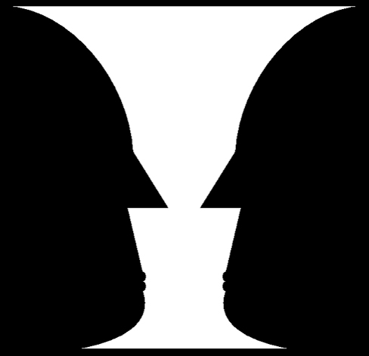
Figure/Ground
HAWKES LEARNING
Notes:
One Gestalt principle is the figure-ground relationship. In short, we separate our visual world into the figure, or object, and the ground, or background. As a result, our perception can vary drastically depending on what we see as the figure and what we see as the ground. Here, what do you see? A vase? Or two faces?

Slide 3
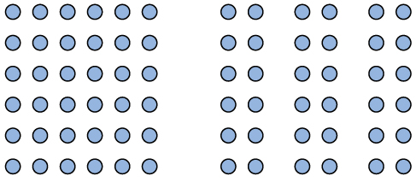
Proximity
HAWKES LEARNING
Notes:
For proximity, items that are close to one another tend to be grouped together. Here, the dots grouped close together are seen as a group.

Slide 4
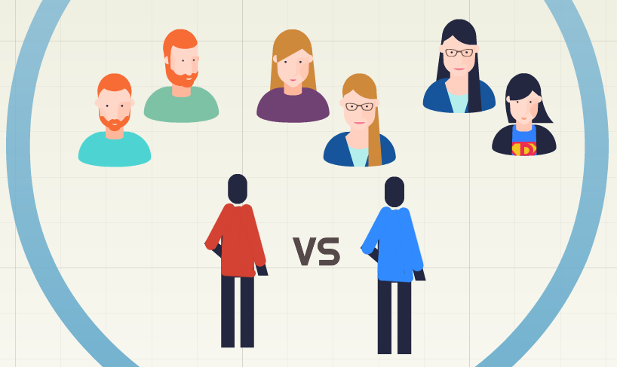
Similarity
HAWKES LEARNING
Notes:
We also use the principle of similarity to group items; items that look alike tend to be grouped together. Even if you don’t understand what is happening in a football game, you know the offensive from the defensive team based on the uniforms.

Slide 5
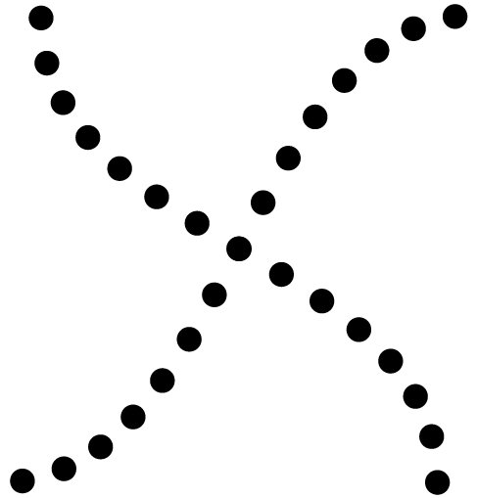
Continuity
HAWKES LEARNING
Notes:
The law of continuity suggests we are more likely to perceive continuous, smooth flowing lines rather than jagged broken lines.

Slide 6
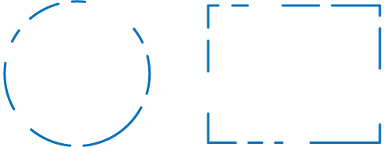
Closure
HAWKES LEARNING
Notes:
Closure refers to the fact that our brains will automatically complete objects. Here, we see a circle and a rectangle, but they are not actually closed figures. In fact, this is what is most interesting about Gestalt principles: our perceptions may not match reality. Although you may see a circle here, it is only in your perception; it does not actually exist.

Slide 7




HAWKES LEARNING

