Slide 1
HAWKES LEARNING
What is Learning?
Notes:
What is learning?

Slide 2
Unlearned Behaviors
Instincts
Reflexes
HAWKES LEARNING
Notes:
To understand learning, we must first understand unlearned behaviors, which tend to come in two forms: instincts and reflexes.

Slide 3

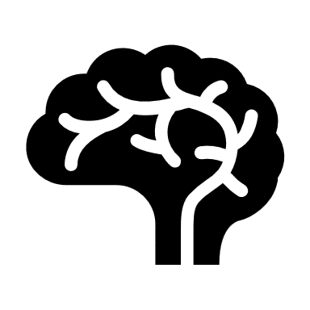
Instincts
Complex
HAWKES LEARNING
Notes:
Instincts are innate behaviors that are complex, involving the whole organism and higher brain centers. For example, mating behavior or behaviors that support survival would be considered instincts.

Slide 4
Reflexes
Simple
HAWKES LEARNING
Notes:
Reflexes, on the other hand, are far simpler behaviors, usually involving a specific body part and lower brain centers. A knee-jerk response or pupil dilation would be good examples.

Slide 5
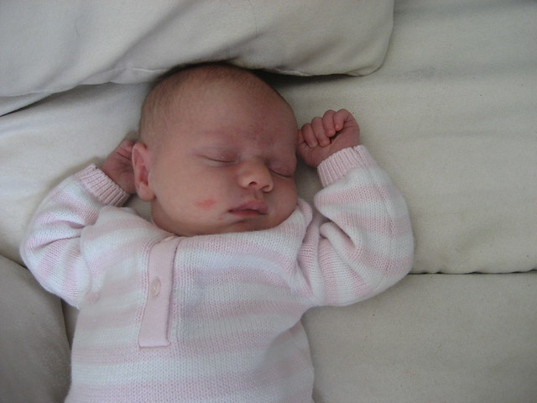
Instincts and Reflexes
This Photo by Unknown Author is licensed under CC BY-ND
HAWKES LEARNING
Notes:
Instincts and reflexes help organisms adapt to their environments and do not need to be learned. For example, babies have many reflexes when born. One, the sucking reflex, allows the baby to obtain nutrients because the baby sucks automatically when something is placed in the mouth.

Slide 6


Learning
Relatively permanent
Change in behavior
Experience
HAWKES LEARNING
Notes:
In contrast, learning is a relatively permanent change in behavior that results from experience. When you think of learning to kick a ball or learning how to write, we can only learn those through experience. They are not innate behaviors.

Slide 7
Associative Learning
Classical Conditioning
Operant Conditioning
HAWKES LEARNING
Notes:
A simple form of learning is associative learning in which we learn that events occur together. There are different types of learning that fit the idea of associative learning. They are classical and operant conditioning.

Slide 8


Classical Conditioning
Stimulus A
Stimulus B
Thunder
Lightning
HAWKES LEARNING
Notes:
In classical conditioning, organisms learn that two stimuli occur together or in sequence. For example, over time, you learned that thunder and lightning co occur.

Slide 9





Operant Conditioning
Behavior
Consequence
A+
!!!!!
Dishes
HAWKES LEARNING
Notes:
In operant conditioning, organisms learn that a behavior and its consequence occur together or in sequence. For example, if a child earned an A on a paper and he received a reward, the child would be more likely to engage in that behavior in the future. On the other hand, if a child yelled in the store and was later given extra chores as a punishment, the child would be less likely to engage in that behavior in the future.

Slide 10





Observational Learning
HAWKES LEARNING
Notes:
Another way to learn is observational learning in which organisms watch others to determine how to behave. We often engage in observational behavior in new situations where we are not sure what to do. The first time you attend school or court often elicits observational learning.

Slide 11




HAWKES LEARNING

