Slide 1
HAWKES LEARNING
Operant Conditioning
Introduction to Psychology
Notes:
In operant conditioning, organisms learn to associate a behavior and its consequence. Let’s explore more about this type of learning.

Slide 2



Law of Effect
Behavior
Satisfying Consequence
Notes:
Operant conditioning is based on the law of effect, which states that behaviors that are followed by satisfying consequences are more likely to be repeated. For example, you go to work because you get paid. If you were suddenly no longer being paid, you would probably stop going.

Slide 3
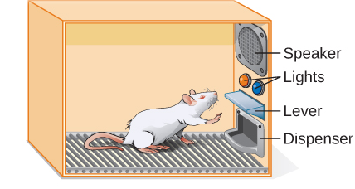
Skinner Box
Notes:
B. F. Skinner used this idea of law of effect to determine how organisms learn through operant conditioning. He placed animals inside of an operant conditioning chamber, called a Skinner box, in which animals could press buttons or levers for a food reward.

Slide 4





Positive vs. Negative
Positive
Negative
Notes:
In order to understand operant conditioning, we must first discuss some of the common terminology, such as the use of positive and negative. These terms do not mean “good” and “bad.” Instead, positive means “addition,” and negative means “subtraction. “ For example, if a child received a candy for a good behavior, this would be positive (addition). If a child received a reduction in chore workload for a good behavior, this would be negative (subtraction).

Slide 5

Reinforcement
Positive
reinforcement
Negative
reinforcement
Notes:
Positive and negative apply to the idea of reinforcement, which means to increase the likelihood of the behavior happening in the future. A positive reinforcement would be to add something good, such as providing a child with a piece of candy for using good manners. A negative reinforcement would be taking away something bad, such as telling a child he doesn’t have to do chores this week due to good behavior.

Slide 6




Punishment
Positive
punishment
Negative
punishment
Notes:
Positive and negative also apply to punishment, which reduces the likelihood of a behavior in the future. A positive punishment would be to add something bad, such as points on a driving record for speeding. A negative punishment would be taking away something good, such as taking away a child’s privileges or toys for bad behavior.

Slide 7




Reinforcement
A+
Notes:
Although it may feel like bribery, we have to keep in mind that we get rewarded for good behavior all of the time. Pay checks, high grades, acceptance into our preferred schools, and praise for a job well done are all examples of reinforcement.

Slide 8
Negative Reinforcement
Reinforcement
Punishment
Notes:
Many people confuse negative reinforcement with punishment. Remember that reinforcement always has the goal of increasing the likelihood of a behavior. Punishment, in contrast, always has the goal of decreasing the target behavior.

Slide 9

Effects of Spanking
Stimulus
FEAR
Disciplinarian
Notes:
Punishment can decrease unwanted behavior, especially if the punishment is immediate. However, spanking has been shown to have negative impacts, such as fear of the stimulus that resulted in the spanking, fear of the disciplinarian, and increased levels of aggression and antisocial behaviors.

Slide 10


Shaping
Successive approximations
Notes:
An important aspect of operant conditioning with animals is shaping. Instead of rewarding only the target behavior, we reward successive approximations of the target behavior. For example, if you wanted your dog to jump through a hoop, you would wait forever for the dog to complete this behavior spontaneously. You need to, instead, reward for small steps towards the behavior.

Slide 11




Reinforcer Types
Primary
Secondary
Notes:
Another important factor to operant conditioning is the type of reinforcers used. Primary reinforcers have innate reinforcing qualities, such as water, food, sleep, shelter, touch, and pleasure. A secondary reinforce has no inherent value. For example, money is only useful for buying primary reinforcers. It has no value in and of itself.

Slide 12
Partial Schedules
Fixed
Variable
Interval
Ratio
Notes:
Research has repeatedly shown that the best way to teach a person or animal a behavior is through positive reinforcement. If an animal or person is continuously reinforced, the behavior is learned quickly. However, we sometimes want to reward more sporadically than every time a behavior is performed. In those cases, there are various schedules of partial reinforcement that can be used. To understand the partial reinforcement schedules, we again must understand some specific terminology. Fixed refers to a set number of responses between reinforcements, compared to variable, where the number of responses will vary. Schedules can also be intervals, referring to the amount of time between reinforcements, or ratios, referring to the number of responses between reinforcements.

Slide 13
Schedules of Reinforcement
Fixed Interval
Variable Interval
Fixed Ratio
Variable Ratio
Notes:
We can combine these terms into four different schedules of reinforcement: fixed interval, variable interval, fixed ratio, and variable ratio.

Slide 14

Fixed Interval
Notes:
A fixed interval occurs when a behavior is rewarded after a set amount of time has passed. Some examples of a fixed interval would be receiving a paycheck every week or getting another pain reliever after the dosage time has passed.

Slide 15



Variable Interval
Unpredictable
Notes:
A variable interval occurs when the reinforcement is based on varying amounts of time which are unpredictable. Surprise inspections, pop quizzes, and checking email for important messages are all examples of a variable interval. You cannot predict when these events will occur.

Slide 16


Fixed Ratio
Free!
Notes:
A fixed ratio schedule refers to a reinforcement that occurs after a set number of responses has occurred. Many of us have customer appreciation cards where we earn free items once we buy a certain number. Have you ever gotten a free ice cream after buying 5? You were just rewarded on a fixed ratio schedule.

Slide 17

Variable Ratio
Behavior
Reward!
Notes:
The final schedule is a variable ratio. Here, the number of responses for a reward vary. This schedule is actually a powerful one in that it creates persistent behavior. Imagine if every time you performed a behavior, you could get a reward. The possible occurrence of a reward makes us more likely to perform the behavior in question. This logic is exactly the reason why so many people gamble. They could strike it rich on the next play, and if they don’t, maybe it is the next play, or the next.

Slide 18
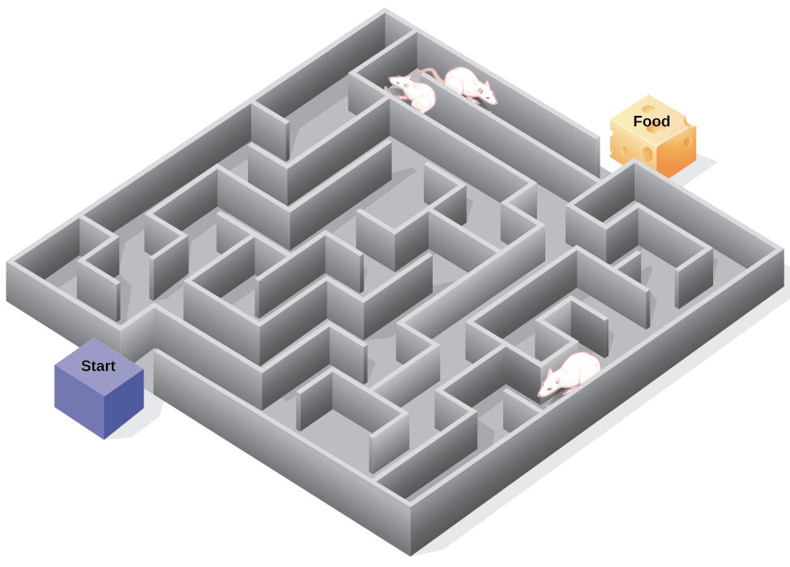

Latent Learning
Cognitive map
Notes:
Another branch of research on latent learning helped to expand our knowledge of operant conditioning. Edward Tolman conducted research in which hungry rats were placed in a maze with no food reward. During their explorations, these animals were generating a cognitive map of the maze. When he put them in the maze again, this time with food, they knew exactly how to solve the maze. This experiment demonstrated that organisms learn, even in the absence of immediate reinforcement. This type of learning was actually coined latent learning: learning that occurs but is not observable in behavior until there is a reason to demonstrate it.

Slide 19




HAWKES LEARNING

