Slide 1
HAWKES LEARNING
What Are Intelligence and Creativity?
Introduction to Psychology
Notes:
Psychologists have wondered what constitutes intelligence and how to measure it.

Slide 2



Spearman
General (g) intelligence
HAWKES LEARNING
Notes:
Researchers have defined intelligence in a variety of ways over the years. For example, Charles Spearman believed intelligence consisted of one general factor, called G, which could be measured and compared across individuals.

Slide 3




Cattell
Crystallized Intelligence
Fluid Intelligence
HAWKES LEARNING
Notes:
In contrast, Raymond Cattell divided intelligence into crystallized and fluid intelligence.

Slide 4
Crystallized Intelligence
HAWKES LEARNING
Notes:
Crystallized is acquired knowledge, everything you know from school or experience.

Slide 5
Fluid Intelligence
HAWKES LEARNING
Notes:
Fluid intelligence is the ability to see complex relationships and solve problems. It also includes facets such as processing speed.

Slide 6
Sternberg
Analytical
Practical
Creative
HAWKES LEARNING
Notes:
Robert Sternberg developed the triarchic theory of intelligence that states that intelligence consists of three parts: analytical (problem solving), practical (street smarts and common sense), and creative (imaginative and innovative problem solving).

Slide 7


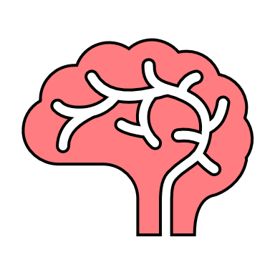

Gardner
Logical-mathematical
Linguistic
Gardner
Gardner
Musical
Bodily kinesthetic
Spatial
Naturalist
Interpersonal
Intrapersonal
Emotional Intelligence
HAWKES LEARNING
Notes:
Howard Gardner developed the multiple intelligence theory that divides intelligence into 8 different types. Linguistic (skilled in language), Logical-mathematical (sees numeric patterns), strong with reason, and logic are closest to what we might imagine an academic test would measure.

Slide 8
Gardner
Bodily kinesthetic
Musical
Spatial
HAWKES LEARNING
Notes:
Gardner had other intelligences, however. Musical (understands rhythm, pitch, and tone), bodily kinesthetic (skilled in body movements), and spatial (sees relationships between objects and how they move).

Slide 9
Gardner
Naturalist
Interpersonal
Intrapersonal
Emotional Intelligence
HAWKES LEARNING
Notes:
Some others are naturalist (appreciates the natural world), interpersonal (ability to be sensitive to emotional states of others), and intrapersonal (ability to assess personal feelings and motivations). Gardner’s inter and intrapersonal intelligences are often combined into emotional intelligence.

Slide 10



Creativity
Divergent Thinking
HAWKES LEARNING
Notes:
What is creativity? Creativity is defined as the ability to generate, create, and discover new ideas, solutions, or possibilities. Creativity is often assessed by the ability to engage in divergent thinking or outside the box thinking. If asked how to get from California to Texas, a convergent or logically correct way to answer that question might be to drive or fly. A divergent thinking, however, may generate several novel ways including by boat.

Slide 11




HAWKES LEARNING

