Slide 1
HAWKES LEARNING
Measures of Intelligence
Introduction to Psychology
Notes:
Over the years, there have been a variety of ways to measure intelligence.

Slide 2

Intelligence Quotient
HAWKES LEARNING
Notes:
In general, the term IQ means intelligence quotient, which is a score earned on a test designed to measure intelligence.

Slide 3



Intelligence Tests
Stanford-Binet
Wechsler
Alfred Binet
Verbal
Visual spatial
Fluid reasoning
Working memory
Processing speed
HAWKES LEARNING
Notes:
These measures of intelligence have differed over the years.

Slide 4


Stanford-Binet
Alfred Binet
Louis Terman
Standardized
Normed
NORM
HAWKES LEARNING
Notes:
The Stanford-Binet began with Alfred Binet who started reliable intelligence testing in the early 1900s. He was asked to develop a test to identify children who needed additional help in school.

Slide 5
Louis Terman
Standardized
Normed
NORM
HAWKES LEARNING
Notes:
Louis Terman added to intelligence testing by conducting tests with thousands of differently aged children so that the test could be standardized and administered the same way each time. In addition, testing on so many children allowed norming of the data, which allows researchers to compare an individual to the “norm” for that age group.

Slide 6
Wechsler
Visual spatial
Fluid reasoning
Verbal
Working memory
Processing speed
HAWKES LEARNING
Notes:
Another scale is the Wechsler Adult Intelligence Scale, which was designed by David Wechsler. This scale, and the various age-appropriate options that were developed afterwards, combines a variety of different subtests of verbal and nonverbal skills. Some of the skills include verbal comprehension, visual spatial skills, fluid reasoning, working memory, and processing speed.

Slide 7
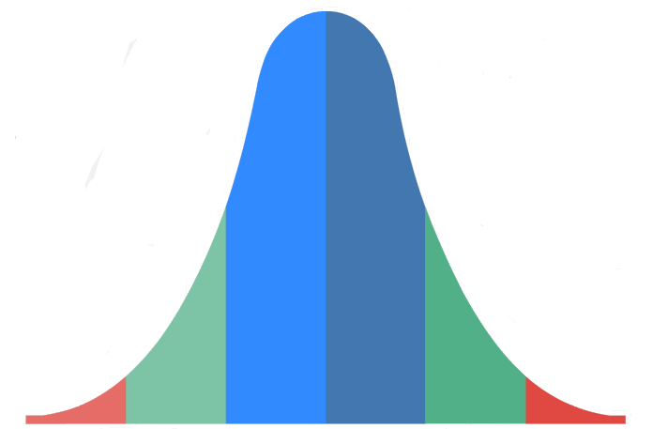
Bell Curve
Mean
HAWKES LEARNING
Notes:
The results of intelligence tests usually follows a bell curve known as a normal distribution. A normal distribution means that once you have measured a trait from a large enough group, that most of the people will fall towards the average (the mean) and less and less people will be at the extremes of the range.

Slide 8
Intelligence
Standard Deviation
70
85
115
130
Mean = 100
HAWKES LEARNING
Notes:
When it comes to IQ, the mean or average is 100. A standard deviation describes how data are dispersed in the population. For IQ, the standard deviation is 15 points such that a normal IQ score would range between one standard deviation below to one standard deviation above the mean, or 85 to 115. Most people fall within two standard deviations of the mean, meaning that most people score between 70 to 130 on a given IQ test. Scores below 70 or above 130 are not typical.

Slide 9
Intellectually Disabled
Mild
Moderate
Severe
Profound
2%
HAWKES LEARNING
Notes:
For those 2% of people who do fall below 70, they are classified as intellectually disabled. Depending on the severity of the disability, these individuals might be classified as mildly, moderately, severely, or profoundly impacted.

Slide 10
Intellectually Disabled
Intellectually gifted
2%
HAWKES LEARNING
Notes:
On the other end, approximately 2% of the population scores above 130. These individuals are intellectually gifted.

Slide 11



Importance
HAWKES LEARNING
Notes:
Measuring intelligence is important for several reasons. First, it allows schools to determine students who many need additional help or additional challenges. Second, intelligence testing can be used in courts to determine if someone is intelligent enough to stand trial. Finally, individuals may also be able to draw disability payments if they are intellectually challenged.

Slide 12




HAWKES LEARNING

