Slide 1
HAWKES LEARNING
The Source of Intelligence
Introduction to Psychology
Notes:
Researchers have often wondered about the source of intelligence: is it genetic or from experience?

Slide 2



Minnesota Twins Study
HAWKES LEARNING
Notes:
The Minnesota Twins Study of Twins Reared Apart found that identical twins raised together and identical twins raised apart had higher correlations between their IQ scores than siblings or fraternal twins raised together. This study suggests there is a genetic component to intelligence.

Slide 3



Range of Reaction
HAWKES LEARNING
Notes:
Range of reaction is a theory that each person responds to the environment in a unique way based on genetic makeup. Your genetic potential is fixed, but whether you reach it or not is dependent on your environment. If you were supposed to be intellectually gifted but lacked opportunities, you may not reach that potential.

Slide 4


Range of Reaction
Genetic?
Range of Reaction?
HAWKES LEARNING
Notes:
For example, individuals from different ethnic and racial backgrounds have lower IQ scores. However, is that genetic or a product of the range of reaction? Growing up in poverty means growing up without basic needs: food, safety, shelter. Anxiety and stress as a result would be detrimental to reaching someone’s full intellectual potential.

Slide 5
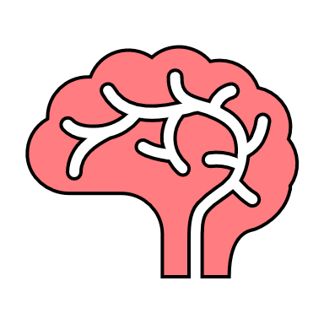

Learning Disabilities
Learning Disabilities
Intellectual Disabilities
Specific impairments
Global difficulties
HAWKES LEARNING
Notes:
Learning disabilities are cognitive disorders that affect different areas of cognition, particularly language and reading. Learning disabilities are specific neurological impairments. Intellectual disabilities, on the other hand, are global intellectual or developmental difficulties.

Slide 6




Learning Disabilities
Dysgraphia
Dyslexia
E A X
HAWKES LEARNING
Notes:
There are several different kinds of learning disabilities, but we only consider two here.

Slide 7
Dysgraphia
HAWKES LEARNING
Notes:
Dysgraphia is a type of learning disability in which individuals struggle to write legibly. Even intellectually gifted individuals can suffer from dysgraphia.

Slide 8
Dyslexia
E A X
HAWKES LEARNING
Notes:
Dyslexia, another learning disability, involves an inability to correctly process letters. Children with dyslexia may not understand which letter goes with which sound. These individuals may have difficulty sounding out words and may mix up letters within words when reading.

Slide 9




HAWKES LEARNING

