Slide 1
HAWKES LEARNING
Parts of the Brain Involved with Memory
Notes:
In this lesson, we will explore the parts of the brain involved with memory.

Slide 2
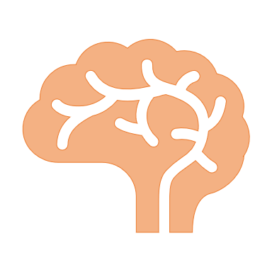
Memory
?
?
?
?
?
HAWKES LEARNING
Notes:
Researchers have wondered whether memory located in one specific part of the brain or in multiple places.

Slide 3
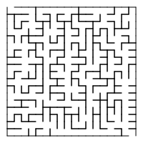

Karl Lashley
Engrams
This Photo by Unknown Author is licensed under CC BY-SA
Equipotentiality hypothesis
HAWKES LEARNING
Notes:
Karl Lashley, specifically, tried to locate engrams, or the group of neurons that formed a permanent representation of memory. After training rats to run mazes, he was unable to disrupt their memories by creating lesions in different areas. This finding led to the equipotentiality hypothesis which states that if one part of the brain that is involved in memory is damaged, another brain part will take over.

Slide 4

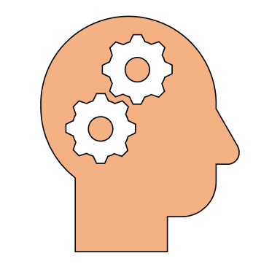
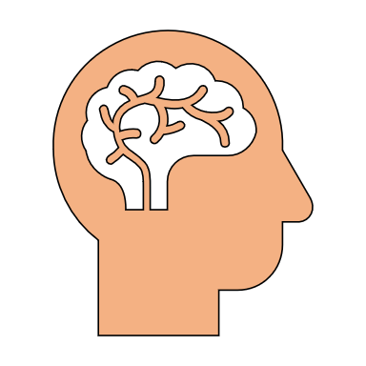
Parts of the Brain Involved with Memory
Amygdala
Hippocampus
Cerebellum
Prefrontal Cortex
HAWKES LEARNING
Notes:
Many scientists do, in fact, believe that the entire brain is involved in memory but there are certain areas that have specific memory functions. We will discuss them here.

Slide 5






Amygdala
Fear
Encoding
Memory consolidation
Freeze
HAWKES LEARNING
Notes:
The amygdala’s main function is related to emotion, specifically fear and aggression. This emotional component can help with memory encoding, or learning, as well as memory consolidation, the process of transferring new learning to long-term memory. For example, rats who were conditioned to anticipate foot shock after a tone froze in anticipation after the tone. If their amygdalas were damaged, however, they lost this response.

Slide 6

Hippocampus
X
Recognition memory
Spatial memory
Memory consolidation
H.M.
Meaning
HAWKES LEARNING
Notes:
The hippocampus is also important to memory as was demonstrated by a name named H. M. who had both his left and right hippocampus removed to control his epilepsy. From the day of surgery, he was unable to form new memories even though he could remember events from his childhood. It appears the hippocampi are responsible for recognition memory, spatial memory, memory consolidation, and connecting memories with meaning.

Slide 7


Cerebellum
Classical conditioning
HAWKES LEARNING
Notes:
For many who have explicit memory problems, they are still able to create implicit memories – procedural memory such as riding a bike, motor learning such as walking, and classical conditioning – through the cerebellum.

Slide 8
Prefrontal Cortex
Encoding
Retrieval
HAWKES LEARNING
Notes:
The prefrontal cortex has been shown to be involved in both encoding and retrieval of information. Interestingly, PET scans show activation in the left inferior prefrontal cortex for encoding, and the right for retrieval.

Slide 9


Neurotransmitters
Memory
HAWKES LEARNING
Notes:
Arousal theory suggests that strong emotions trigger the formation of strong memories which may be based on the release of neurotransmitters. One such strong memory is a flashbulb memory – a memory formed from an emotion event that appears to be exceptionally clear and detailed. It is important to keep in mind, however, that simply because a memory seems highly accurate, that does not mean that it actually is.

Slide 10




HAWKES LEARNING

