Slide 1
HAWKES LEARNING
Stages of Development
Introduction to Psychology
Notes:
In this lesson, we will discuss the stages of development, specifically prenatal, infant, child, adolescent, and adult development.

Slide 2
Prenatal Development
Germinal Stage
Embryonic Stage
Fetal
Stage
Notes:
There are three stages of prenatal development: germinal, embryonic, and fetal.

Slide 3
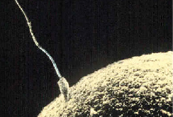
Germinal Stage
Zygote
Mitosis
Notes:
The germinal stage lasts from conception (the meeting of the sperm and the egg to form a zygote) until 2 weeks when the developing zygote implants into the uterus. During this two-week time period, the zygote begins as a two-celled structure and undergoes rapid mitosis (cell division).

Slide 4


Embryonic Stage
Formation of placenta
Organs
Notes:
The embryonic stage occurs from implantation until roughly 8 weeks. During this time, the placenta forms to provide nutrients to the developing embryo. The heart begins to beat, the organs form, and the brain begins to form as well.

Slide 5
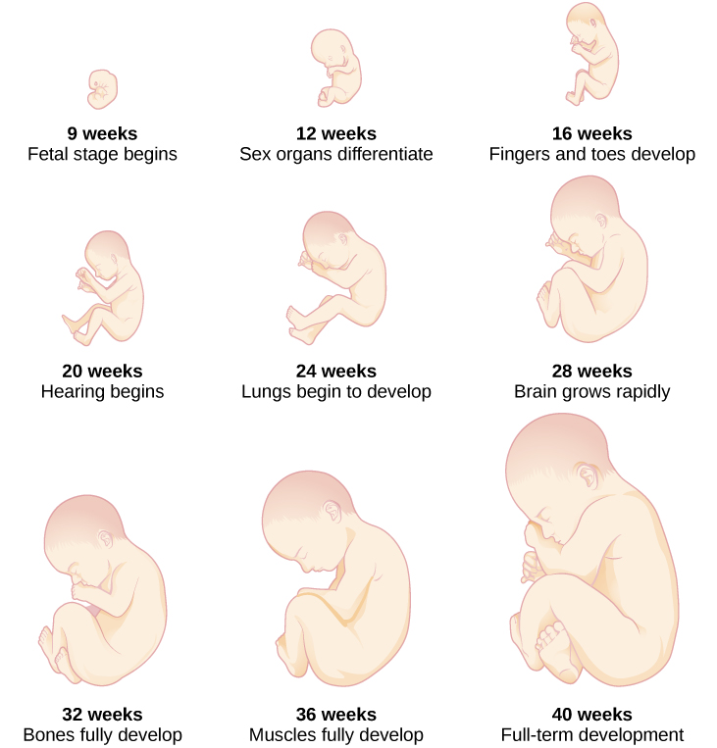
Fetal Stage
Growth
Fine-tuning
Notes:
The fetal stage, from 9 to 40 weeks, involves growth and fine-tuning of the fetus. By 24 weeks, the fetus stands a good chance if born too soon because it has undergone a tremendous amount of development. Around 40 weeks, babies will be born.

Slide 6





Prenatal Care
Teratogens
small head
poor judgment
ADHD
Notes:
Prenatal care is important to reduce risks to the baby. For instance, everything that the mother ingests can impact the baby. A teratogen is anything that can cause a birth defect. Alcohol and drugs are obvious culprits. Excessive maternal drinking can result in a host of issues, including small head size, abnormal facial features, poor judgement and impulse control, attention deficit hyperactivity disorder, and more.

Slide 7


Newborns
smells
voices
reflexes
Notes:
After the baby is born, they start with newborn reflexes, which are automatic responses that help them survive. In addition, they are not a blank slate; they have preferences, such as those for face, human voices–especially mom’s–and the ability to differentiate smells, such as the smell of their mother.

Slide 8


Childhood Physical Growth
Growth
Pruning
Notes:
With regard to physical development, children grow rapidly, doubling their weigh in the first 6 months of life. Growth isn’t always steady; there are spurts and times of constancy, but growth characterizes childhood. When it comes to the brain, there is a time of growth of neural connections, followed by a time of pruning, or fine-tuning those connections.

Slide 9



Childhood Cognitive Development
Notes:
Cognitively, children develop drastically. They begin to communicate through gestures and then words. They learn properties of objects. By preschool, a child can do a variety of tasks, including count, predict the next part of a story, and enjoy pretend play. They also begin to understand theory of mind: the idea that others have minds of their own. As they age, children become increasingly more logical and can begin to understand hypothetical situations and abstract concepts by the time they are 11 years old.

Slide 10
Language
Cooing
Babbling
First Words
Vocab Spurt
Notes:
It is important to note the tremendous growth that occurs in language. Babies coo and then babble, using the sounds of all the languages of the world, and then start to narrow those sounds to the home language by a year. After learning first words around 1 year, they undergo a vocabulary spurt and learn language at a rapid pace. All of these aspects suggest that language is a biologically important function.

Slide 11
Childhood Psychosocial Development
Attachment
&
Self-Concept
Notes:
Psychosocial issues for this age group include attachment and self-concept.

Slide 12

Attachment
Strange Situation
Strange room
Secure base
Notes:
Attachment refers to the connection with others. The ultimate function of attachment was to provide children with a safe base in which to explore the world. Attachment styles were studied using a laboratory situation called the “Strange Situation,” which introduced a child to a strange room, then a stranger, and then being left in the room with the stranger.

Slide 13




Attachment Styles
Unresponsive
Clingy
>
=
Notes:
This research revealed three attachment styles. A securely attached child preferred the caregiver over the stranger, sought the caregiver when stressed, and became distressed when the caregiver left. An avoidantly attached child was unresponsive to the caregiver, did not care if the caregiver left, and treated the stranger the same as the caregiver. A resistantly attached child was clingy with the caregiver, angry when the caregiver left, and difficult to comfort on return.

Slide 14


Self-Concept
“Me”
Notes:
In self-concept, children begin to develop an idea of who they are. Across development, children develop an ability to share, separate from parents with little anxiety, and begin to identify themselves by groups, such as their grade or their interests. As they get older, they start to identify themselves with traits, such as being shy or outgoing.

Slide 15
Parenting Styles
Authoritative
Parenting
Authoritarian
Parenting
Permissive Parenting
Uninvolved Parenting
Notes:
Self-concept involves becoming confident in your own abilities, which can be facilitated by good parenting. Parenting style, in fact, might help or hinder the development of the self-concept.

Slide 16
Authoritative Parenting
Reasonable demands
Listens
Consistent limits
Notes:
An authoritative parent gives reasonable demands and consistent limits, expresses warmth and affection, and listens to the child’s point of view.

Slide 17



Authoritarian Parenting
Obedience
Notes:
In authoritarian style, the parents place a high value on obedience, are often strict, and express little warmth.

Slide 18

Permissive Parenting
Punishment
Boundaries
Notes:
Permissive style involves parents that are highly affectionate and rarely use punishment or set boundaries.

Slide 19


Uninvolved Parenting
Notes:
The final style, the uninvolved parent, is sometimes referred to as neglectful. They may have little involvement with their children, perhaps not even knowing where they are. These parenting styles can obviously impact the degree to which a child feels confident in his or her self.

Slide 20


Adolescence
Puberty
Menstruation
Viable sperm
Pubic and body hair
Body changes
Notes:
Now, we will move to the primary issues of adolescence. Physically, the greatest focus is on puberty. Girls will experience the start of their menstrual periods, and boys will experience their first release of viable sperm. They will develop secondary sexual characteristics, such as pubic and body hair as well as body changes.

Slide 21
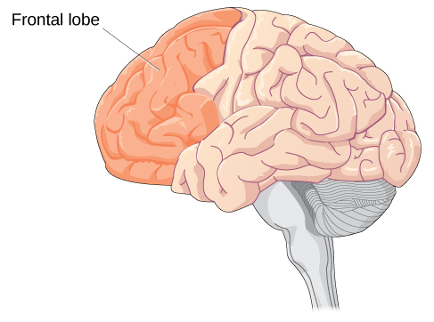
Adolescent Physical Development
Notes:
With regard to the brain, the frontal lobe is still developing throughout this time, which explains poor decision-making during adolescence.

Slide 22


Adolescent Cognitive Development
Notes:
Cognitively, adolescents can consider multiple points of view, imagine hypothetical situations, and form new ideas. They also have cognitive empathy by being able to take the perspective of others and understand their feelings.

Slide 23
Adolescent Psychosocial Development
Who am I??
Notes:
Psychosocially, adolescents are figuring out who they are and what they stand for. During this time, peer groups become important even though they still feel warm feelings for their parents.

Slide 24

Adult Physical Development
Notes:
Finally, development continues in adulthood. It is important to keep in mind that adulthood has three distinct stages: early, middle, and late adulthood. Physically, maturation is complete by adulthood, although we may still put on some height, and weight can certainly fluctuate. In young adulthood, physical abilities are at their peak, and they slowly decline past this point in time.

Slide 25
Adult Cognitive Development
Crystallized intelligence
Fluid intelligence
Notes:
Cognitively, growth continues into adulthood. Specifically, crystallized intelligence--the information gathered over a lifetime--holds steady or improves over time. Fluid intelligence, such as processing speed, declines, however. Research suggests that remaining physically and mentally active can help slow this decline.

Slide 26

Adult Psychosocial Development
Notes:
For adults, successful aging depends on some psychosocial factors. Job satisfaction, for example, is one important factor. In addition, positive relationships with others in their lives can contribute to a sense of well-being.

Slide 27




HAWKES LEARNING

