Slide 1
HAWKES LEARNING
Motivation
Notes:
Why do we do the things we do? In this lesson, we will discuss motivation, or the needs that direct our behaviors.

Slide 2




Intrinsic vs. Extrinsic
Extrinsic
Intrinsic
HAWKES LEARNING
Notes:
Motivation can be either extrinsic, or from external sources, or intrinsic, from internal sources. Extrinsic motivation may come in the form of praise or reward. Intrinsic motivation comes from personal desire. Intrinsically motivated behaviors – behaviors you do because you want to do them – are more personally satisfying.

Slide 3




Intrinsic vs. Extrinsic
HAWKES LEARNING
Notes:
Sometimes extrinsic reward for something we enjoy can make that activity less enjoyable. For example, if you love to bake and you open a bakery, you may no longer find baking as fulfilling once you receive a physical reward (money). However, if your customers provide praise, this verbal reinforcement may reinstate that motivation.

Slide 4






Intrinsic Motivation
Belonging
Evaluation
Challenge
Control
HAWKES LEARNING
Notes:
When it comes to the classroom, there are a multitude of ways to improve intrinsic motivation. First, students should feel a sense of belonging and respect. Evaluative aspects should be de-emphasized and tasks should be challenging but doable. Finally, students should feel a sense of control over the environment.

Slide 5
Instinct Theory
HAWKES LEARNING
Notes:
There have been a variety of theories of motivation. For instance, William James felt that behavior was driven by instincts. Some of these instincts include protection for offspring, hunting, and an urge to eat sweets. A major criticism of this theory was the degree to which we learn behaviors, rather than behave instinctively.

Slide 6


Drive Theory
Homeostasis
HAWKES LEARNING
Notes:
Another theory related to drive reduction, or our need to maintain bodily homeostasis. Therefore, a thirsty individual would be motivated to find hydration.

Slide 7

Arousal Theory
Bored
Optimal Level
Stressed
HAWKES LEARNING
Notes:
We also have a need for a certain level of arousal. If we are under aroused, we become bored. Over aroused – stressed. Hence, we strive for an optimal amount of arousal. This level may vary depending on a variety of factors including task difficulty. If we are doing a relatively easy task, arousal can be higher; if we are engaged in a difficult task, however, arousal should be lower. This principle makes up the Yerkes-Dodson law.

Slide 8



Self-Efficacy
HAWKES LEARNING
Notes:
Self-efficacy is a person’s belief in his or her own capability to complete a task. Albert Bandura felt that our self-efficacy played into motivation. Specifically, we are more likely to accept challenges if we feel capable of succeeding.

Slide 9




Social Motives
Need for Achievement
Need for Affiliation
Need for Intimacy
HAWKES LEARNING
Notes:
We also have social motives. The need for achievement, for example, refers to our need for accomplishment. Need for affiliation refers to our need for positive interactions with others. Finally, we seek deep, meaningful relationships to fill a need for intimacy.

Slide 10
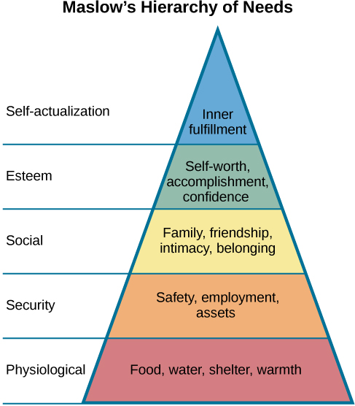
Hierarchy of Needs
This Photo by Unknown Author is licensed under CC BY
HAWKES LEARNING
Notes:
Finally, we have a hierarchy of needs in which physiological needs have to be satisfied before higher needs. If you are worried about where your next meal will come from, it probably matters less if you have a significant other! Unless, of course, that person can feed you. At the apex of the pyramid is self-actualization needs. Here, a person strives to achieve one’s potential, whatever that may be.

Slide 11




HAWKES LEARNING

