Slide 1
HAWKES LEARNING
Hunger and Eating
Notes:
In this lesson, we will explore hunger and eating behaviors.

Slide 2
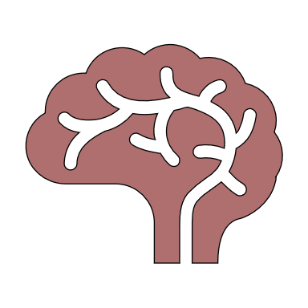
Physiological Mechanisms
Empty Stomach
Glucose
HAWKES LEARNING
Notes:
There are a variety of physiological mechanisms that serve as the basis of hunger. An empty stomach or a drop in glucose can cause a variety of signals to the brain that induce eating behavior. Similarly, upon eating, signals are sent again to provide feelings of satiation, or fullness. One such signal is the hormone leptin, which is a satiety signal.

Slide 3
Metabolism
Calories In
Calories Out
HAWKES LEARNING
Notes:
Our body weight can be affected by a variety of factors. Our activity level versus the number of calories we consume are big factors. In addition, our metabolism – or how much energy we need in a given period of time – can play a role. People with high metabolisms burn more calories than those with low metabolisms.

Slide 4


Set Point Theory
Metabolism
HAWKES LEARNING
Notes:
The set-point theory argues that metabolism naturally slows down when someone diets and exercises. This effect happens to help the person maintain his or her weight. If true, this theory would make it more difficult for individuals to lose weight.

Slide 5








Obesity
HAWKES LEARNING
Notes:
Nearly two in three adults and one in six children are classified as either overweight or obese. Being in these categories increases risk for diabetes, sleep apnea, cancer, infertility, and arthritis.

Slide 6







Eating Disorders
Bulimia Nervosa
HAWKES LEARNING
Notes:
Some individuals suffer from eating disorders in which they are fearful of gaining weight and, therefore, engage in behaviors to reduce their weight. Those suffering from bulimia nervosa engage in binge eating behavior that is followed by an attempt to compensate for the food consumed. They may vomit or exercise to excess.

Slide 7
Eating Disorders
Binge-Eating
Anorexia Nervosa
HAWKES LEARNING
Notes:
Binge eating disorder includes binge eating but without the compensatory behavior afterwards. Finally, anorexia nervosa is characterized by food restriction. Individuals with anorexia often have a distorted body image, feeling they are overweight when they truly are not.

Slide 8




HAWKES LEARNING

