Slide 1
HAWKES LEARNING
Emotion
Notes:
We all experience emotions, which are subjective states that we usually describe as our feelings.

Slide 2






Components of Emotion
HAWKES LEARNING
Notes:
Theories of emotion take into account three components: physiological arousal, psychological appraisal, and subjective experience. Our emotions are often influenced by our experiences and backgrounds. For instance, someone who has had rodents as pets may not fear them; others may be terrified.

Slide 3
Theories of Emotion
James-Lange Theory
Cannon-Bard Theory
Schachter-Singer Two-Factor Theory
HAWKES LEARNING
Notes:
There have been a variety of theories of emotions.

Slide 4




James-Lange Theory
HAWKES LEARNING
Notes:
The James-Lange Theory posits that emotions arise from physiological arousal. Here, a stimulus such as a bunch of bugs would cause a sympathetic nervous system reaction of increased heart and respiration rate. You would experience fear after these physiological responses.

Slide 5




James-Lange Theory
HAWKES LEARNING
Notes:
There is evidence that supports the James-Lange theory. Specifically, individuals who were partially paralyzed reported less intense emotions.

Slide 6
Cannon-Bard Theory
Same time
HAWKES LEARNING
Notes:
In contrast, the Cannon-Bard Theory argued that the physiological arousal and the emotional experience occur simultaneously.

Slide 7
Schachter-Singer Two-Factor Theory
Am I?
HAWKES LEARNING
Notes:
In the Schachter-Singer two-factor theory individuals must cognitively interpret the situation in order to determine which emotion is appropriate. If our physiological response is relatively similar across emotions, a cognitive label would be identify the emotion.

Slide 8

Evidence
Epinephrine
Emotions
HAWKES LEARNING
Notes:
In an experiment that shows support for this theory, researchers gave epinephrine to individuals and told them they wouldn’t experience any emotional changes. When put in a room with a confederate who either acted elated or angry, these individuals later reported feeling those same emotions. This effect did not happen with those who knew what to expect from the epinephrine injection.

Slide 9
Pathways
Cognitive appraisal
Thalamus
Amygdala
HAWKES LEARNING
Notes:
There are two pathways for emotion. One involves the cortex and cognitive appraisal. The other, however, bypasses the cortex via a connection directly between the thalamus and amygdala. This explains why we sometimes act without thinking, such as jumping when someone scares you.

Slide 10
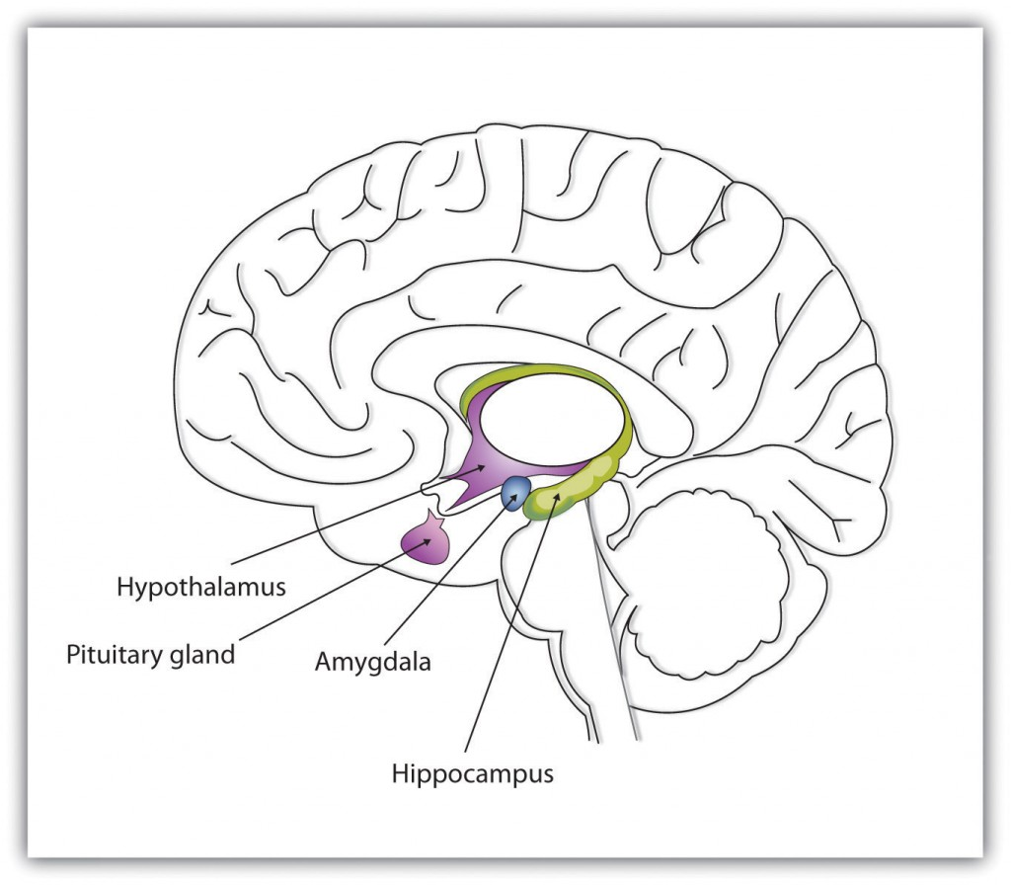
Limbic System
HAWKES LEARNING
This Photo by Unknown Author is licensed under CC BY-SA-NC
Notes:
The limbic system is important to feelings of emotions. For example, the hypothalamus activates the sympathetic nervous system whereas the amygdala is responsible for tying emotional value to learned information. The hippocampus can be impacted by stress, resulting in reductions in size.

Slide 11






Impact of Culture
HAWKES LEARNING
Notes:
It is important to keep in mind the fact that cultural display rules can influence the demonstration of emotions. For example, people in the United States are more likely to show emotions in front of others whereas Japanese individuals do not.

Slide 12
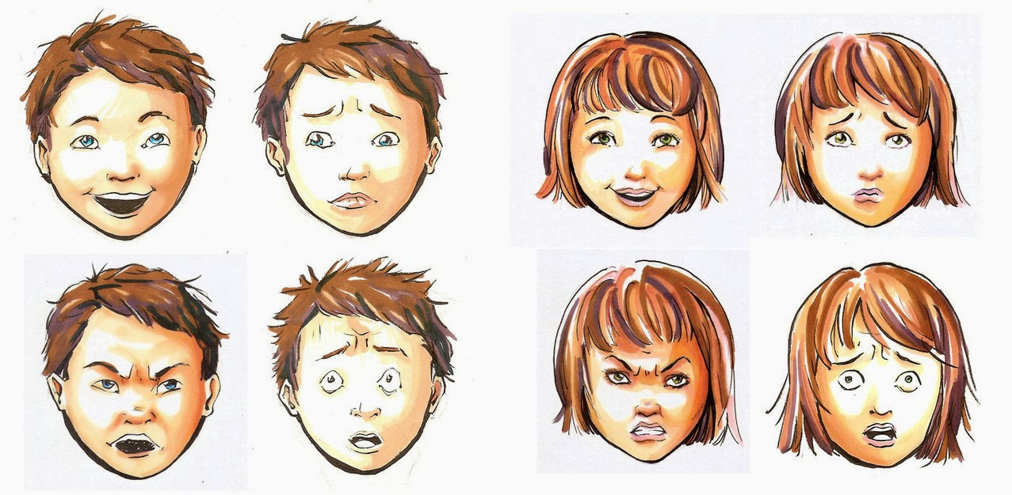
Emotions
HAWKES LEARNING
This Photo by Unknown Author is licensed under CC BY
Notes:
However, even though we may not always show emotions due to our cultures, our ability to decipher emotions on the faces of others, specifically 7 different emotions of happiness, surprise, sadness, fright, disgust, contempt, and anger.

Slide 13




HAWKES LEARNING

