Slide 1
HAWKES LEARNING
Describing and Analyzing Data

Slide 2
Lesson Goals
Measures of Central Tendency
Measures of Dispersion
The Empirical Rule
Measures of Relative Position
HAWKES LEARNING

Slide 3
Measures of Central Tendency
Mean is often referred to as the average. $\frac{x_{1}+x_{2}+⋯+x_{n}}{N}$
The median of the data set is the middle value in an array of the data.
The mode is the value in the data set that occurs most frequently.
An outlier is a value in the data that is extreme compared with the rest of the data.
HAWKES LEARNING

Slide 4
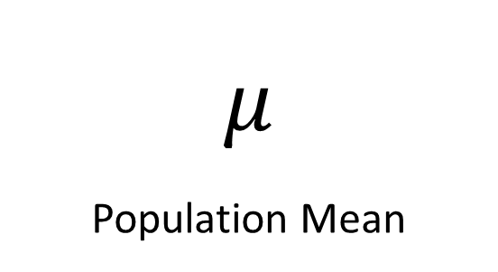
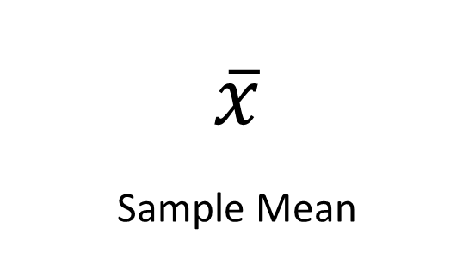
Mean
$$μ$$
Population Mean
$$\overline{x}$$
Sample Mean
vs
HAWKES LEARNING
Notes:
Class width is the number of distinct data points each class may contain. The class widths must be the same for all classes in a grouped frequency distribution. Secondly, the classes should never overlap. The class width will always equal the difference between either consecutive lower class limits or consecutive upper class limits.
Class limits
Upper limit- The highest point or number in the class width.
Lower limit- The lowest point or number in the class width.

Slide 5
Measures of Dispersion
The range is the difference between the largest and the smallest number in the data set.
The standard deviation is a measure of how much we might expect a member of the data to differ from the mean.
HAWKES LEARNING
Notes:
A frequency distribution is a count of every member of the data set and how often each value occurs
Relative Frequency Distribution- The relative frequency of a class is the percentage of all data that fall into that particular class. It can be displayed as a percentage or a fraction.
Grouped Frequency Distribution- Data is grouped into categories/ classes that have the same width and do not overlap
Class width
Discrete categories- no overlap

Slide 6
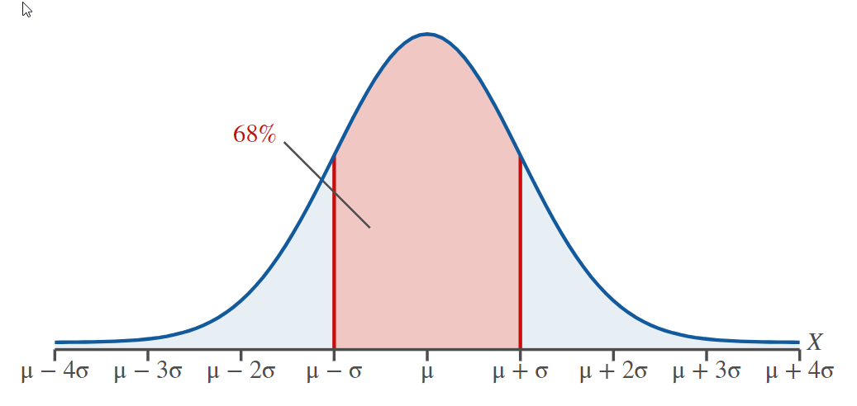
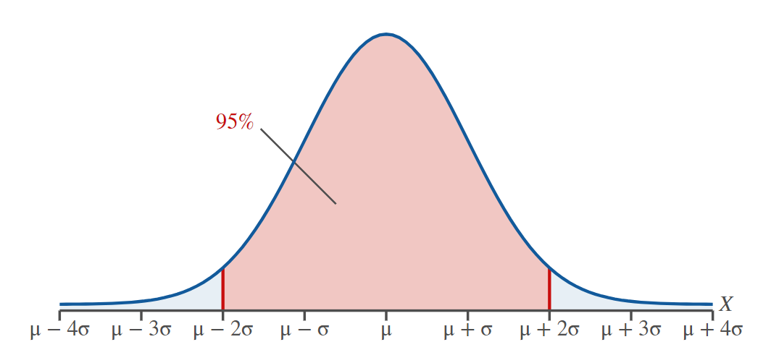
The Empirical Rule
or
HAWKES LEARNING

Slide 7
Measures of Relative Position
Percentiles divide the data into 100 equal parts and tell you approximately what percentage of the data lies at or below a given value.
Example: The 25th percentile is the first 25% of the data that is less than or equal to the value identified.
The median represents the 50th percentile.
HAWKES LEARNING
Notes:
Bars can be horizontal or vertical
It's also a useful tool if we are more interested in the frequencies in individual categories rather than how the categories compare to the whole.
The width says nothing about bar. The height is the frequency.
A side-by-side bar graph is just as the title suggests. The bars are placed next to one another to show the similarities and/or differences between populations.
A stacked bar graph places the bars from each population on top of one another. This allows the reader to compare different categories and how the whole of each category is broken down.

Slide 8




HAWKES LEARNING

