Slide 1
HAWKES LEARNING
Theoretical Perspectives on Society

Slide 2
Lesson Goals
Society through the major theoretical perspectives:
Functionalism
Conflict Theory
Social Interactionism
HAWKES LEARNING

Slide 3
Émile Durkheim and Functionalism
Collective conscience: the communal beliefs, morals, and attitudes of a society
Social integration: how strongly a person is connected to their social group
Preindustrial societies: mechanical solidarity (low division of labor) Industrial societies: organic solidarity (high division of labor)
Anomie: without law; experienced in times of social uncertainty, like war or a large change in the economy

Slide 4
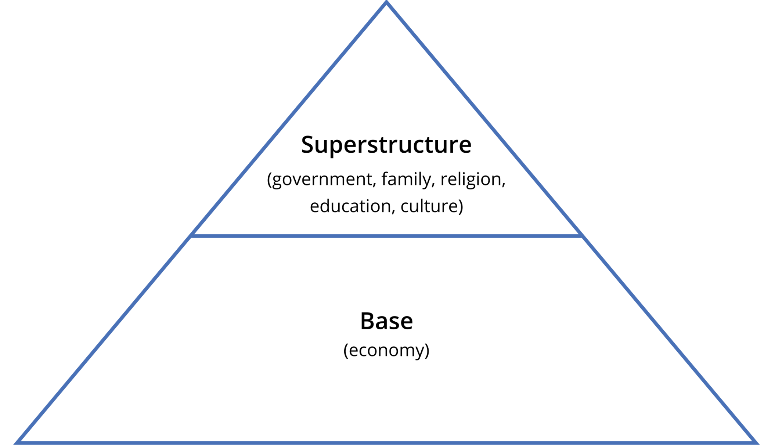
Karl Marx and Conflict Theory
Conflict as the primary means of social change
Saw conflict between owners of the means of production and laborers
Believed conflict happened in times of social revolution
Capitalism: “dictatorship of the bourgeoisie”

Slide 5
Karl Marx and Conflict Theory
Alienation: the condition in which the individual is separated emotionally and psychologically from their society, work, and sense of self
Alienation from the product of one’s labor
Alienation from the process of one’s labor
Alienation from others
Alienation from one’s self

Slide 6
Karl Marx and Conflict Theory
False consciousness: a condition in which a person's beliefs, ideals, or ideology are not in their own best interest
Class consciousness: the awareness of one's rank in society; a way to overcome false consciousness
Class as advocate for social improvements
HAWKES LEARNING

Slide 7
Max Weber and Social Interactionism
Status based on noneconomic factors: education, kinship, religion
Both status and class determine someone’s power or influence; status class and power are base of society.
Rational society: built around logic and efficiency, not morality and tradition; societies can become too rational.
If rationality and efficiency are the main focuses, it can be dehumanizing.
HAWKES LEARNING

Slide 8
Max Weber and Social Interactionism
Iron cage: result of industrialization and rationalization; where the individual is trapped by institutions
Disenchantment of the world: final condition of humanity
Rationalized, modern society: more supermarkets than family-owned stores → is it universally desirable?
HAWKES LEARNING

Slide 9
The Protestant Work Ethic
Predestination
Protestant Work Ethic
All events have already been decided by God.
Hardworking and successful: chosen
Lazy or indifferent: damned
People are encouraged to work hard for personal gain and forego helping others.
Became foundation of capitalism
HAWKES LEARNING

Slide 10




HAWKES LEARNING

