Slide 1
Section 10.R.1
Multiplication and Division with Fractions and Mixed Numbers

Slide 2
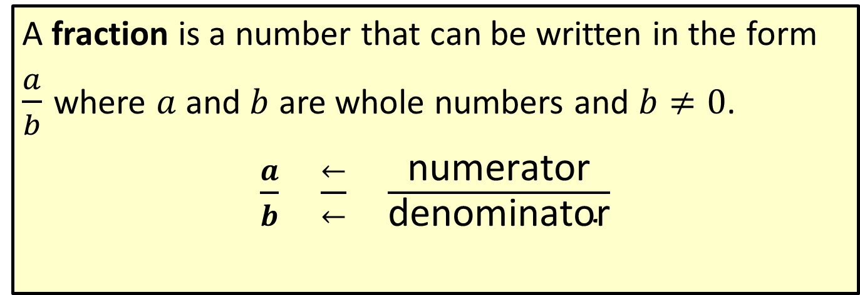
Definition: Fraction
A fraction is a number that can be written in the form
$\frac{a}{b}$ where $a$ and $b$ are whole numbers and $b≠0$.
​$\begin{matrix}\frac{a}{b} & \frac{←}{←} & \frac{\text{numerator}}{\text{denominator}}\end{matrix}$

Slide 3
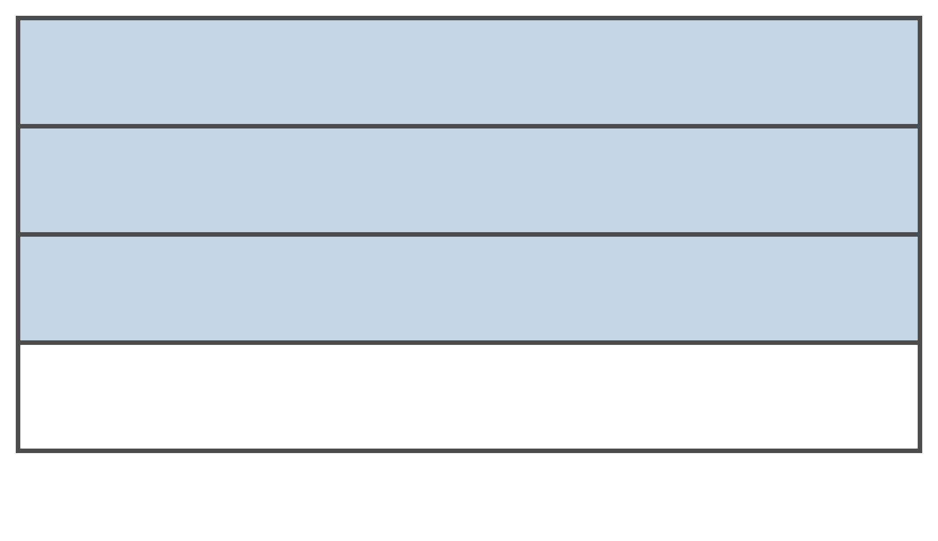
Example 1: Understanding Fractions
Write a fraction indicating
a. ​the shaded part of the rectangle and
b. ​the unshaded part of the rectangle.
Solution

Slide 4
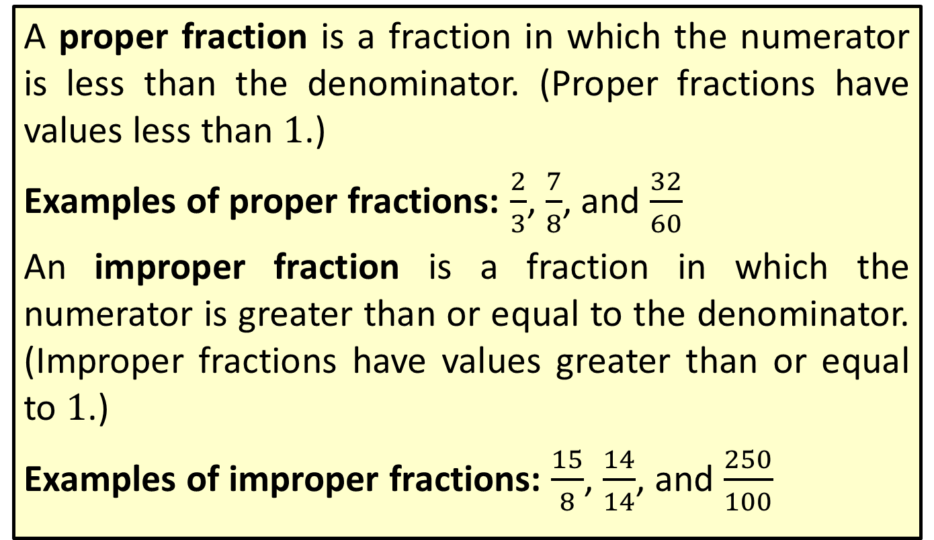
Definition: Proper Fractions and Improper Fractions
A proper fraction is a fraction in which the numerator is less than the denominator. (Proper fractions have values less than 1.)
Examples of proper fractions: $\frac{2}{3}$, $\frac{7}{8}$, and $\frac{32}{60}$
An improper fraction is a fraction in which the numerator is greater than or equal to the denominator. (Improper fractions have values greater than or equal to 1.)
Examples of improper fractions: $\frac{15}{8}$, $\frac{14}{14}$, and $\frac{250}{100}$

Slide 5
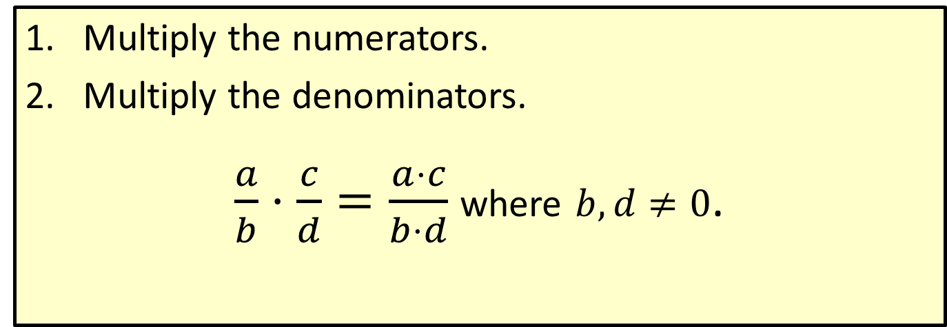
Procedure: To Multiply Fractions
​Multiply the numerators.
​Multiply the denominators.
​$\frac{a}{b}⋅\frac{c}{d}=\frac{a⋅c}{b⋅d}$ where $b,d≠0$.

Slide 6

Example 2: Multiplying Fractions
Find the product of $\frac{1}{3}$ and $\frac{2}{7}$.
Solution

Slide 7

Example 3: Multiplying Fractions
Find $\frac{2}{5}$ of $\frac{7}{3}$.
Solution

Slide 8

Example 4: Multiplying Fractions
Multiply.
​$\frac{4}{13}⋅3$
​$\frac{9}{8}⋅0$
​$\frac{4}{3}⋅\frac{5}{3}⋅\frac{2}{7}$
Solution

Slide 9

Example 5: Finding Equivalent Fractions
Find the missing numerator that will make the fractions equivalent.
$$\frac{3}{4}=\frac{?}{36}$$
Solution

Slide 10

Example 6: Finding Equivalent Fractions
Find the missing numerator that will make the fractions equivalent.
$$\frac{11}{10}=\frac{?}{50}$$
Solution

Slide 11

Example 7: Reducing Fractions to Lowest Terms
Reduce $\frac{16}{28}$ to lowest terms.
Solution
Find the prime factorization of the numerator and the denominator, then divide out the common factors.

Slide 12

Example 8: Reducing Fractions to Lowest Terms
Reduce $\frac{45}{36}$ to lowest terms.
Solution
Using prime factors, we have

Slide 13

Example 9: Multiplying and Reducing Fractions
Multiply and reduce to lowest terms.
$$\frac{18}{35}⋅\frac{21}{12}$$
Solution

Slide 14

Example 10: Multiplying and Reducing Fractions
Multiply and reduce to lowest terms.
$$\frac{17}{50}⋅\frac{25}{34}⋅8$$
Solution
not a prime number.

Slide 15

Example 11: Multiplying and Reducing Fractions
Multiply and reduce to lowest terms.
$$\frac{3}{35}⋅\frac{15}{4}⋅\frac{7}{9}$$
Solution

Slide 16
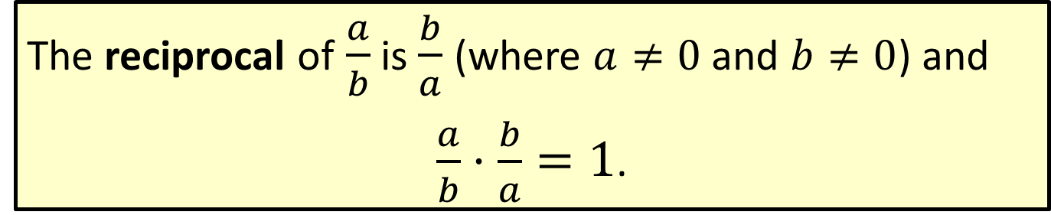
Definition: Reciprocal
The reciprocal of $\frac{a}{b}$ is $\frac{b}{a}$ (where $a≠0$ and $b≠0$) and
$\frac{a}{b}⋅\frac{b}{a}=1$.

Slide 17
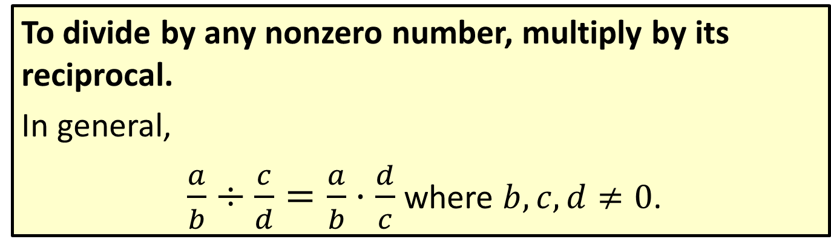
Procedure: To Divide Fractions
To divide by any nonzero number, multiply by its reciprocal.
In general,
$\frac{a}{b}÷\frac{c}{d}=\frac{a}{b}⋅\frac{d}{c}$ where $b,c,d≠0$.

Slide 18

Example 12: Dividing Fractions
Divide:
​$\frac{2}{3}÷\frac{5}{8}$
​$\frac{3}{4}÷4$
Solution

Slide 19

Example 13: Dividing and Reducing Fractions
Divide and reduce to lowest terms.
$$\frac{16}{27}÷\frac{8}{9}$$
Solution

Slide 20

Example 14: Application: Writing and Reducing Fractions
If you had $\$30$ and you spent $\$26$ to buy a computer keyboard,
​What fraction of your money did you spend for the keyboard?
​What fraction do you still have?
Solution

Slide 21

Example 15: Application: Dividing Fractions
A truck is towing 3000 pounds. This is $\frac{2}{3}$ of the truck's towing capacity.
a. Can the truck tow more than 3000 pounds?
b. If you were to multiply $\frac{2}{3}$ times 3000, would the product be more or less than 3000?
c. What is the towing capacity of the truck?
Solution

