Slide 1
Section 10.R.3
Addition and Subtraction with Fractions

Slide 2
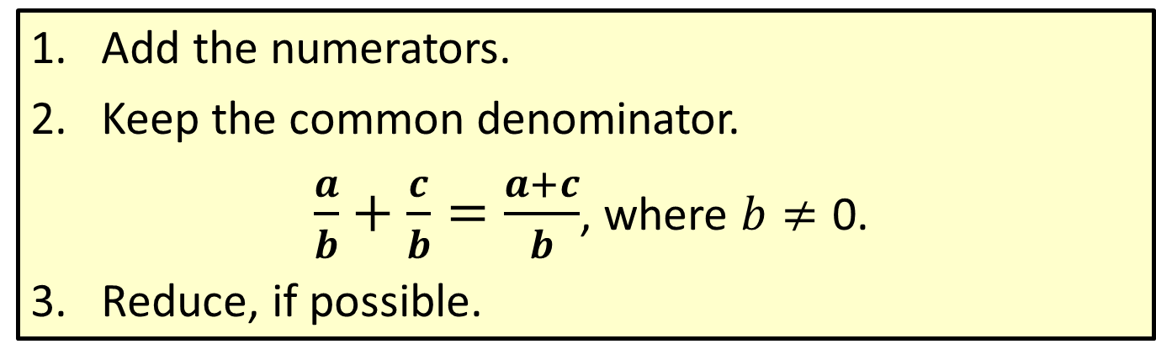
Procedure: To Add Fractions with the Same Denominator
​Add the numerators.
​Keep the common denominator.
$\frac{a}{b}+\frac{c}{b}=\frac{a+c}{b}$, where $b≠\text{0}$.
​Reduce, if possible.

Slide 3

Example 1: Adding Fractions with the Same Denominator
Find the sum: $\frac{1}{5}+\frac{2}{5}$
Solution

Slide 4

Example 2: Adding Fractions with the Same Denominator
Find the sum: $\frac{1}{11}+\frac{2}{11}+\frac{3}{11}$
Solution

Slide 5
Procedure: To Add Fractions with Different Denominators
​Find the least common denominator (LCD).
​Change each fraction into an equivalent fraction with that denominator.
​Add the new fractions.
​Reduce, if possible.

Slide 6
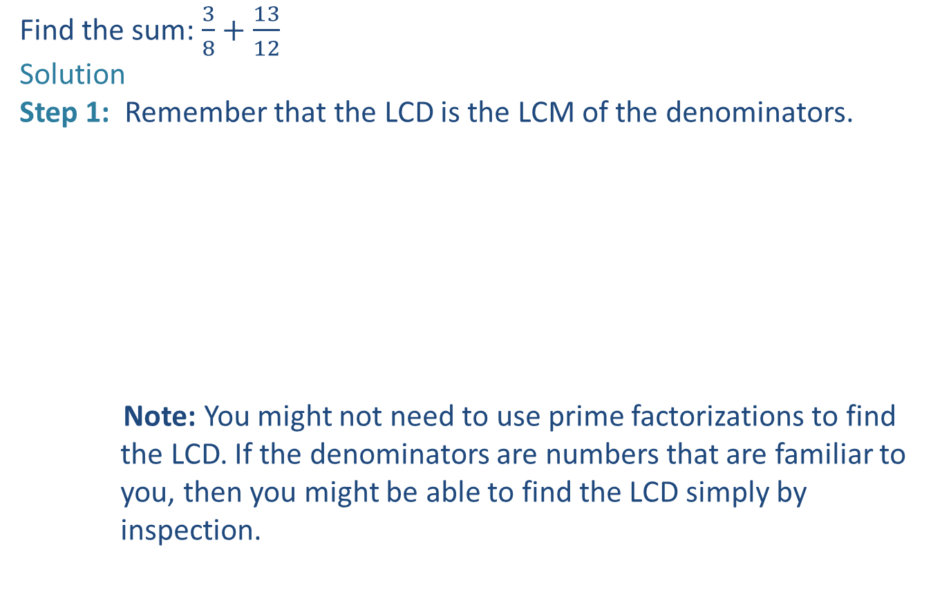
Example 3: Adding Fractions with Different Denominators
Find the sum: $\frac{3}{8}+\frac{13}{12}$
Solution
Step 1: Remember that the LCD is the LCM of the denominators.
Note: You might not need to use prime factorizations to find
the LCD. If the denominators are numbers that are familiar to
you, then you might be able to find the LCD simply by
inspection.

Slide 7
Example 3: Adding Fractions with Different Denominators (cont.)

Slide 8

Example 4: Adding Fractions with Different Denominators
Find the sum: $\frac{7}{45}+\frac{7}{36}$
Solution
Step 1: Find the LCD.
Step 2: Steps 2, 3, and 4 can be written together in one step.

Slide 9
Example 4: Adding Fractions with Different Denominators (cont.)
Notice that, in adding fractions, we also may choose to write them vertically.
The process is the same.

Slide 10
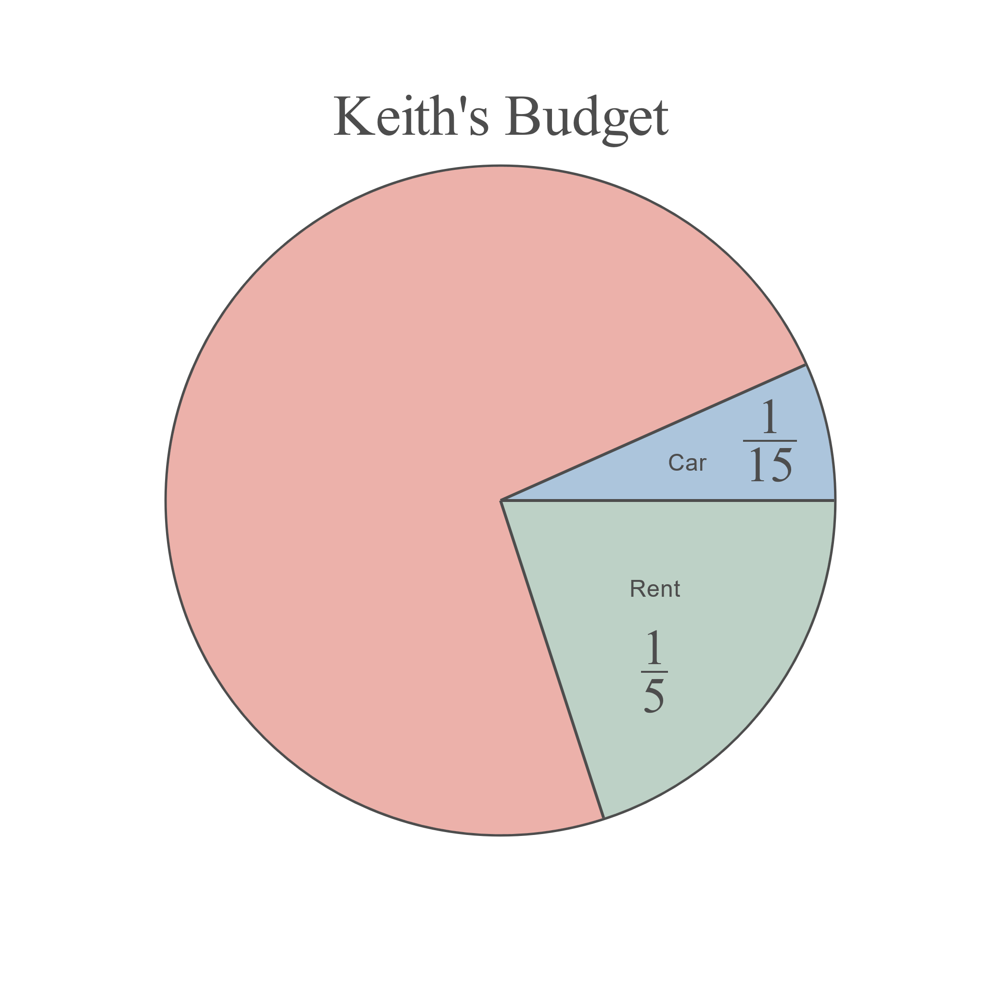

Example 5: Application: Adding Fractions
If Keith's total income for the year was $\$48,000$ and he spent $\frac{1}{5}$ of his income on rent and $\frac{1}{15}$ of his income on his car, what total amount did he spend on these two items?
Solution
We can add the two fractions and then multiply the sum by $48,000. (Or we can multiply each fraction by $48,000, and then add the results. We will get the same answer either way.) The LCD is 15.

Slide 11
Example 5: Application: Adding Fractions (cont.)

Slide 12
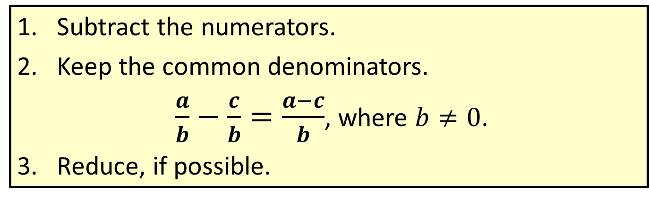
Procedure: To Subtract Fractions with the Same Denominator
​Subtract the numerators.
​Keep the common denominators.
$\frac{a}{b}−\frac{c}{b}=\frac{a−c}{b}$, where $b≠0$.
​Reduce, if possible.

Slide 13

Example 6: Subtracting Fractions with the Same Denominator
Find the difference: $\frac{9}{10}−\frac{7}{10}$
Solution
The difference is reduced just as any fraction is reduced.

Slide 14
To Subtract Fractions with Different Denominators
​Find the least common denominator (LCD).
​Change each fraction to an equivalent fraction with that denominator.
​Subtract the new fractions.
​Reduce, if possible.

Slide 15

Example 7: Subtracting Fractions with Different Denominators
Find the difference: $\frac{9}{10}−\frac{2}{15}$
Solution
Step 1: Find the LCD.
Step 2: Find fractions equivalent to

Slide 16
Example 7: Subtracting Fractions with Different Denominators (cont.)
Step 3: Subtract.
Step 4: Reduce, if possible.

Slide 17

Example 8: Subtracting Fractions with Different Denominators
Find the difference: $\frac{7}{20}−\frac{3}{28}$
Solution
Step 1: Find the LCD.
Step 2: Steps 2, 3, and 4 can be written in one step.

Slide 18
Example 8: Subtracting Fractions with Different Denominators (cont.)
Or, we can write the fractions vertically.

