Slide 1
Section 10.R.5
Determining Sample Spaces

Slide 2
Definition: Terms Related to Probability
Outcome: An individual result of an experiment.
Sample Space: The set of all possible outcomes of an experiment.
Event: Some (or all) of the outcomes from the sample space.

Slide 3
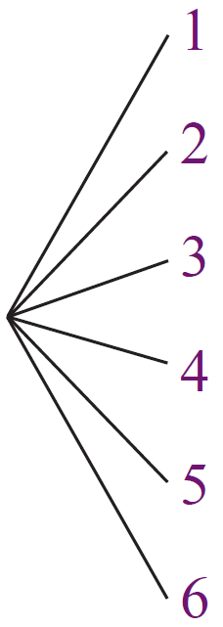
Example 1: Finding All Outcomes Using a Tree Diagram
A 6-sided die is rolled. Draw a tree diagram illustrating the possible outcomes of
this experiment.
Solution
Since the die has 6 sides, we will label
the possible outcomes as 1, 2, 3, 4, 5,
and 6.

Slide 4
Example 2: Finding the Sample Space Using a Tree Diagram
A coin is tossed twice. Draw a tree diagram illustrating this experiment and list the possible outcomes in the sample space.
Solution
Following the branches (left to right) shows the four outcomes in the sample space.

Slide 5
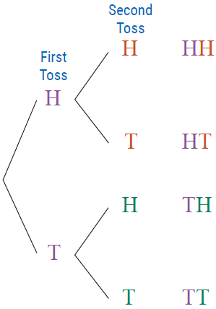
Example 2: Finding the Sample Space Using a Tree Diagram (cont.)
Outcomes: HH, HT, TH, TT

Slide 6
Example 3: Finding the Sample Space Using a Tree Diagram
A coin is tossed and then one of the numbers (1, 2, and 3) is chosen at random from a box. Draw a tree diagram illustrating the possible outcomes of the experiment and list the outcomes in the sample space.
Solution
There are six outcomes in the sample space.

Slide 7
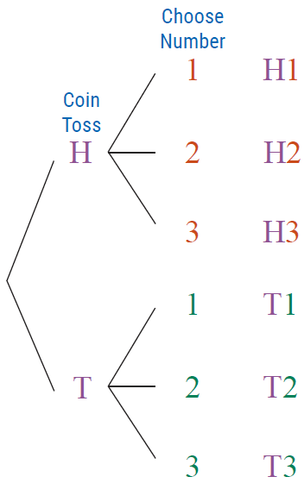
Example 3: Finding the Sample Space Using a Tree Diagram (cont.)
Outcomes:
H1, H2, H3, T1, T2, T3

