Slide 1
Section 11.R.5
Evaluating Radicals

Slide 2
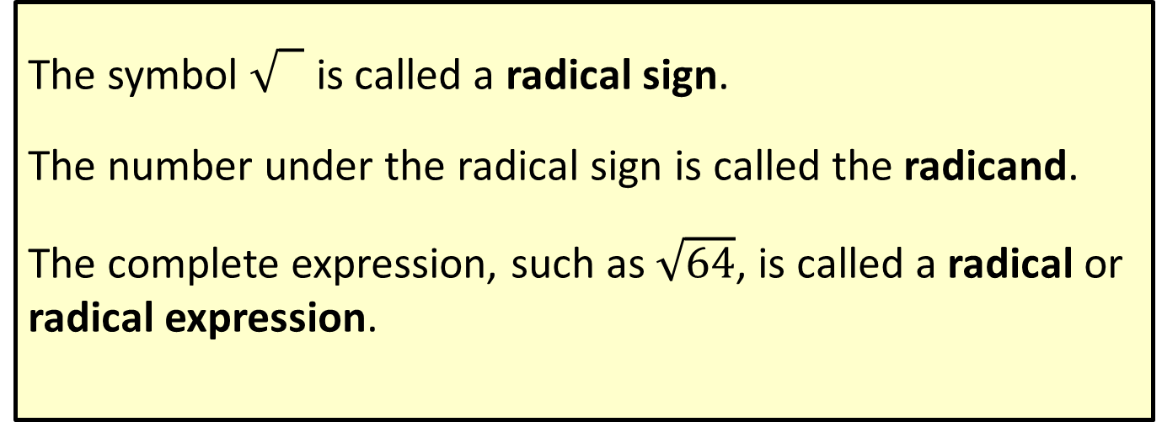
Definition: Radical Terminology
The symbol 0 is called a radical sign.
The number under the radical sign is called the radicand.
The complete expression, such as $\sqrt{64}$, is called a radical or radical expression.

Slide 3
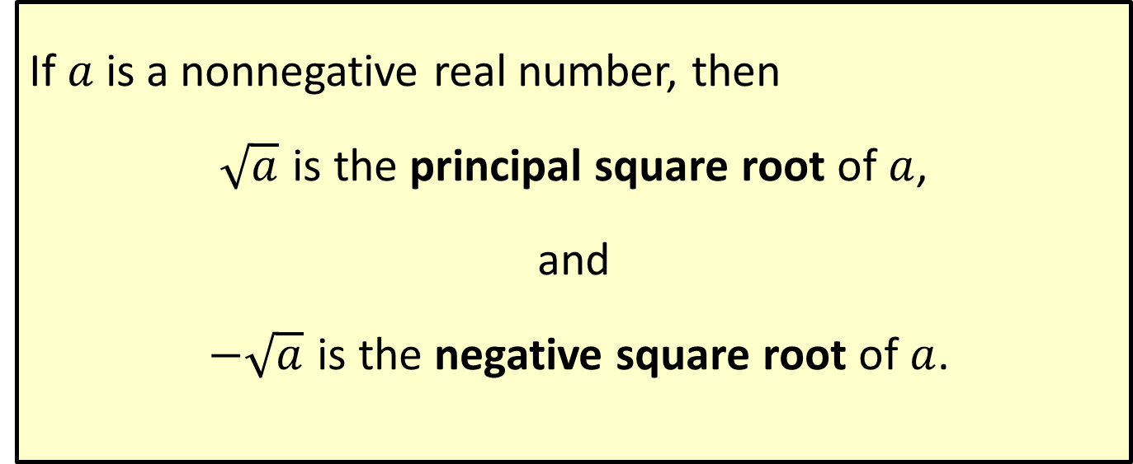
Definition: Square Root
If $a$ is a nonnegative real number, then
$\sqrt{a}$ is the principal square root of $a$,
and
$−\sqrt{a}$ is the negative square root of $a$.

Slide 4

Example 1: Evaluating Square Roots
$\sqrt{36}$ ​
$\sqrt{121}$
​ $\sqrt{0}$
​ $\sqrt{−25}$
Solution

Slide 5

Example 2: Evaluating Square Roots
​$\sqrt{\frac{16}{25}}$​
$−\sqrt{0.0009}$
Solution

Slide 6
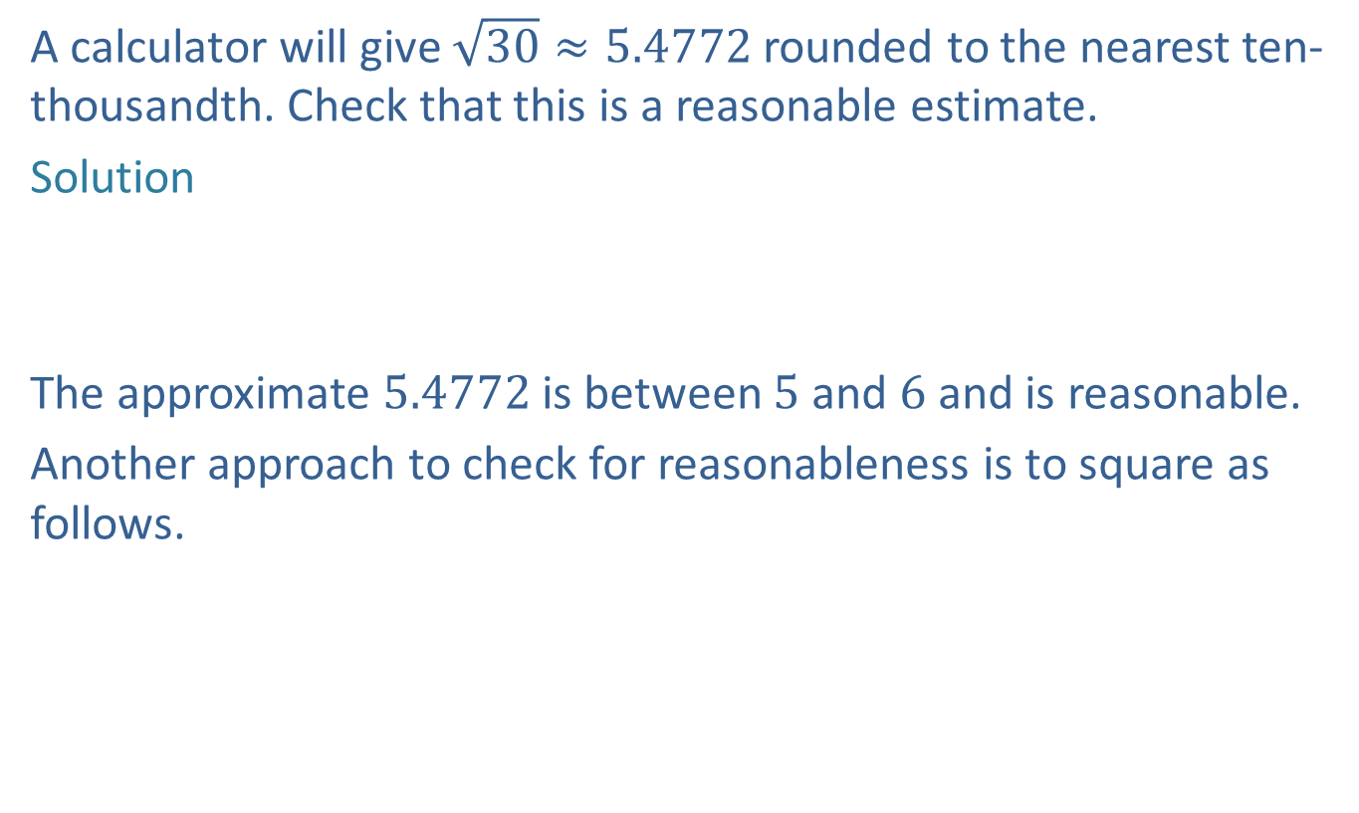
Example 3: Estimating Square Roots
A calculator will give $\sqrt{30}≈5.4772$ rounded to the nearest ten-thousandth. Check that this is a reasonable estimate.
Solution
The approximate 5.4772 is between 5 and 6 and is reasonable.
Another approach to check for reasonableness is to square as follows.

Slide 7
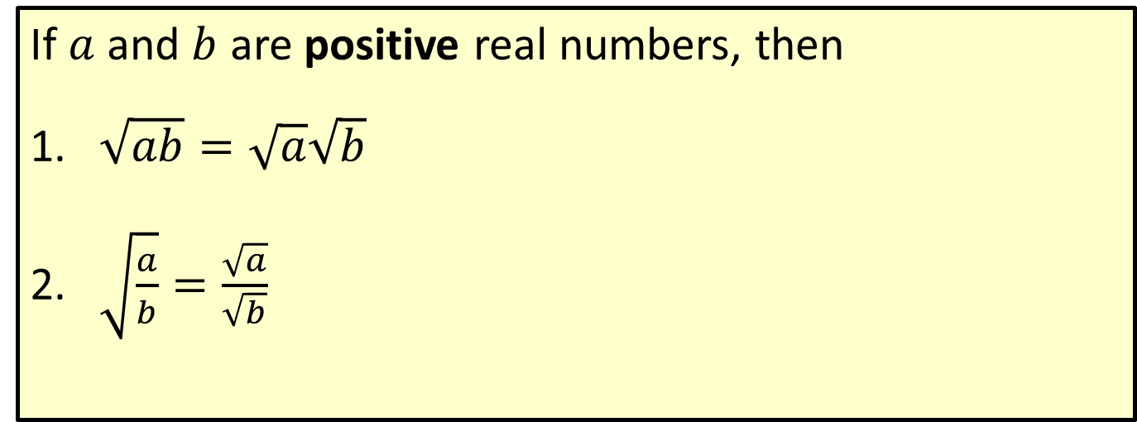
Properties of Square Roots
If $a$ and $b$ are positive real numbers, then
​$\sqrt{ab}=\sqrt{a}\sqrt{b}$
​$\sqrt{\frac{a}{b}}=\frac{\sqrt{a}}{\sqrt{b}}$

Slide 8
Definition: Simplest Form for Square Roots
A square root is considered to be in simplest form when the radicand has no perfect square as a factor.

Slide 9

Example 4: Simplifying Radical Expressions
Simplify each numerical expression so that there are no perfect square factors in the radicand.
​$\sqrt{48}$
​$\sqrt{63}$
​$\sqrt{\frac{75}{16}}$
Solution

