Slide 1
Section 5.R.1
Operations with Real Numbers

Slide 2
Definition: Rules for Addition with Real Numbers
​To add two real numbers with like signs,
  ​add their absolute values and
  ​use the common sign.
​To add two real numbers with unlike signs,
  ​subtract their absolute values (the smaller from the larger), and
  ​use the sign of the number with the larger absolute value.

Slide 3
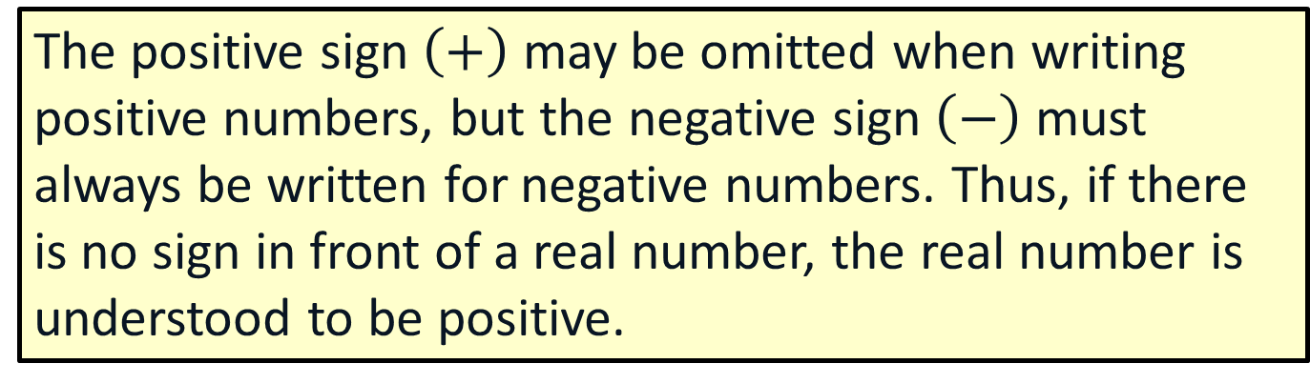
Note
The positive sign $\left(+\right)$ may be omitted when writing positive numbers, but the negative sign $\left(−\right)$ must always be written for negative numbers. Thus, if there is no sign in front of a real number, the real number is understood to be positive.

Slide 4
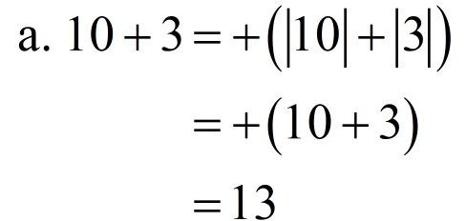

Example 1: Addition with Like Signs
Add.
​ $10+3$
$\left(−10\right)+(−3)$
​$\left(−1.4\right)+(−2.5)$
Solution
a.
Add the absolute values, + is the common sign.

Slide 5
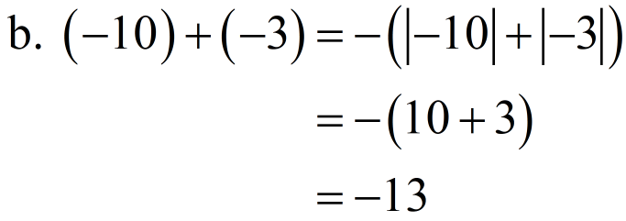

Example 1: Addition with Like Signs (cont.)
Add the absolute values, − is the common sign.
Add the absolute values, − is the common sign.

Slide 6
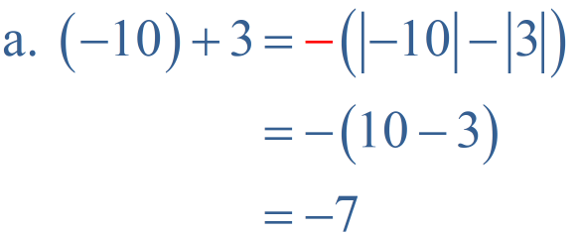

Example 2: Addition with Unlike Signs
Add.
$\left(−10\right)+3$
$10+\left(−3\right)$
$−\frac{7}{11}+\frac{5}{11}$
Solution
Subtract the absolute values. Use – because |-10|>|3|.

Slide 7
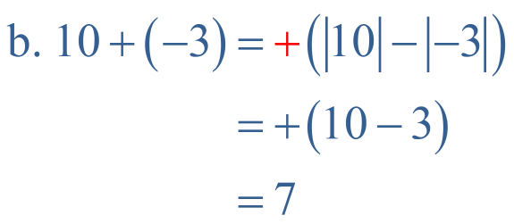
Example 2: Addition with Unlike Signs (cont.)
v
Subtract the absolute values.
Use + because |10|>|−3|.
Subtract the absolute values.
Use – because

Slide 8
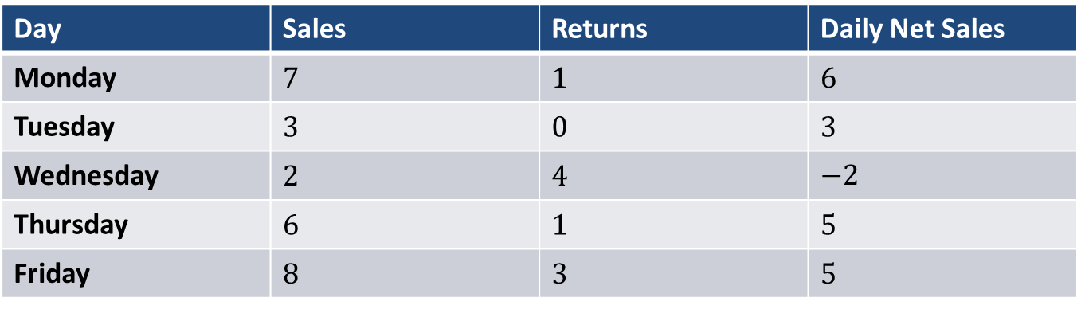
Example 3: Application: Reading a Table
Susan is a salesperson for a shoe store. Last week her sales of pairs of shoes were as follows.
Day | Sales | Returns | Daily Net Sales
Monday | 7 | 1 | 6
Tuesday | 3 | 0 | 3
Wednesday | 2 | 4 | $$−2$$
Thursday | 6 | 1 | 5
Friday | 8 | 3 | 5
What were Susan's net sales for last week?
Solution
Susan’s net sales for the week were 17 pairs of shoes.

Slide 9
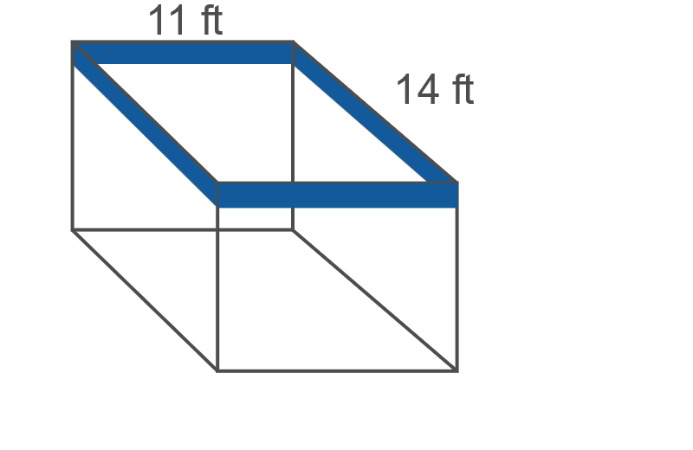

Example 4: Application: Calculating the Perimeter of a Rectangle
Barbara is redecorating and wants to put a wallpaper border around the top edge of her dining room. The dining room is in the shape of a rectangle and the dimensions are $11 ft$ by $14 ft$. How many feet of wallpaper border will she need?

Slide 10
Example 4: Application: Calculating the Perimeter of a Rectangle (cont.)
Solution
To determine the amount of wallpaper border needed, find the distance around the top edge of the room. To do this, add the lengths of each side of the room together.
Perimeter
Barbara will need 50 feet of wallpaper border.

Slide 11
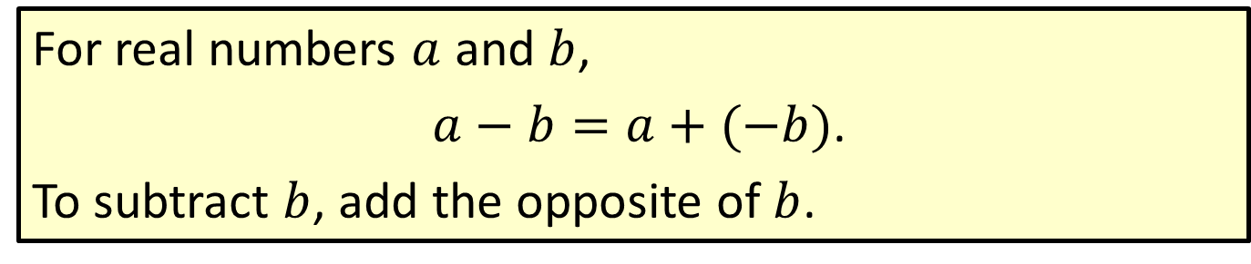
Definition: Rule for Subtraction with Real Numbers
For real numbers $a$ and $b$,
$a−b=a+(−b)$.
To subtract $b$, add the opposite of $b$.

Slide 12
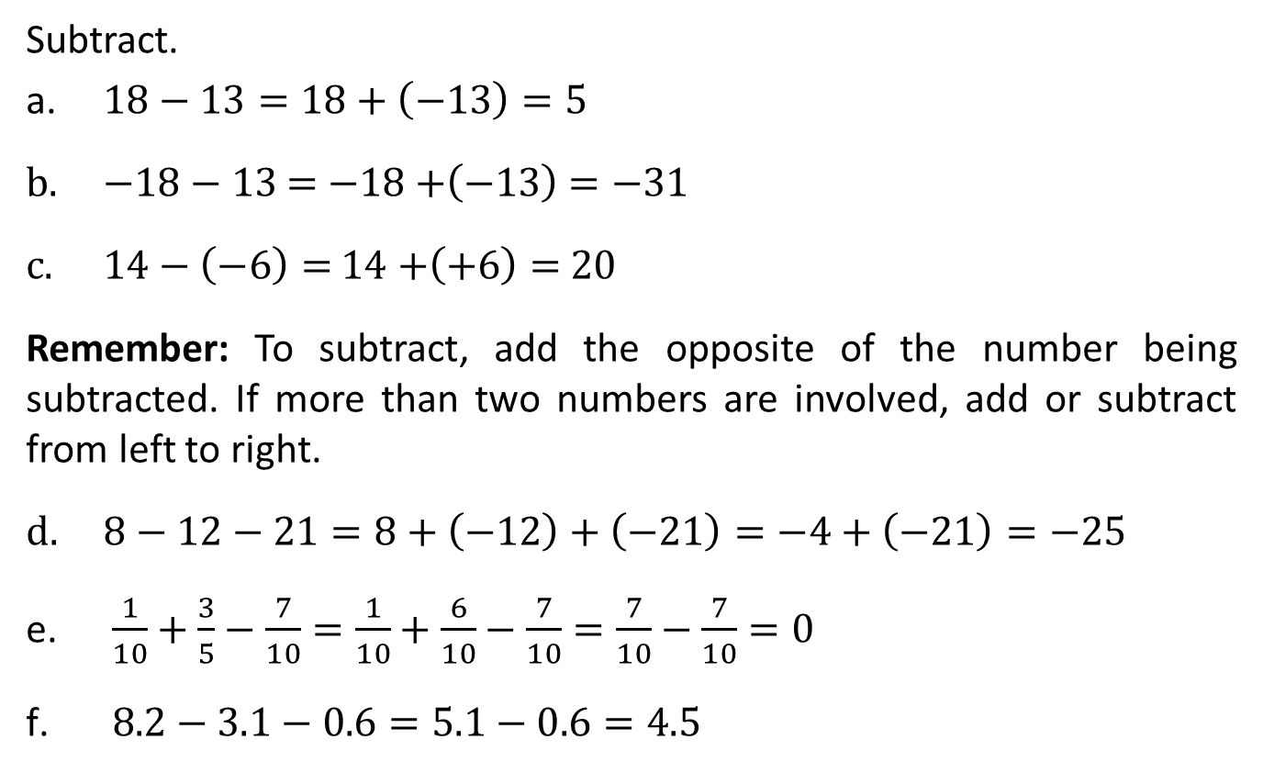
Example 5: Subtraction with Real Numbers
Subtract.
​$18−13=18+\left(−13\right)=5$
$−18−13$ $=$ $−18+$​$\left(−13\right)$ $=−31$
$14−\left(−6\right)=$ $14$ $+$​$\left(+6\right)=$ $20$
Remember: To subtract, add the opposite of the number being subtracted. If more than two numbers are involved, add or subtract from left to right.
$8−12−21=8+\left(−12\right)+\left(−21\right)=−4+\left(−21\right)=−25$
$\frac{1}{10}+\frac{3}{5}−\frac{7}{10}=$ $\frac{1}{10}+\frac{6}{10}−\frac{7}{10}=$ $\frac{7}{10}−\frac{7}{10}=0$
$8.2−3.1−0.6=5.1−0.6=4.5$
Subtracting 13 is the same as adding −13.
Subtracting −6 is the same as adding +6.

Slide 13
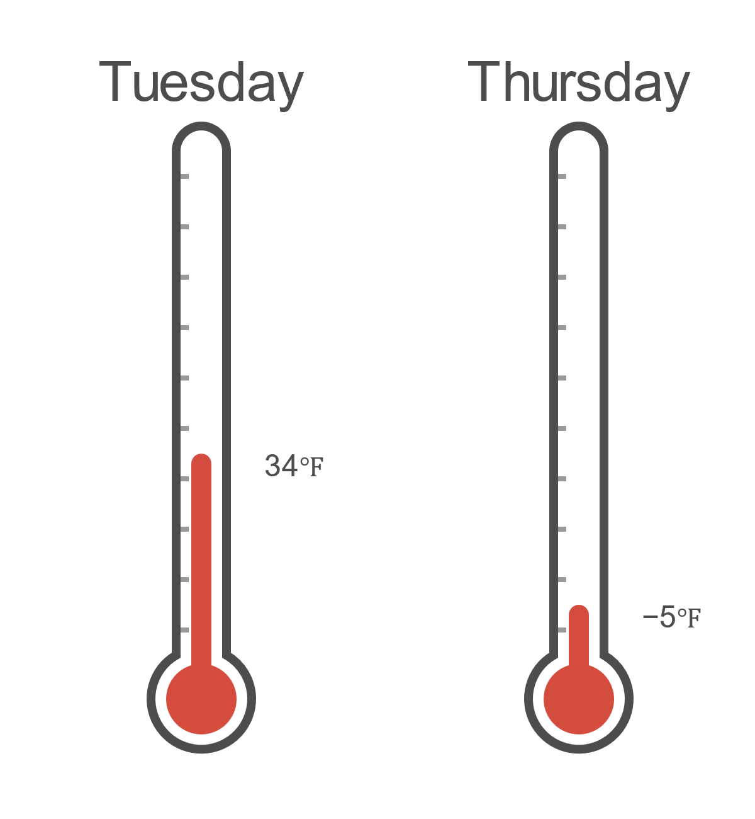

Example 6: Application: Calculating Change in Value
At noon on Tuesday the temperature was $34℉$. By noon on Thursday the temperature had dropped to $−5℉$. How much did the temperature drop between Tuesday and Thursday?

Slide 14
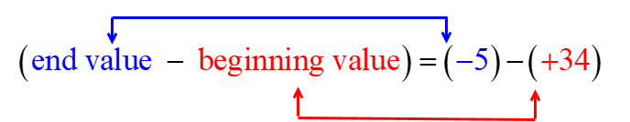
Example 6: Application: Calculating Change in Value (cont.)
Solution
For change in value:
Between Tuesday and Thursday the temperature changed −39 ℉ (or dropped 39 ℉).

Slide 15
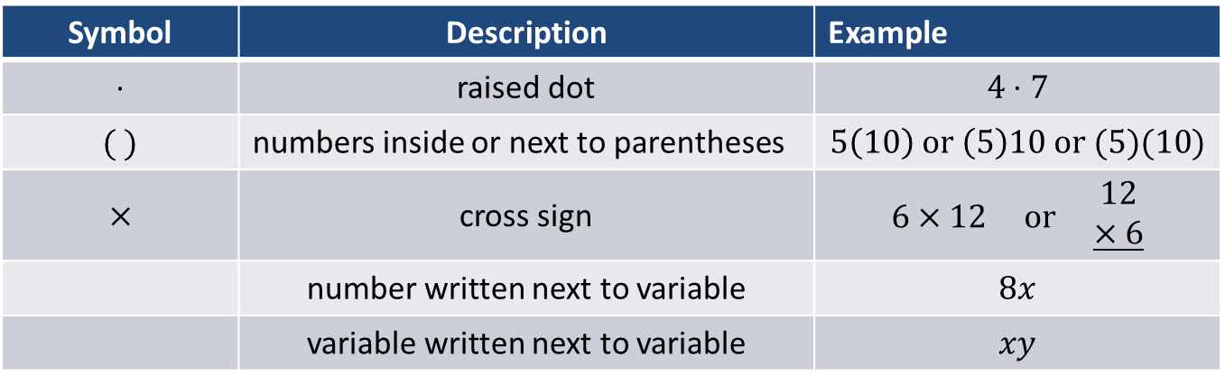
Table 1: Symbols for Multiplication
Symbol | Description | Example
∙ | raised dot | $$4 \text{∙} 7$$
$$( )$$ | numbers inside or next to parentheses | $$5\left(10\right) or \left(5\right)10 or (5)(10)$$
$$×$$ | cross sign | $$6×12 or \begin{aligned}12 \\ \underline{×6}\end{aligned}$$
 | number written next to variable | $$8x$$
 | variable written next to variable | $$xy$$

Slide 16
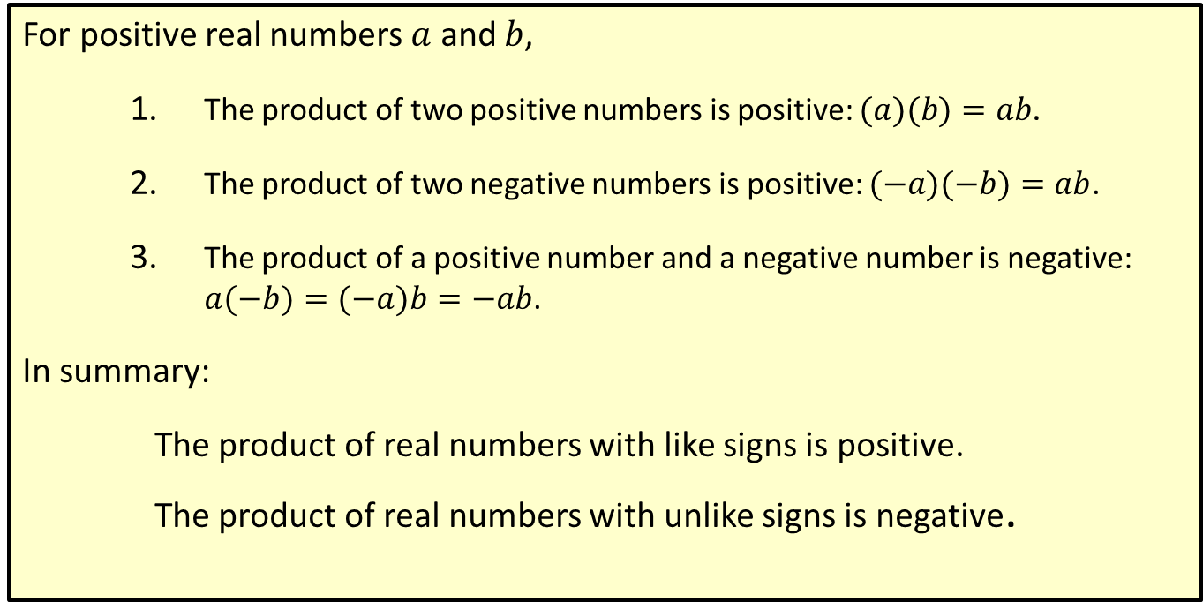
Procedure: Rules for Multiplying Positive and Negative Real Numbers
For positive real numbers $a$ and $b$,
  ​The product of two positive numbers is positive: $(a)(b)=ab$.
  ​The product of two negative numbers is positive: $(−a)(−b)=ab$.
  ​The product of a positive number and a negative number is negative: $a(−b)=(−a)b=−ab$.
In summary:
The product of real numbers with like signs is positive.
The product of real numbers with unlike signs is negative.

Slide 17

Example 7: Multiplication with Positive and Negative Real Numbers
Multiply.
​ $8(−5)$ $=$ $−40$
​$−6\left(\frac{1}{2}\right)$ $=−3$
​$9(−4)(2)$ $=$ $−36\left(2\right)=−72$
​ $−3(−4)$ $=12$
​$\left(−\frac{3}{4}\right)\left(−\frac{1}{2}\right)$ $=$
​$(−2.1)(−0.03)$ $=0.063$
Product of a positive and a negative is negative.
Product of two negatives is positive.

Slide 18
Definition: Area of a Rectangle
The area of a rectangle (measured in square units) is found by multiplying its length by its width.

Slide 19
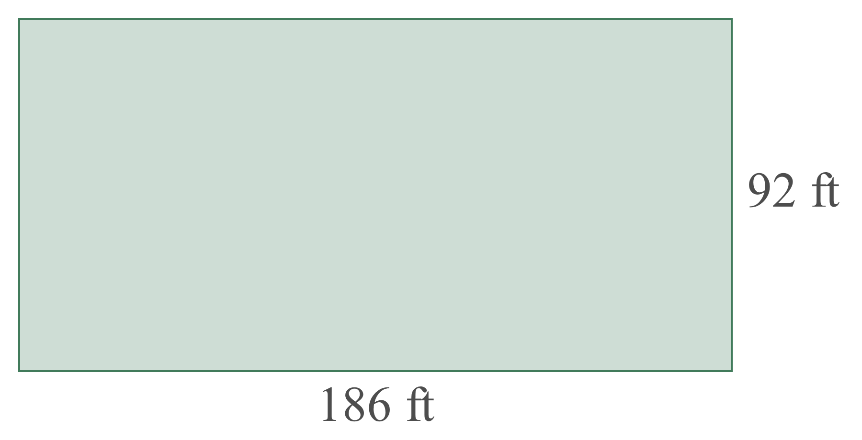
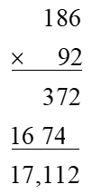

Example 8: Application: Calculating the Area of a Rectangle
Calculate the area of a rectangular plot of land with the dimensions shown here.
Solution
To find the area, we multiply: $186 ft∙92 ft$.
square feet

Slide 20
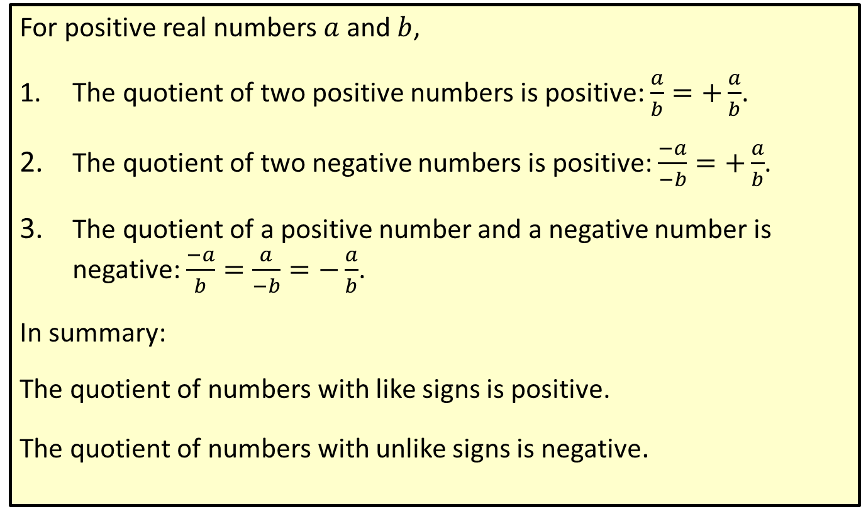
Procedure: Rules for Dividing Positive and Negative Real Numbers
For positive real numbers $a$ and $b$,
​The quotient of two positive numbers is positive: $\frac{a}{b}=+\frac{a}{b}$.
​The quotient of two negative numbers is positive: $\frac{−a}{−b}=+\frac{a}{b}$.
​The quotient of a positive number and a negative number is negative: $\frac{−a}{b}=\frac{a}{−b}=−\frac{a}{b}$.
In summary:
The quotient of numbers with like signs is positive.
The quotient of numbers with unlike signs is negative.

Slide 21

Example 9: Division with Positive and Negative Real Numbers
Divide.
​$\frac{30.6}{−2}=−15.3$
​$\frac{−18}{−6}$​ $=3$
$−\frac{51}{3}$ $=−17$

Slide 22
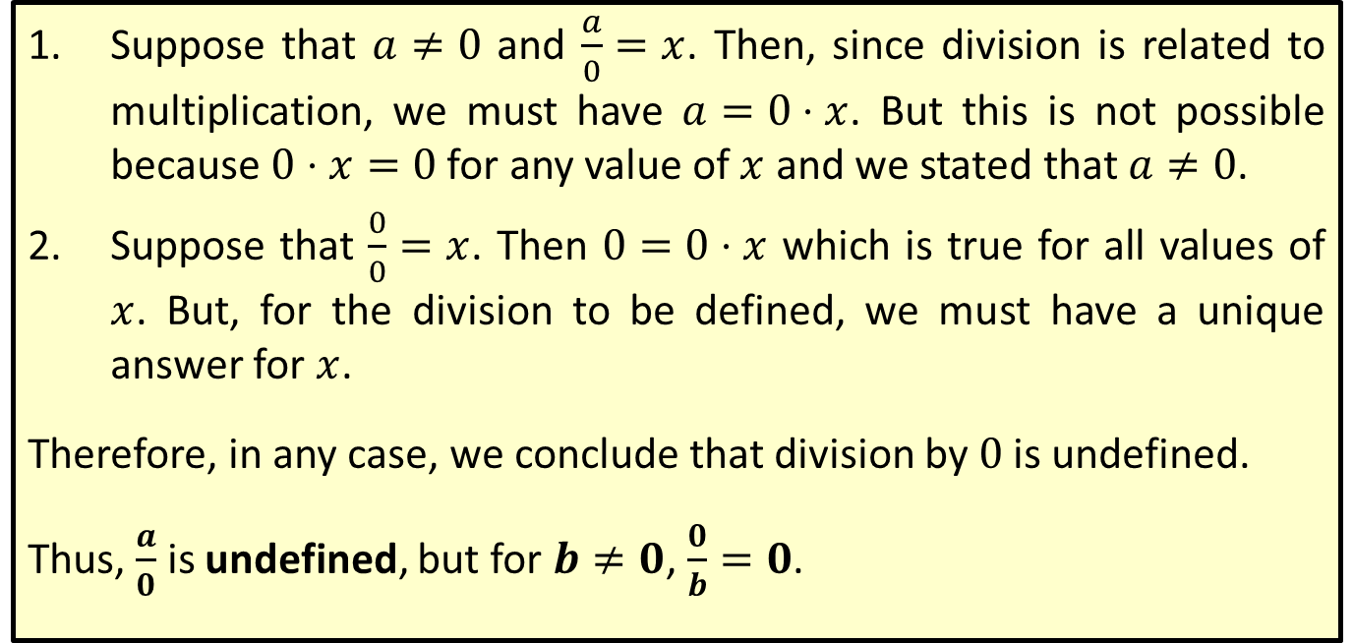
Division by 0 is Undefined
​Suppose that $a≠0$ and $\frac{a}{0}=x$. Then, since division is related to multiplication, we must have $a=0⋅x$. But this is not possible because $0⋅x=0$ for any value of $x$ and we stated that $a≠0$.
​Suppose that $\frac{0}{0}=x$. Then $0=0⋅x$ which is true for all values of $x$. But, for the division to be defined, we must have a unique answer for $x$.
Therefore, in any case, we conclude that division by 0 is undefined.
Thus, $\frac{a}{0}$ is undefined, but for $b≠0$, $\frac{0}{b}=0$.

Slide 23

Example 10: Division with 0
Divide.
​$\frac{0}{−7}=0$
​$\frac{9}{0}$ is undefined.

